Slide 1

Safeguarding children and adults
Group B safeguarding
Notes:
Welcome and introduction
Trainer introduces themselves.
Group B
Group B includes all practitioners who have regular contact with adults, children and members of the public in their roles. This includes practitioners who are or aren't registered or regulated, and volunteers.
You have a bit more knowledge in terms of what to look out for and you're building relationships. You get a bit more insight into people's lives, but if you're worried or concerned, you report it. You could have a discussion with your line manager or designated safeguarding person or report directly to social services.
People in Group B know what to look for and have clear knowledge of the reporting process and their own responsibilities.
Examples of people in Group B:
care home workers
nursery workers, nannies and childminder assistants
domiciliary care workers
staff or volunteers in roles with direct contact with children and adults known to be, or likely to be, ‘at risk’.
The trainer should:
remind participants that they should have completed the Group A safeguarding training before doing the Group B course
be familiar with their own organisation’s safeguarding policies before running the training.

Slide 2
Housekeeping
  Health and safety
  Attendance
  Fire procedure
  Toilets
  Trigger warning about the course’s content
Remember to use supervisions to debrief if you’re suffering trauma because of an incident of abuse, harm or neglect. Ask for help.
Notes:
The trainer goes through housekeeping for the day (the non-negotiable rules).
Emphasise ‘confidentiality’ – don’t mention any identifiable things, for example: names. Don’t share any personal information during the training.
The trainer should reiterate if they hear anything that causes them concern, they’ll potentially need to report this information on.
The trigger warning is critical.
Trainers need to:
monitor the reactions of the group
make sure people aren’t becoming overly distressed due to the content
be aware that participants may need time away from the session, or additional support, advice and guidance, and signposting
remind the people taking part that they’ll be available during breaks and after the training to meet with anyone who may need additional support or advice
remind staff that it’s important for all staff to feel supported when managing and dealing with safeguarding issues.
Staff should be confident that they know who to report to, that they feel they will be believed and will be supported.
Staff should be able to use supervision to debrief and seek support, either from managers or a Designated Safeguarding Person.
As a trainer, it’s also important that you use things like supervision for your own support needs and well-being, and get support if you need it.

Slide 3
Learning agreement
How will we work as a group to meet our learning outcomes?
Confidentiality
Participation: be brave and respectful
Personal safety: trigger warning
Timing and breaks
Mobile phones on silent
Take notes
Notes:
Trainer works with the group to set out what’s expected of them, and negotiable housekeeping of the day.

Slide 4
Learning outcomes
Describe how to work in ways that safeguard people from abuse, harm and neglect.
Explain factors, situations and actions that could lead or contribute to abuse, harm and neglect.
Understand legislation, national policies, codes of conduct and professional practice in safeguarding.
Know how to recognise and report different types of abuse, harm and neglect.
Notes:
Trainer goes through the learning outcomes for Group B.

Slide 5
Your thoughts, ideas and reflections
Add your thoughts, ideas, reflections or questions to discuss.
Notes:
This is a place to add sticky notes from the group with questions, thoughts and reflections.

Slide 6
Introductions
Notes:
Introductions and ice breaker. These could include:
what matters to you?
what makes you feel safe?
where’s your “happy place”?

Slide 7
Multi-agency training
Agencies need to work together to safeguard children, adults and families.
In a 2023 report, Care Inspectorate Wales (CIW) found that training with other agencies (called ‘multi-agency training) is key to having collective responsibility for safeguarding.
This session will help agencies to:
understand what the process is for multi-agency training
understand what their responsibilities are
take collective responsibility for safeguarding.
Notes:
Some training is an opportunity for multi-agency practitioners to come together to learn and discuss specific safeguarding issues in a collaborative environment that allows for shared learning, holistic understanding and a collective responsibility to be developed.

Slide 8
National safeguarding training, learning and development standards and framework
Introduced in 2022, the standards and framework identifies staff groups A to F.
This session is for Group B practitioners.
Group B memorable principles:
I am a key part of the safeguarding process
I know when, how and who to report to
I will make sure the individual’s voice is heard.
Notes:
Reminder of where Group B fits on the National safeguarding training, learning and development framework.

Slide 9
Making this training work for you
We know that training isn’t always enough on its own. We need to make sure you can understand and use what you learn today.
Which activities would help the training to stick in your mind for you to use later?
We’ll come back to your suggestions later.
Notes:
Highlight the importance of consolidating learning after today and ask learners to be thinking about practical activities they could carry out following today’s session, to gain further experience and/ or embed their learning. We provide some suggestions as we go through the slides in the orange boxes. Encourage participants to make a note of any suggestions that particularly resonate for them in their role.

Slide 10
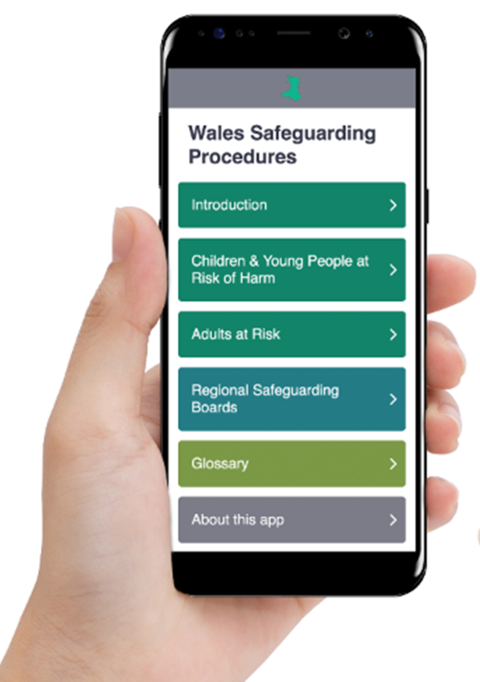
Download the app
Wales Safeguarding Procedures
Notes:
The trainer should suggest that everyone downloads the app. The group can use it as a reference throughout the course and beyond to check procedures and definitions.
The Wales Safeguarding Procedures were launched in 2019. They replaced the Interim Policy and Procedures for the Protection of Vulnerable Adults. You can access them:
• online www.safeguarding.wales or www.diogelu.cymru.
• as a free and bilingual app available for Android and iOS. (Search for ‘Wales Safeguarding Procedures’).

Slide 11
Why am I here?
Everyone has to have an awareness of safeguarding and to know how to respond if they have concerns.
Everyone has the right to be protected from abuse, harm and neglect.
Safeguarding is everybody’s business and everyone has a responsibility for safeguarding.
It’s part of your role as a practitioner.
Notes:
The trainer should explain that all practitioners must, as part of their role, share any concerns they have about citizens’ safety and well-being, including safeguarding.
The trainer should explain that the course will go into detail about what safeguarding means.
Each practitioner and organisation must:
contribute to safeguarding and promoting the individual’s well-being
share information using data protection guidelines
work with practitioners in their team and other agencies to better understand the individual, their circumstances and their needs
develop co-productive working relationships with the individual who’s at risk, their family and carers to find out what matters to them and to make sure they feel respected and informed.

Slide 12
Exercise
Who’s responsible for protecting children and adults?
Social services staff
Staff in the Police Force
HM Prison and Probation staff
Staff within schools and education departments
Health service staff
People in voluntary or third sector organisations
Human resources
The public
YOU
This is not a matter of personal choice
Notes:
Depending on time, this exercise can be done as a ‘shout out exercise’, or smaller groups or tables can use a flip chart and markers to make their own lists and feed back to the rest of the group.
This is not an exhaustive list.
Safeguarding: what’s my role?
Safeguarding is everyone’s business.
All staff have an ethical and professional duty to report if they:
witness any abuse
get information about abuse, suspected abuse or concerns about the care or treatment of an adult at risk
have concerns or suspicions about possible abuse or inappropriate care.
The trainer should highlight that, under sections 126 and 130 of the Social Services and Well-being Act, key statutory agencies have a duty to pass on concerns about adults or children who may be at risk of abuse. This includes local authorities, the NHS, police, probation and youth offending services. There are also specific responsibilities in relation to child protection under the Children Act 1989, 2004.
The trainer should advise that staff don’t need to know the detail of the legislation within this training, but it’s important that they speak to their manager or Designated Safeguarding Person if they have any concerns.

Slide 13
What are the personal and professional barriers that may stop people recognising and reporting abuse, harm or neglect?
What are the reasons someone who’s experiencing abuse, harm or neglect might not recognise or share it?
Discussion point
Notes:
This exercise can be done either:
as a whole-group exercise: trainers can ask the group to name some key barriers, and they feed back to whole group
in two groups: the trainer can ask half the room to consider the first question, and half the room to consider the second. Participants must be prepared to feedback to the wider group.
Handout: barriers to sharing allegations and suspicions.

Slide 14
What the law, policy and guidance says
Social services and Well-being Act (Wales) 2014 (sometimes called SSWBA)
Working together to safeguard people, 2022
Welsh Safeguarding Procedures, 2019
Human Rights Act 1998
United Nations Convention on the Rights of the Child
United Nations Convention of the Rights of Older Persons
Children Act 1989 and 2004
Violence Against Women Domestic Abuse and Sexual Violence Act 2015
Mental Capacity Act 2005
GDPR
Notes:
The trainer should make the group aware of their key statutory responsibilities. This is what we MUST do under the law.
We don’t expect the group to remember all of key principles of the legislation on this slide. But the trainer will need to be familiar with all the legislation and how it relates to safeguarding so they can relate the law to the training and scenarios featured later in the course. This additional background knowledge will also support the trainer to accurately answer questions from the group.
The trainer should explain that there are many different laws that underpin safeguarding. The people attending the course don’t need to worry about, or must remember, all these laws. The trainer needs to explain to the members of the group that they just need to know that these laws exist and highlight the key duties local authorities have.
Optional activity: matching pairs — match each piece of legislation with its description
Violence against women is the official phrase used by Welsh Government to describe abuse that happens only to women because they are women, for example: female genital mutilation (FGM). The title reflects global and national statistics that women are disproportionately affected by all forms of abuse (United Nations). FGM was made illegal in the UK more than 30 years ago.
You can find out more about local authorities’ statutory responsibilities under part 7 of the Social Services and Well-being Act 2014 on our website.
You can also find information on statutory guidance under the Act on our website.

Slide 15
Recognising abuse
Be aware!
Even if you have a lot of safeguarding experience, it isn’t always easy to recognise a situation where abuse, harm or neglect may happen or has already happened.
Report!
We aren’t experts in recognising abuse, harm or neglect but should share any concerns we have
It isn’t our place to decide whether or not abuse has taken place. But we should report any concerns we have or if someone’s made an allegation.
Notes:
The trainer should go through the key messages on this slide.

Slide 16
The law: our Duty to Report
Sections 128 and 130 of the Social Services and Well-being (Wales) Act 2014 requires health and social care professionals and teachers to inform the local authority if they have reasonable cause to suspect a person is at risk of experiencing abuse, neglect or other types of harm.
Anyone who isn’t a “relevant partner” must still report any safeguarding concerns they have in the same way as those with a statutory duty to report.
This includes your private life – you must report concerning behaviour of a friend, family member or neighbour who is also a practitioner/person in a position of trust to the police and/or to social services.
Notes:
The trainer should be aware that the SSWBA refers to “relevant partners” as:
the police
local authorities
probation services
local health boards
NHS trusts
any other persons who have to follow the regulations.
But the Welsh Safeguarding Procedures say that everyone working in health and social care, including volunteers, has a duty to pass on concerns. Anonymity can’t be guaranteed.
You can find more information about this slide on Welsh Government’s website or the Welsh Safeguarding Procedures app.

Slide 17
The law: our duty to co-operate
If a local authority requests the co-operation of a relevant partner in the exercise of any of its functions, the person must comply with the request unless the person considers that doing so would be incompatible with the person’s own duties, or otherwise have an adverse effect on the exercise of the persons functions.
Wales Safeguarding Procedures 2019
This means if social services asks a relevant partner to co-operate so it can carry out its safeguarding responsibilities, the person must agree – unless they think that it would be incompatible with their own duties, or get in the way of their work.

Slide 18
Exercise
What is the duty of candour?
The duty of candour applies when something goes wrong with an individual's care or support that has, or has the potential to have, an adverse effect on the individual's well-being. For example, not reporting safeguarding concerns that were witnessed or disclosed.
It means that health and care professionals must:
  tell the person (or, where appropriate, their advocate, carer or family) when something has gone wrong
  apologise to the person (or, where appropriate, their advocate, carer or family)
  offer an appropriate remedy or support to put matters right (if possible).
Police have a duty of candour as part of the response to the Hillsborough families report (2023).
In 2024, the House of Lords passed an amendment to UK Government’s Victims and Prisoners Bill. This means public servants, including prison officers, will have a duty of candour and have to give full and frank evidence at inquests and other hearings.
SCW-DutyofCandour-ENG-V01.pdf (socialcare.wales)
the-duty-of-candour-statutory-guidance-2023_0.pdf (gov.wales)
Notes:
The trainer can do this exercise either:
as ‘shout out exercise’
on tables with flip chart and markers and read out the notes made by each group at the end.
The trainer should ask the group what they think the duty of candour is before showing the information on the slide.
The duty of professional candour applies to all social care professionals registered with Social Care Wales. More information is available on our website.

Slide 19
The six principles which support legislation, guidance and the Wales Safeguarding Procedures
Principle 1: Put the wishes, needs and well-being of the child or desired outcomes of the adult at risk first
Principle 2: Be alert to the needs of children or adults at risk (including any potential or suspected abuse, or risk of abuse or harm) and understand what to do
Principle 3: Share appropriate information and have direct access to advice to discuss any concerns about a child or adult
Principle 4: Able to use their professional judgment to work with the child’s or adult’s needs and personal outcomes
Principle 5: Work in a multi-agency and co-operative way, record decisions appropriately and review progress regularly
Principle 6: Be supported by leaders or managers to achieve the desired outcomes for the individual
Notes:
Optional slide
The trainer should be able to explain that these principles are specific to the Welsh Safeguarding Procedures, but complement the five key principles of the Social Services and Well-being Act 2014.
Optional principles activity
In pairs, identify which principles are proactive and which are reactive. Are some both? Use the cards to show understanding of which principles are proactive (green) or reactive (red).

Slide 20
Activity
Choice
Respect
Honesty
Support
Participation
Person-centred
Rights
Privacy
Partnership
Well-being
Consent
Protection
Diversity
Prevention
Empowerment
Equality
Notes:
Activity: values cards. The aim of the exercise is to identify that there is no right or wrong answer. All values are important and will be influenced by the individual’s own experience and beliefs, where they work and the situation. This exercise encourages good debate, and multi-agency working.
The trainer should make sure that any challenges in groups are respectful and managed appropriately.
There are three ways to do this exercise:
give a pack of cards to each group, and ask the group to rank the importance of these principles in safeguarding from most to least important. The group must be prepared to explain their decision
give each table two cards and ask them what the word means to them in terms of safeguarding in their roles
revisit principles of safeguarding by reading out each principle in turn and ask learners to hold up their value card if they think it applies.

Slide 21
Collective responsibility for safeguarding
Multi-agency working is one of the key principles of the Wales Safeguarding Procedures.
Safeguarding is a joint responsibility, where the whole is greater than the sum of its parts.
This includes appropriate information sharing.

Slide 22
Early help and prevention
The Wales Safeguarding Procedures emphasises the need for early help and prevention, from abuse, harm and neglect. Early help can:
protect adults and children from becoming ‘at risk’ by addressing concerns early
prevent problems from getting worse
reduce the need for safeguarding enquiries and interventions
mean long-term benefits for health and well-being.
Notes:
Highlight why we need effective early help and prevention:
better to avoid escalation
makes the system more sustainable
better outcomes.

Slide 23
Exercise
What does person-centred practice look like?
Building trust with the person to encourage them to be open and honest.
Understanding what a typical day looks like for them.
Finding out what the person would like to see change in their daily lives.
Finding out what matters to the individual.
Understanding how they manage risks.
Recognising when you need to put the person’s safeguarding interests over their wishes and feelings.
Notes:
The trainer can either do this exercise as ‘shout out exercise’ or on tables with flip chart and markers and read out the lists made by each group at the end.
Interesting to compare “child-centred” to “adult-centred”.

Slide 24
Approach
Old approach
Attitude: ‘we know best’
Process-led
System-focused
Doing things for, or to, the child, adult or family
No clear voice of the child or adult
Child- or person-centred approach
Attitude: ‘they know best’
Led by the child, adult or family
Sees the child or adult as an individual
Outcome-focused
Obvious voice and control of the child or adult

Slide 25
Values and codes of practice
‘If we get our own values right, we get safeguarding right’
Codes of Practice and guidance | Social Care Wales

Slide 26
Code of Professional Practice
TRAINER TO ADD
Please add in the relevant code of professional practice for your sector or the sector you’re training
The next slide offers the code for social care

Slide 27
Social Care Wales Code of Professional Practice for Social Care: key values
3.3 working with individuals and carers to keep themselves safe
3.5 supporting individuals and carers to express concerns or make complaints, taking complaints seriously and responding to them or passing them to the appropriate person
3.7 using relevant processes and procedures to challenge and report dangerous, abusive, discriminatory or exploitative behaviour and practice
3.8 raising concerns with your employer or an appropriate authority where the practice of colleagues or other professionals may be unsafe or adversely affecting standards of social care and support
3.9 bringing to the attention of your employer or the appropriate authority, resource or operational difficulties that might get in the way of the delivery of safe social care and support.
Notes:
The trainer should emphasise that every practitioner is expected to conduct themselves appropriately both inside and out of the organisation. They, as individuals, must abide by organisational policies.
The trainer can give examples, for example, it’s unacceptable to:
be aggressive or discourteous towards members of the public or a fellow colleague
being arrested for being drunk and disorderly
put inappropriate comments on social media that are in breach of the organisation’s social media policy.
The trainer should advise that practitioners are obligated to make sure they’re aware of, and comply with, policies that about sharing information and using social media.
The Code of Professional Practice for Social Care reinforces your responsibilities to prevent and report abuse, particularly sections 3 and 6.
There’s a code of practice for non-statutory agencies on the Welsh Government website. This advice is for individuals, groups and organisations offering activities or services to children and adults in Wales.

Slide 28
Two key values in safeguarding practice
1. Safeguarding is everybody’s responsibility
2. A child-centred or person-centred practice
A practitioner has two tasks:
1. to prevent situations where a child/adult may experience abuse, neglect and harm
… and if this isn’t effective…
2. to identify emerging concerns about abuse, neglect and harm to the individual.
Notes:
The trainer should discuss the key values in with the group.

Slide 29
Exercise
What does safeguarding mean to you?
Protecting adults and children from abuse, neglect and maltreatment
Preventing harm to adults’ or children’s health
Making sure children and adults get safe and effective care
Supporting all adults and children to have the best outcomes
Educating people around them to recognise the signs and dangers of abuse and neglect
Promoting their well-being
Notes:
The trainer should make sure that participants are aware safeguarding has both protective and preventative aspects. Reiterate that during this training children and adults will be referred to as ‘people.’
Group exercise: the trainer should ask the group ‘What does safeguarding mean to you?’ first and get participants to shout out ideas before revealing the answers on this slide.
The trainer should go through the points on this slide and explain what they mean. For example: the trainer can refer to child development and the basic needs of both adults and children such as food, clothing, shelter, affection, health and education, feeling safe and being free from harm.
If needs aren’t met it can have a major impact on a child or adult’s health and well-being. For example: impact on a child’s self-esteem and possibly leading to problems in adolescence and adulthood.
Safeguarding covers child protection as well as early intervention and prevention services.
Conversations with families may indicate at the report or report stage that early intervention services are needed.
Safeguarding adults involves:
preventing and protecting adults at risk from abuse or neglect
educating people around them to recognise the signs and dangers of abuse and neglect
promoting their well-being.
One important difference between safeguarding adults and safeguarding children is an adult’s right to self-determination. Adults may choose not to act at all to protect themselves.

Slide 30
Exercise
What does it mean to you if a child or adult is ‘at risk’?
A child at risk is a child who is experiencing or is at risk of abuse, neglect, or other kinds of harm. This includes children who have lost or are at risk of losing parental care. Specific risks include serious physical, emotional, or psychological abuse, sexual abuse, and domestic or family violence. ​
When local authority social services receive a report about a child at risk of harm, abuse or neglect, they have a duty to respond.
If the evidence indicates the child is suffering or likely to suffer significant harm, then Section 47 enquiries of the Children Act 1989 should be initiated. The aim is to establish the nature of the harm and whether it's significant. ​
Notes:
This question can be discussed in groups, and the trainer invites groups to feedback after five minutes. Trainer to ensure that following information is pulled out:
The trainer should highlight that child protection applies to all children under 18.
Adult protection applies to anyone who’s 18 or over.
Significant harm doesn’t have the same legal meaning in adult protection as it does in child protection.
It may also be useful for the trainer to be familiar with the definition of an adult at risk:
Section 126 of the Social Services and Well-being Act (2014) defines an adult at risk as someone over 18 who:
(a) is experiencing or is at risk of abuse or neglect, and
(b) has needs for care and support (whether or not the authority is meeting any of those needs) and
(c) as a result of those needs, is unable to protect himself or herself against the abuse or neglect or the risk of it.

Slide 31
Exercise
What does it mean to you if a child or adult is ‘at risk’?
There is no statutory definition of significant harm. Therefore, practitioners must: ​
‘Where the question of whether harm is significant turns on the child’s health or development, the child’s health or development is to be compared with that which could reasonably be expected of a similar child’ (Section 31(9), Children Act 1989.) ​
An “adult at risk” is an adult who: ​​
Is experiencing or is at risk of abuse or neglect, ​
has needs for care and support (whether or not the authority is meeting any of those needs), and ​
as a result of those needs, is unable to protect himself or herself against the abuse or neglect or the risk of it. ​
Notes:
This question can be discussed in groups, and the trainer invites groups to feedback after five minutes. Trainer to ensure that following information is pulled out:
The trainer should highlight that child protection applies to all children under 18.
Adult protection applies to anyone who’s 18 or over.
Significant harm doesn’t have the same legal meaning in adult protection as it does in child protection.
It may also be useful for the trainer to be familiar with the definition of an adult at risk:
Section 126 of the Social Services and Well-being Act (2014) defines an adult at risk as someone over 18 who:
(a) is experiencing or is at risk of abuse or neglect, and
(b) has needs for care and support (whether or not the authority is meeting any of those needs) and
(c) as a result of those needs, is unable to protect himself or herself against the abuse or neglect or the risk of it.

Slide 32
Exercise
Significant harm (children)
The Children Act 1989 refers to Child Protection as a child who is experiencing or likely to experience significant harm.
What does ‘significant harm’ mean to you?
Notes:
This is an exercise that can be done in two ways:
as a ‘shout out exercise’ or on tables with a flip chart and markers, and read out the lists made by each group at the end
by asking participants to work in groups or individually, and to read out their definition to the wider group.
The trainer must highlight that the local authority alone is responsible for determining whether the threshold of significant harm has been met.

Slide 33
Definition of significant harm
There isn’t a statutory
definition of ‘significant harm’.
‘Where the question of whether harm is significant turns on the child’s health or development, the child’s health or development is to be compared with that which could reasonably be expected of a similar child (Section 31(9), Children Act 1989.)
Notes:
The trainer should explain that knowledge of ‘normal’ child development helps to understand patterns of ‘abnormal’ child development.
All children with eligible needs will have a care and support plan regardless of their status.
The Children Act (1989 and 2004) defines harm as:
ill treatment, including sexual abuse, physical abuse and forms of ill treatment, which aren’t physical, for example, emotional abuse
impairment of health (physical or mental)
impairment of development (physical, intellectual, emotional, social or behavioural). The Human Rights Act (2000) adds “Serious breach of personal integrity”
impairment suffered from seeing or hearing ill treatment of another.
“Impairment” can include damage, hurt, weakening, injury or loss.

Slide 34
Implications for practice
Workers need to be able to:
  recognise patterns of overall child development
  detect when a child's development may be going 'off track’
Knowledge of ‘normal’ child development helps us to understand different child development patterns.

Slide 35
Comfort break

Slide 36
Exercise
What does the word ‘abuse’ mean to you?
Being abused means a child or an adult is hurt by someone else. It doesn’t have to be deliberate or intentional.
Abuse isn’t acceptable and is NEVER ok.
Abuse may be a single act or can continue over a long time and may take different forms.
There are five categories of abuse defined in the Social Services and Well-being Act (Wales) 2014.
Can you name the five categories of abuse?
Notes:
There are three ways to do this exercise:
as a ‘shout out exercise’
on tables with flip chart and markers and read out the lists made by each group at the end
definitions cut out on paper and stuck to the wall, learners to move around the room to indicate their answer.
The trainer should explain that abuse and neglect shouldn’t happen to anyone. But, sadly, it does happen. Sometimes, people may be so used to being treated badly, or don’t understand that what’s being done to them is wrong, they don’t realise that it’s actually abuse. Everyone has the right to live safely.
The trainer should explain that abuse can be a one-off event that can have a massive impact on a person, or can be a series of episodes. Even episodes that appear to be minor and happen over a period of time, can have a huge impact. This can have a very negative impact on someone’s self-esteem, self-worth and health.
The trainer should advise that abuse doesn’t always have to be intentional – it can happen because someone’s stressed, experiencing poverty, experiencing issues with mental health or substance misuse, or don’t have the training or understanding to support another person.
Abuse can happen to anyone – including us as individuals – regardless of ethnicity, religion, background or gender identity.

Slide 37
Five categories of abuse
Physical abuse
Sexual abuse
Emotional or psychological abuse
Financial abuse
Neglect

Slide 38
Exercise
List as many different examples of abuse and potential indicators of abuse you can think of under each heading.
Notes:
The trainer should advise that the group isn’t looking for the actual types of abuse that have been perpetrated against the person, but how the person reacts, physical signs, emotional signs or social indicators.
There are two ways to do this exercise:
get five pieces of flip chart paper – each with a heading of one of the categories of abuse placed on different tables, one for each group. Each individual or group asked to move around to each category of abuse in turn, and for a maximum of two mins, write down as many indicators as they can think of relating to that category of abuse for both children and adults.
As above but sheets of paper can move as opposed to participants, who remain seated.
The trainer should try to get the whole group to share their knowledge. Each group should nominate a spokesperson to feedback what they discussed and go through what they recorded on the flip chart. Trainer to draw out examples and indicators that are relevant for children and adults. Trainer should make sure that they are confident with the types, signs and indicators of abuse themselves before completing this exercise. Please refer to the Wales Safeguarding Procedures for further information.
The Social Services and Well-being Act 2014 identifies five main categories of abuse – physical, sexual, financial, emotional and psychological.
A child or adult at risk may be abused in more than one way – indicators need to be considered together and in combination. Abuse can be a one-off event, or a series of lower-level concerns. Abuse doesn’t have to be intentional.
It’s also important to remember that observing any one of these factors does not mean that abuse has occurred. They are warning indicators only. The trainer should tell participants that if they’re concerned, they should seek advice from their line manager or Designated Safeguarding Person (DSP) in the first instance.

Slide 39
Definitions of abuse
Physical abuse
Any physical pain, suffering or injury that is wilfully inflicted.
End of defence of physical punishment in Wales. The law says:
all physical punishment is illegal in Wales
children have the same protection from assault as adults.
This means the law is clear – easy for children, parents, professionals and the public to understand.
The Welsh legislation removes a 160-year-old legal defence for parents of reasonable punishment and gives children the same protection from assault as adults.
Notes:
The trainer should go through each point on the slide to make sure that participants understand the key points of each definition of abuse. The trainer doesn’t need to use all of the examples.
There’s a handout to go with this slide in the pack’s appendix, which gives detailed definitions of the types of abuse.
The trainer should highlight that just because someone sees one or two possible signs, this doesn’t mean that someone has been abused.
They should seek advice from the manager, or the named safeguarding person in their department, rather than ignore these concerns. If employees can’t get hold of their manager or the DSP in their department, they must contact social services intake teams for advice.
Physical abuse can include all types of physical harm including:
shaking
poisoning
punching
hitting
slapping
kicking
biting
dragging someone
restraining someone using excessive force
using medication to control someone or keep them quiet
deliberately making a child ill (known as ‘fabricated illness’).
There are lots of types of physical punishment and it isn’t possible to include a definitive list. It involves anything where a child is punished using physical force, including smacking, hitting, slapping and shaking.
Sexual abuse can involve forcing or coercing a person to take part in sexual activities, for example:
rape
indecent assault
forcing someone to watch sexual images or pornography.
This abuse can happen face-to-face (direct acts of sexual abuse) or over the internet (indirect acts of sexual abuse).
The trainer should make sure that they mention child sexual exploitation as a form of sexual abuse.
Child sexual exploitation and grooming is a form of sexual abuse involving an exchange or some form of payment which can include money, mobile phones and other items, drugs, alcohol, a place to stay, ‘protection’ or affection.
People can be groomed over the internet. The vulnerability of the person and the grooming process perpetrators use means the person being groomed isn’t able to recognise the exploitative nature of relationships. This means they can’t give informed consent. Consent is irrelevant if a person has been groomed, coerced or manipulated. If a person doesn’t understand what sex means, or says no, then this is sexual assault or rape.
It’s important to recognise that exploitation of adults can happen for exactly the same reasons. People may be exploited in a number of ways (for example: for labour or criminal purposes).
Emotional or psychological abuse may involve indicating to a person that they are worthless, unloved or inadequate so that the person is wary, afraid, isolated – it can be very hard to spot. Examples include:
shouting or screaming at a person on a regular basis
calling a person names
blame
humiliating a person in front of others
being critical
being very unaffectionate
telling a person they don’t like them or love them.
Witnessing domestic abuse in the home, even if it isn’t directly aimed at the person, can have a significant negative impact on a person’s health and well-being.
The trainer should explain:
that abuse/neglect can have both long- and short-term impacts on the child or adult
emotional abuse always accompanies other forms of abuse, because of the emotional impact on the person, although it can be one of the hardest to spot.

Slide 40
Definitions of abuse
Sexual abuse
Abuse refers to a person being involved in sexual activity to which they are unwilling, or unable, to give informed consent, or which they don’t fully understand.
Can involve contact or non-contact acts.
Emotional or psychological abuse
Persistent emotional ill treatment.
Wilful infliction of mental suffering.
Can be experienced on its own, or often overlaps with other types of abuse.
Notes:
The trainer should go through each point on the slide to make sure that participants understand the key points of each definition of abuse. The trainer doesn’t need to use all of the examples.
There’s a handout to go with this slide in the pack’s appendix, which gives detailed definitions of the types of abuse.
The trainer should highlight that just because someone sees one or two possible signs, this doesn’t mean that someone has been abused.
They should seek advice from the manager, or the named safeguarding person in their department, rather than ignore these concerns. If employees can’t get hold of their manager or the DSP in their department, they must contact social services intake teams for advice.
Physical abuse can include all types of physical harm including:
shaking
poisoning
punching
hitting
slapping
kicking
biting
dragging someone
restraining someone using excessive force
using medication to control someone or keep them quiet
deliberately making a child ill (known as ‘fabricated illness’).
There are lots of types of physical punishment and it isn’t possible to include a definitive list. It involves anything where a child is punished using physical force, including smacking, hitting, slapping and shaking.
Sexual abuse can involve forcing or coercing a person to take part in sexual activities, for example:
rape
indecent assault
forcing someone to watch sexual images or pornography.
This abuse can happen face-to-face (direct acts of sexual abuse) or over the internet (indirect acts of sexual abuse).
The trainer should make sure that they mention child sexual exploitation as a form of sexual abuse.
Child sexual exploitation and grooming is a form of sexual abuse involving an exchange or some form of payment which can include money, mobile phones and other items, drugs, alcohol, a place to stay, ‘protection’ or affection.
People can be groomed over the internet. The vulnerability of the person and the grooming process perpetrators use means the person being groomed isn’t able to recognise the exploitative nature of relationships. This means they can’t give informed consent. Consent is irrelevant if a person has been groomed, coerced or manipulated. If a person doesn’t understand what sex means, or says no, then this is sexual assault or rape.
It’s important to recognise that exploitation of adults can happen for exactly the same reasons. People may be exploited in a number of ways (for example: for labour or criminal purposes).
Emotional or psychological abuse may involve indicating to a person that they are worthless, unloved or inadequate so that the person is wary, afraid, isolated – it can be very hard to spot. Examples include:
shouting or screaming at a person on a regular basis
calling a person names
blame
humiliating a person in front of others
being critical
being very unaffectionate
telling a person they don’t like them or love them.
Witnessing domestic abuse in the home, even if it isn’t directly aimed at the person, can have a significant negative impact on a person’s health and well-being.
The trainer should explain:
that abuse/neglect can have both long- and short-term impacts on the child or adult
emotional abuse always accompanies other forms of abuse, because of the emotional impact on the person, although it can be one of the hardest to spot.

Slide 41
Definitions of abuse (continued)
Financial abuse
Affects both children and adults
Theft or misuse of a person’s money, property or resources.
Getting money or possessions by threat, persuasion or exploitation.
Neglect
Not meeting a person’s basic needs: physical, emotional, social needs
Not giving an adequate level of care
All types of abuse and neglect have a negative impact on a person and can have short-term or long-term effects.
Notes:
Financial abuse was included as a category of children’s abuse under the Social Services and Well-being Act (Wales) 2014.
An example of financial abuse could be where a parent or carer is receiving benefits and direct payments from social services to spend on their disabled child, but instead spends the money on themselves. This means that the child doesn’t get the extra care or support that they need. This is likely to have a harmful effect on their life, well-being or safety. Other examples may include children forced into labour, selling a child’s belongings, or fabricating a child’s illness to claim benefits.
For adults, there may be similar indicators, but examples can also include:
theft of money or personal belongings
signing over a property or coercing someone to change a will
taking out credit cards or loans in someone’s name without their consent
misusing a Lasting Power of Attorney.
Neglect means a failure to meet a person's basic physical, emotional, social or psychological needs, which is likely to result in an impairment of the person's well-being.
Signs and symptoms may include:
a person saying they haven’t had anything to eat, or not having money to buy lunch
teasing for body odour or dishevelled appearance
a person dressed in inappropriate clothing, for example: no coat when it’s raining
an older child having to get their sibling ready for school
a person may be left in a state of poor hygiene (for example: dirty clothes, soiled, not helped to wash)
someone being left on their own for long periods of time or a doctor may not be contacted when a person is unwell
poor dental care
weight loss.
All types of abuse, harm or neglect have a negative impact on a person and can have short or long-term effects.

Slide 42
Exercise
What does the word ‘neglect’ mean to you?
“Neglect” means a failure to meet a person's basic physical, emotional, social or psychological needs, which is likely to result in an impairment of the person's well-being. For example, an impairment of the person's health or, in the case of a child, an impairment of the child's development.
(SSWBA, s126 and Wales Safeguarding Procedures 2019)
Safeguarding | Law Wales (gov.wales)
Notes:
There are three ways to do this exercise:
as ‘shout out exercise’
on tables with flip chart and markers and read out the lists made by each group at the end
definitions cut out on paper and stuck to the wall, learners to move around the room to indicate their answer.
The trainer should be aware that neglect can also cover acts of omission (for example: a staff member hasn’t been trained to provide the care required, or there someone hasn't made sure that appropriate equipment is available).

Slide 43
Six types of neglect in children and young people
Physical neglect
Supervisory neglect
Nutritional neglect
Identity neglect
Medical neglect
Educational neglect
Notes:
The trainer should ask learners to look at their apps and name all six types of neglect, and give examples.
If there isn’t enough time, or the content isn’t applicable to attendees, trainers still need to cover this slide and make sure the group leaves with this understanding.
The six sub-headings under neglect are only relevant for children.

Slide 44
Self-neglect (adults only)
There are three main forms of self -neglect:
lack of self-care
lack of care of a person's environment
refusal of services.
Self-neglect can happen because:
  of an individual's choice of lifestyle
  the person may be depressed, have poor health, have cognitive problems, or be physically unable to care for themselves.
What actions do you think you can take?
Talk to the person.
Make a report to social services if there are significant concerns.

Slide 45
Situational risk areas
Modern slavery and human trafficking
County lines
Female genital mutilation (FGM)
Forced marriage
Radicalisation
Domestic abuse
Hate crime
Institutional abuse
Notes:
Trainers can signpost participants to the Wales Safeguarding Procedures to find out more about these terms and report back the information they have found to the wider group.

Slide 46
What is domestic abuse?
Domestic abuse is:
“…the behaviour of a person towards another person is “domestic abuse” if each aged 16 or over and are personally connected to each other, and the behaviour is abusive....It does not matter whether the behaviour consists of a single incident or course of conduct..” This is irrespective of gender or sexuality. (Domestic Abuse Act, 2021)
Domestic abuse can involve some or all of the following types of abuse:
Emotional/psychological
Financial
Sexual
Physical
Neglect
Coercion and control is also often present.
Notes:
A personal relationship between the victim and perpetrator is key to the definition of domestic abuse. This is how domestic abuse is generally understood amongst the public and agencies.
We define people who are ‘personally connected’ as:
intimate partners
ex-partners
family members or individuals who share parental responsibility for a child.
The victim and perpetrator don’t have to be living in the same household.
Trainers should break down the definitions of abuse to facilitate understanding.
The trainer could ask the group what they understand the term domestic abuse to mean before facilitating a whole group discussion, then revealing the information on the slide.
Trainers could complete the free NHS e-learning module Group 1 training on violence against women, domestic abuse and sexual violence training to help them answer questions on this slide confidently, and signpost victims and staff to appropriate support links.
Line managers can find guidance on the e-learning on the Welsh government website
The trainer should explain that domestic abuse can happen when someone is hurt by someone they love, such as a boyfriend or a girlfriend, partner, husband or wife. Domestic abuse can occur in all types of relationships.
Women are statistically more likely to be victims or survivors of domestic abuse. This isn’t to say that men can’t be victims, and both can experience abuse at the hands of male and female perpetrators, or same-sex partners.
But statistics do show that over 90 per cent of domestic abuse perpetrators are male. Domestic abuse can also include adolescent to parent abuse, and older people can experience abuse from other family members.
It’s rarely a one-off incident and can happen to people of all ages. If a person has committed a violent act once, it’s likely they will do it again. The perpetrator will in these cases be known to the person. This harm or ‘hurt’ can, and will, involve different types of abuse at the same time. Examples include:
physical abuse: hitting, kicking, pushing, choking or throwing objects
sexual abuse: rape, sexual assault, revenge porn, sexual exploitation or forced sex work
financial abuse: controlling benefits or wages, acquiring debt or stealing
emotional or psychological abuse: name calling, gaslighting, threats, intimidation, criticism, undermining, emotional blackmail, ‘guilt tripping’, bullying, calling someone names, insulting or threats
coercion and control: isolating someone from support or making a person subordinate
perpetrators can often threaten physical or sexual violence with other types of abuse to control the victim
gaslighting is a type of manipulation, where someone uses denial, misdirection, contradiction and lying to make the victim question his or her own memory, stability and sanity (for example, by denying the incident ever happened).
This definition includes honour-based abuse and forced marriage. Victims aren’t always from one gender or ethnic group.
The frequency and severity of domestic violence can vary dramatically. It’s still abuse even if it happens only once, and it can be an ongoing pattern of behaviour. But the one constant element of domestic abuse is the abuser's consistent efforts to maintain power and control over the victim.
For more information or advice, contact the local domestic abuse services, local social services departments, or the Live Fear Free helpline on 0808 80 10 800.

Slide 47
Children are victims too!
The Domestic Abuse Act 2021 officially recognised, for the first time, that children who both witness domestic abuse between family members, or directly experience violence, should be classed as victims in their own right.
Research has shown that witnessing domestic abuse can have a hugely negative impact (known as adverse childhood experiences or ACEs) on a child’s long-term physical, emotional and social development that can last into adulthood.
Because of this, we should consider a “whole family” approach. This means recognising that all members of the family will be affected, and that they’ll all have a unique response to their situation, and need individualised support.
Notes:
The trainer should read information as presented on slide. It’s important to break down the definitions and explore understanding of sexual violence.
Before this Act, there had been no official recognition in law of children as victims of domestic abuse in their own right.
Children are individuals and may respond to witnessing abuse in different ways. Some examples include:
becoming anxious or depressed
having difficulty sleeping
having nightmares or flashbacks
not attending school as often as they should, or not performing as well as school.
If someone is worried that a child is living in a potential domestic abuse situation, they should speak to their safeguarding lead straight away as this is a child protection issue.

Slide 48
Lunch break

Slide 49
Exercise
What situations could increase the risk of abuse, harm and neglect?
Drug or alcohol misuse
Age (young or old)
Mental health
Physical learning disabilities
Being isolated
Domestic abuse
Abused or Neglected before
Lonely or bullied
Under stress because of low income or poor housing
Notes:
This activity can be done in three ways:
the trainer could ask the whole group the question first, “What makes a person at increased vulnerability to risk of abuse?’ and then ask the group to consider and shout out their views
the trainer could ask the group to split into pairs and give them several minutes to discuss the question, and then to feed back to the wider group.
as a shout-out exercise, where the trainer asks the group what situations could increase the risk of abuse, harm or neglect.
Just because a person has experienced one or more of these factors, doesn’t mean that they WILL experience abuse, as other factors need to be considered. For example: an individual’s personal resilience, strengths and other protective factors.
The trainer also needs to highlight that any one of us could experience abuse at some point in our lives, as there are times that we will all be vulnerable.

Slide 50

Discussion point: life journey
Think about part of a life journey
Are there times or events that might increase a person’s vulnerability?
Why?
Birth
Death
Notes:
This is a group exercise. Each group should be given a flip chart. The life course considers four key areas:
child (0 to 12 years)
teenager (13 to 19 years)
mid-life (20 to 60 years)
60 years and over.
The trainer can change the age ranges or add more ages if the training group is very big.
There are three ways to run the discussion:
all groups are asked to consider the whole life course, and to feed back on what key occasions during the life course a person’s vulnerability might increase, and the reasons behind this
each group can be given one specific age range, and asked to feed back on key sources of vulnerability, and the reasons behind this, in this specific age group
each piece of paper refers to a specific age range, and each given to one group.
Participants should complete in as much detail as they can in two minutes before papers are passed around again, so that each group has the opportunity to consider all the age groups.
The trainer should encourage groups to think about key moments that make someone vulnerable. Is this the same for everyone? What are the common factors?
More dependence and more isolation equals more risk of abuse.
Vulnerability is dynamic and not static.
Vulnerability linked to other factors in an individual’s life.

Slide 51
Perpetrators of abuse
People may be abused regardless of their age, racial origin, social class, gender, culture, religious beliefs, disability or sexual identity.
They’re usually abused by people they know and trust.
This could be from within or outside the family.

Slide 52
Exercise
Who may be a perpetrator of abuse?
Males
Females
Health professionals
Police officers
Social workers
Teachers
Religious figures
Family and friends
Anyone including a colleague or another staff member.
Notes:
The trainer should ask the whole group as a ‘shout out’ exercise who may be a perpetrator of abuse. The trainer should aim to highlight that anyone can be a perpetrator of abuse.
Trainers can add their own examples, especially ones that are more relevant to their own settings.

Slide 53
Trigger warning
Notes:
REFERRING TO NEXT FEW SLIDES.
Optional content: local victim case studies. Aim to highlight that abuse can happen anywhere. Trainer to decide if this is an appropriate activity to be used, dependent on the needs of group.
The trainer should make sure that, if they include this content, they give a trigger warning. The trainer should highlight that the case studies are emotive, and can be triggering because of knowledge of cases, or personal impact. The trainer should advise people that if they aren’t comfortable and wish to leave the room for this part of the training, they are able to do so.
If the trainer uses the content, they should monitor participants for non-verbal signs of distress, and discreetly offer support if needed. The trainer should remind participants that it’s important they feel safe and reassure them that the trainer’s there to offer support and to signpost to services if needed. The trainer should tell participants that they’ll be given contact numbers for helplines.

Slide 54
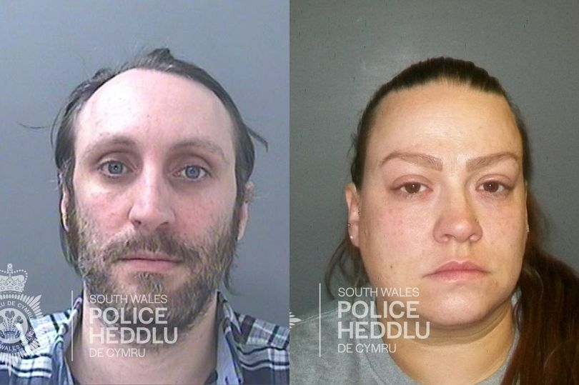
David and Kim Crapper, Barry South Wales
Notes:
These case studies are to give participants a flavour of some recent prosecutions and convictions linked to child and adult abuse. The trainer may wish to use some or all of these examples, or focus on children or adult case studies to suit the audience. Trainers can also update materials with more recent case studies, as long as information is available in the public domain.
Married couple, David and Kim Crapper, raped and sexually abused a young girl. They convinced her their treatment of her was "normal" and repeatedly took advantage of her.
The offences came to light when the victim told a friend about the husband and wife's behaviour and they were arrested by police.
Sentencing the pair, Judge David Wynn Morgan said: "It's hard to think of a more monstrous (offence)." Cardiff Crown Court heard the abuse began when she was very young and went on for years.
In her interview to police, the victim said when she told David Crapper, 38, "no" he became angry and accused her of "leading him on" and told her he could be put in prison. He told her to sit on his lap, that he "got hard" while cuddling her and she saw him touching himself. He later touched her and made her touch him, and showed her pornography.
The victim said: "I was confused by what he was saying and felt disgusted." The abuse escalated to David Crapper raping the victim and this happened repeatedly. David Crapper later told his wife about the abuse, who "wanted to join in too."
Kim Crapper, 39, started to sexually abuse the victim by touching her, was present when David Crapper raped the victim and had sex with her husband in front of the victim.
The Crappers were arrested by police after the victim reported the couple. David Crapper admitted raping and sexually abusing the victim. Kim Crapper also admitted abusing the victim. The defendants, of Queen Street in Barry, pleaded guilty to sexual assault of a child under 13, sexual assault, cause/incite a child to engage in sexual activity, and engaging in sexual activity in the presence of a child. David Crapper also pleaded guilty to rape and causing a child to watch a sexual act.
Susan Ferrier, for David Crapper, said there was "little" to say in mitigation for her client. She said he had admitted the offences and had prevented the victim from having to give evidence. She said Crapper had "fallen into distorted thinking patterns" and would have found it difficult to "call time" on the abuse had the victim not contacted the police
Ruth Smith, for Kim Crapper, said her client was in a "controlling, toxic and abusive relationship" and felt "powerless and helpless". She said Crapper was manipulated by her husband who "drew her" into committing the abuse. She conceded that the victim would "never get over" the actions of the defendants.
Judge Wynn Morgan said the physical harm caused to the victim was "incalculable" and both the defendants had "failed to exhibit true remorse". He sentenced David Crapper to 17 years in prison, with an extended four years on licence. Kim Crapper was sentenced to six years in prison, with an extended licence of three years. Both will serve two-thirds of their sentence before being considered for parole. The defendants were made subject to sex offender notification requirements and a sexual harm prevention order indefinitely.

Slide 55

Drama teacher
Kelly Burgess, Newport
Notes:
A drama teacher from south Wales was charged with a host of sexual offences against a teenage boy. Kelly Burgess, from Newport, faces four allegations of sexual activity with a boy aged between 13 and 17.
The alleged incidents cover a period between January and late August 2013. Burgess, from Newport, appeared before North Somerset Magistrates' Court near Weston-super-Mare where she pleaded guilty to four allegations of adult abuse of a position of trust - sexual activity with a boy aged between 13 and 17.
Prosecutor Michael Collins told the court: "The significant relationship in this case is one of a teacher and pupil.
"We have heard the age of the pupil as in the charges.
"The defendant at the material time was working as his teacher."
Summarising the offences and recommending the case be sent to crown court for sentencing, Mr Collins added: "The defendant and child had attended a sexual health clinic wherein the child made some revelations to the practice nurse that he was or had been in a sexual relationship with a 25-year-old teacher and named the defendant.”
Ms Burgess pleaded guilty to all four charges and was sentenced to ten months in prison, suspended for two years.
Judge Euan Ambrose, sitting at Bristol Crown Court, declared: “You make it clear that you were both participating in what you thought was a relationship of equals, but it was quite clearly not a relationship of equals – you were at all times a teacher and he was a pupil.”

Slide 56
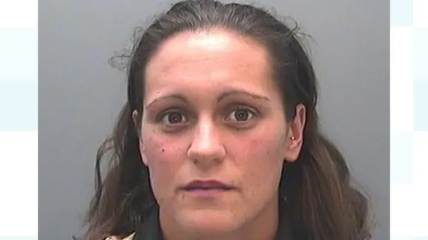
Rhian Nokes, Port Talbot
Notes:
Credit: South Wales Police
Rhian Nokes was born in Port Talbot. She was a Welsh former footballer and rugby player. She began playing football with Cardiff City as a goalkeeper and represented the Wales women's national side. In 2018, she was convicted of sex offences against a minor after entering into a relationship with a child while working as a sports coach.
A teaching assistant and former international sportswoman who abused her position of trust to groom and sexually abuse a pupil was sentenced to seven years in jail.
Rhian Nokes used her position as a gym teacher to impress the child and lied about having a brain tumour to start the relationship.
The 29-year-old initially denied seven charges relating to sexual activity with a child aged 13 to 15, but changed her plea to guilty mid-way through a trial at Swansea Crown Court.
The court heard the victim was in awe of Nokes and began to see her as a trusted friend during the early years of comprehensive school.
Over the course of the next three years, Nokes lied to the pupil about her health and family issues in order to gain sympathy and trust.
She progressed to encouraging the pupil, then aged 15, to meet outside of school and start a sexual relationship.
Nokes was arrested and it was soon established that she had never suffered from cancer.
“Rhian Nokes hid behind her reputation as an accomplished sportswoman and abused the position of trust she held at the school to manipulate the victim and fulfil her own sexual gratification.
“In order to facilitate the relationship, the defendant deceived the victim about her health, feigning treatment for a brain tumour by shaving her hair and feigning seizures in the presence of the pupil.
“The relationship ended after the victim uncovered the lies. She subsequently reported the matter to the police when she became concerned that Nokes was acting inappropriately towards another pupil. Nokes initially denied being involved in a sexual relationship with the pupil.
“However, as a result of the bravery of the victim giving evidence at trial and overwhelming telephone evidence to support the pupil’s account, she changed her plea to guilty to all the offences…” – Nicola Powell, Crown Prosecution Service.

Slide 57
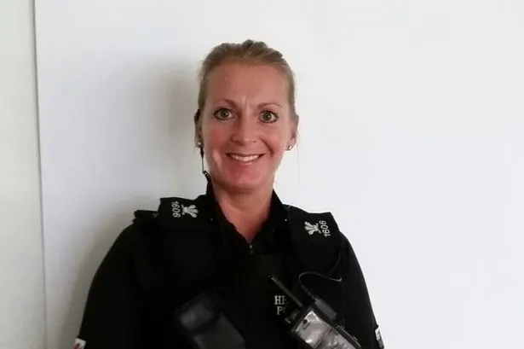
PC Andrea Griffiths, North Wales
Notes:
A police officer quit the force after having sex with a sexual abuse victim while on duty.
PC Andrea Griffiths, 44, was set to be sacked for gross misconduct for having a relationship with the “vulnerable” man in north Wales in 2015.
But she resigned on the morning of a misconduct hearing, saying she "deeply regrets" the fling with the unnamed man, who was a victim of historic sexual offences.
A panel heard PC Griffiths had sex with the man – known as Mr X – both on and off duty, but she claimed she only had sex with him once.
North Wales Police presenting officer Amy Clarke said:
"She developed an inappropriate personal relationship with a vulnerable male who she was responsible for in 2015.
"Miss Griffiths was tasked with being liaison officer and engaged in sexual activity with him.
“She agreed further that sexual activity happened on duty."
PC Griffiths, who joined the police in 2001, admitted gross misconduct at the hearing at North Wales Police headquarters in Colwyn Bay.
A statement from PC Griffiths said: "I recognise I shouldn't have had sexual contact with Mr X on June 29, 2015.
“I accept gross misconduct and deeply regret that it happened.
"To avoid further embarrassment to everyone I have resigned forthwith from North Wales Police."
The professional standards hearing was told she had "fallen below professional standards of integrity, authority and courtesy" and shown "discreditable conduct".
Panel chair Susan Davies added: "PC Griffiths knew of Mr X's personal and medical issues while she took part in that sexual activity, whilst on duty.
"She breached standards of honesty and integrity, specifically integrity. She behaved in way that was discreditable to North Wales Police.
"We found that conduct so serious that dismissal would be justified and therefore amounts to gross misconduct."

Slide 58
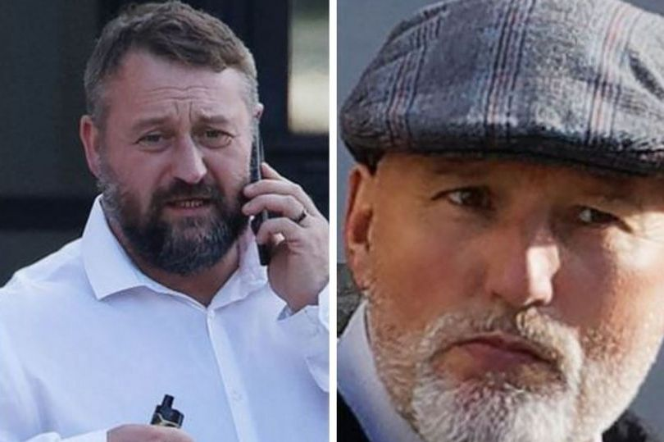
Douglas Stephens and Anthony Thomas,
Swansea
Notes:
Three members of staff at a care home in Swansea were jailed in January 2022 for ill-treating vulnerable residents. Two employees from Gowerton, Swansea, Douglas Stephens and Anthony Thomas, had previously been convicted of ill-treating a person lacking mental capacity. Their colleague, David Wedlake, had previously pleaded guilty to the same offence.
Swansea Crown Court heard Gower Lodge, which was run by a company called TracsCare (now called Accomplish), was a residential home for adults with learning difficulties, complex behavioural issues, and mental health conditions who needed one-to-one care.
During the trial it was acknowledged that the residents' behaviour could often be "challenging", and staff used a system called Studio III which emphasised the management of residents through distraction and de-escalation techniques with physical intervention only being used as a last resort.
The abuse, which happened between 2015 and 2017, came to light when a former member of staff raised her concerns about what she had seen and heard (whistleblowing). They were initially investigated by the care company, before the police were alerted by the care homes owners.
A judge told the trio the way they had treated their victims – all of whom had complex behavioural and emotional issues – had been "abhorrent". He said it was clear there had been a culture at the care home which, effectively, turned a blind eye to the way residents were being ill-treated, and he praised the courage of whistleblowers who came forward with damning testimony about what was going on.
The court heard how 41-year-old Stephens was verbally abusive to residents, made crude sexual comments towards women. On one occasion, he a dragged one woman off a sofa by her hair, knelt on her stomach, and banged her head on floor a number of times. He also used a racial slur towards a male resident, and made barking noises outside his room. Thomas, aged 65, was also verbally abusive, and once dragged a woman by her hair out of the home's lounge.
Wedlake, who was a shift leader at the home, made "callous" comments to a distressed resident who was threatening suicide, and at one stage told her he would give her "a f***ing rope". When the victim accused him of not caring, he replied: "I don't get paid to care." The 38-year-old's offending was recorded on a mobile phone by a colleague who would later become a whistleblower.
Douglas Stephens and Anthony John Thomas were each sentenced to a total of 15 months in prison. David Michael Wedlake was sentenced to 18 weeks in prison. The defendants will serve up to half those sentences in custody before being released on licence to serve the remainder in the community.
Judge Walters said the whistleblowers who came forward to give evidence about what was going on at Gower Lodge were to be commended for their courage, saying such people "give voice to those who have no voice".

Slide 59
Perpetrator characteristics
Beware of stereotypes and prejudices. As you’ve seen from the previous slides, perpetrators come from all backgrounds and will:
  go to great lengths to present themselves in a positive light
  sometimes be both charming and very manipulative
  pretend to follow rules or laws.
Common features of perpetrator behaviour can include any or all of the following:
  grooming
  bullying
  intimidation or threats
  shaming
  coercive control and controlling behaviour
  often isolates victim
  other psychological tactics.

Slide 60
Section 5 procedures
Some perpetrators are also practitioners.
Section 5 of the Wales Safeguarding Procedures covers safeguarding concerns involving ‘people in positions of trust’. The procedures include all ‘practitioners’ including volunteers or sports coaches.
Notes:
Section 5 looks at the process that must be undertaken if there is a concern about anyone working with adults and/ or children. The new procedures are clear this process applies to all those working with children and/ or adults, whether they are qualified professionals, practitioners working for a voluntary sector or private provider, or are a volunteer.

Slide 61
Whistleblowing
Whistleblowing is when someone raises a concern about a dangerous or illegal activity, or any wrongdoing, in their organisation. Raising a concern is known as "blowing the whistle" and is a vital process for identifying risks to people's safety.
We all have a responsibility to report safeguarding concerns, regardless of a person’s status, profession or authority.
The NHS and social care whistleblowing helpline can advise on the whistleblowing process: 08000 724 725.
Notes:
Tell: Refer back to practitioner perpetrators featured on previous slides, plus Welsh headmaster Neil Foden who was convicted of child sexual abuse.
Another high profile practitioner case in Wales is that of Gareth Williams (Deputy Head).
Tell: Next highlight the significance of whistleblowing. All organisations should have a whistleblowing policy.
Tell: You should mention …. Section 5 of the new procedures covers concerns about ‘practitioners’. Section 5 enables low (ish) level concerns to be picked up and looked at to form a picture of the risks. Section 5 covers volunteers, sports coaches etc. Section 5 of the procedures refers to anyone in a ‘position of trust’.
Tell: If you have time you could talk about/ explore any of the following issues which can feature cases involving professionals/whistleblowing:
Culture of an organisation
“Oh, he’s harmless”
Leaving yourself open to allegations
Normalisation of abuse (re the case of Winterbourne view staff)

Slide 62
What are adverse childhood experiences?
‘Adverse childhood experiences (ACEs) are stressful experiences occurring during childhood that directly harm a child (for example: sexual or physical abuse) or affect the environment in which they live (for example: growing up in a house with domestic violence)’
Bellis et al 2016
Notes:
This is an optional slide and will depend on the audience’s experience and knowledge. There’s an expectation that participants would be familiar with ACEs from completing the Group A safeguarding training.
If the audience isn’t familiar with ACEs, the trainer may wish to briefly revisit the concept of ACEs.
Public Health Wales did an ACE study for Wales in 2015. 2000 adults aged 18 to 69 gave anonymous information on their exposure to ACEs before the age of 18, and their health and lifestyles as adults.
The report considered:
how commons ACES were, and how they’re associated with health-harming behaviours in adults
how ACEs affect chronic ill-health, use of health and social care services, and earlier death in adults
how ACEs affect adults’ mental health and well-being.
The study showed that around one in every seven adults aged 18 69 in Wales has experienced four or more ACEs during their childhood and just under half have experienced at least one.
Those experiencing four or more ACEs are:
six times more likely to smoke e-cigarettes or tobacco
11 times more likely to have smoked cannabis
16 times more likely to have used crack cocaine or heroin
20 times more likely to have been jailed at any point in their lifetime.
The trainer should emphasise that research should be analysed critically. The trainer must explain that, just because a person has experienced one or more ACE, it doesn’t mean that they’ll go on to be a perpetrator of abuse. Nor does it mean that they’ll necessarily go on to develop any of the risk factors highlighted by the research. It’s important that we consider every person as unique, with their own strengths, resilience and supportive factors and networks which all have influence their development.

Slide 63
ACEs film
https://www.youtube.com/watch?v=YiMjTzCnbNQ
Notes:
This slide is optional. The trainer should remind participants that the video may be triggering for some individuals, and participants can step out if they don’t feel comfortable watching the video. The trainer should remind the group that they’re available after the session to signpost or support participants.

Slide 64
Transitional safeguarding (18 to 25 years)
An emerging area.
Links with ‘contextual safeguarding’ acknowledges 18 to 25 years as a fundamentally important developmental stage (like 0 to five years).
Acknowledges current systemic shortfalls within children and adult services.
Exposure to specific risks (including contextual).
A more person-centred approach involves children and adult services working more closely together.
  It means children practitioners look forwards and prepare the young person for the adult world and adult practitioners looking backwards to where the young person has come from.
Notes:
In child and adult services, it’s becoming more common that risk ‘contexts’ go beyond the scope of traditional child or adult protection processes. For example, transitional safeguarding, contextual safeguarding, ACEs and trauma-informed practice (a slide on each follow).
The trainer should encourage discussion about working with young people
For example:
an adolescent who’s involved in ‘county lines’ (or other gang-associated harm) may find they receive a criminal justice response, rather than being recognised as a victim of criminal exploitation
a young adult experiencing sexual exploitation may not be eligible for a safeguarding response unless they have care and support needs
a young person who’s subject to a child protection plan may find that support stops abruptly when they turn 18, even though their experiences of maltreatment leave them just as vulnerable as a child leaving care who would be entitled to ongoing support.
A new joint briefing on making transitional safeguarding a reality has been published by the Department of Health and Social Care. You can read it on the UK government’s website.

Slide 65
Transitional safeguarding
Transitional safeguarding involves ‘bridging the gap’ between adult and children services. It recognises that young peoples’ needs don’t change or stop when they reach 18, although the laws and services supporting them often do.
“It is an approach to safeguarding that moves through developmental stages, rather than just focusing on chronological age, building on best practice and learning from both adult and children’s services.
“Those working with adults should be curious about the childhood of the adult they are supporting and those working with children should be ambitious about the adult they are helping to create”
Des Holmes 2021
Notes:
The trainer should encourage discussion about working with young people.

Slide 66
Contextual safeguarding
“Contextual safeguarding highlights a need to consider risks that a child or young adolescent may face in the community and from peers.”
Lloyd and Firmin, 2019
Society
Peers
Home /family
Child/ young person
Neighbourhood / community
School
Notes:
Contextual safeguarding acknowledges risks beyond the scope of traditional child protection processes. This area of practice is developing.

Slide 67
Exercise
What is professional curiosity and why is it important in safeguarding?
Professional curiosity is where a person explores and understands what’s happening for an individual or within a family.
Professional curiosity is a combination of:
  looking
  listening
  asking direct questions
  checking information
  reflecting on information.
  It means not taking a single source of information and accepting it at face value.
  It also means testing out your professional assumptions about different types of families.
Notes:
The trainer can run this exercise in two ways:
ask the group “what is professional curiosity?”, and get the group to shout out answers
splitting the participants into smaller groups and feeding back to the trainer, before the trainer shows the information on this slide.
Professional curiosity is when practitioners try to explore, proactively, what’s happening in someone’s life and really try to understand it, rather than making assumptions or accepting a single source of information at face value.
It’s essential to use professional curiosity, as well as knowing the signs to look for to recognise early signs of abuse, harm or neglect. This will allow staff to identify children and young people who may be in need of help, protection or additional support.
This is often a finding/recommendation from Child and Adult Practice Reviews.
Professional curiosity means that we need to check out the person’s understanding of a situation. What has the person seen? What have they heard that gives them cause for concern? Remind people not to make assumptions. We need to evidence why we have concerns, drawing on evidence and research to support our views if appropriate.

Slide 68
Exercise
Professional curiosity
Is this a child protection or adult protection concern? (Yes/No)
What is it that makes you worried?
What would you do next?
Notes:
The aims of this exercise is for participants to put learning into practice and share knowledge/ encourage professional curiosity. Exercise useful to generate debate and discussion and share view points.
The trainer should select several scenarios to discuss with the group. The scenarios may depend on the audience: for example, either adult or children examples, or a mix of adult and children examples.
This exercise should take about 15 minutes (based on four scenarios) and trainers can run it in two ways:
the trainer reads out example to the whole group and asks participants the questions on the slide.
Participants should use green tick or red cross cards to agree or disagree. The cards are available as a handout in the appendix.
The trainer should ask groups why they answered that way.
The trainer gives each table one case scenario and ask them to answer the questions on the slide as a group.
The trainer can ask some or all groups to read back the scenario and discuss their thoughts and views. This could then be opened up to the wider group for further debate and discussion.

Slide 69
Do you need consent to make a safeguarding report to Children’s Services?
Practitioners have a duty to report suspected abuse and neglect with or without the child’s consent. But it’s best practice to get the child’s consent to report, unless it would place the child at risk of harm.
The overriding consideration when you decide whether to try to get parental consent before making a report is the interests of the child at risk of harm.
Notes:
The trainer should ask the group: “how would you work with someone to get consent?”
The trainer should point out that discussing consent is an example of using a child-centred approach to consult with, and involve, the child in decisions.
If the child objects to the report the practitioner should explain to them that they respect their feelings, but they must make the report to protect the child from possible harm.
Try to get consent from the child’s parent(s) or carer, unless it would increase the risk of harm to the child.
Practitioners should discuss with their agency’s DSP whether it’s appropriate to get consent from the parent(s) or carer. If the parent(s) or carer refuses to give consent, you can still make a report if you still need to.
In this case, you must:
record the reason for carrying on without the parent(s)’s consent
tell social services the parent(s) or carer refused consent
tell the parent(s) or carer that you’ve made a report despite their wishes, unless it would place the child at risk of harm or further harm if you told them.
There’s more information about this in the Welsh Safeguarding Procedures.

Slide 70
Do you need consent from the person to make a report to social services?
Capacity and consent
Not getting consent does not mean you don’t act.
Someone has capacity to give or withhold consent until they’re assessed and proven not to have capacity.
You might need to consider if the Mental Capacity Act 2005 applies to the situation.
In some situations, you can override someone’s consent.
Notes:
The trainer should ask the group this question to start a discussion.
The trainer should remind participants that an adult has the right to withhold consent to a safeguarding report being made about them except in certain circumstances.
An adult has the right to:
make decisions for themselves, even when these might be deemed “too risky” by others around them
choose that no action should be taken
choose what action might be taken
refuse to co-operate in any procedures (unless they’re related to criminal activity).
If you have concerns that abuse, harm or neglect, has happened, is happening, or may happen, you must always share these concerns with your manager or DSP.
Depending on the concern or suspicion, this may involve making a report to the police or social services. Your manager or DSP will be able to advise you.
You should advise the person you’re worried about, wherever possible, about the steps you need to take next.
The Wales Safeguarding Procedures has more information about capacity and consent, including the pointers for practice.
It’s the role of the practitioner to help the adult understand the consequences of their choices. It can be very difficult for us as professionals to accept that a person, who may be in a situation that we consider as potentially abusive, refuses help.
Even if a person lacks capacity, they may not want highly intrusive help such as barring someone from their home or for a person to be referred to the police.
They may want support, but in less intrusive ways such as advice about the options available, but not on a statutory basis. It’s important to consider the information people have when they’re making a choice, so they can consider the options and consequences of their decisions.
Confidentiality guidance highlights that we have a duty to maintain confidentiality as professionals, but this isn’t absolute. There are situations where we can override refusal to give consent, for example:
if the adult at risk is unable to give consent due to coercion or undue influence by someone else
if there’s an overriding public interest (for example, risk to others)
professional duty to disclose (duty to report)
it’s necessary to prevent imminent danger or distress
it’s a life-threatening situation
if we have to report it to the police because a crime has been committed.
There’s more information about this in the Welsh Safeguarding Procedures.

Slide 71
Mental Capacity Act 2005
We must always start by presuming all adults have the capacity to make decisions for themselves.
Mental capacity can be affected by someone having a condition that affects the functioning of the mind or brain (which may be permanent) or can temporarily be affected. For example: under the influence of drugs or alcohol.
We must make sure that we follow the principles of the Mental Capacity Act 2005 when we work with people over 16.
When we think about mental capacity, we must consider the specific decision at the specific time it needs to be made. Mental capacity to make a specific decision can also change.
Notes:
When we work with adults over 18 (children over 16: consider Gillick competence), we must always assume that people are able to make decisions for themselves.
This can include the right to make decisions that we, as professionals, may think are unwise.
Sometimes people may have a disorder of the mind or brain, which affects their thinking. In these cases, we have to use the principles of the Mental Capacity Act 2005. You can find out more about the Act and the Mental Capacity Code of Practice on the UK Government website.
Everyone has capacity to make their own decisions until there’s proof that they can’t. That means we can’t assume they’re unable to make their own decisions because of their:
age
appearance
behaviour
physical or mental health condition.
You must take all reasonable steps to engage with the person and give them the information they need in different ways to help them understand.
If you’ve done this and are still concerned that the person you’re supporting is still unable to:
understand the decision that needs to be made
retain information to help them make the decision
use the information, or see advantages and disadvantages, to help them make the decision
communicate their decision in any way
then you may need to do a mental capacity assessment to make the decision.
For this to happen, you need to have reasonable cause to suspect that the person has difficulty with any of these steps because of an impairment of the mind or brain.
Decisions to assess capacity are specific – a specific decision needs to be made at a particular time.
In order to decide whether an individual has the capacity to make a particular decision you must answer two questions:
stage 1: Is the person unable to make a particular decision (the functional test)?
stage 2: Is the inability to make a decision caused by an impairment of, or disturbance in the functioning of, a person’s mind or brain? This could be due to long-term conditions such as mental illness, dementia, or learning disability, or more temporary states such as confusion, unconsciousness, or the effects of drugs or alcohol (the diagnostic test).
The MCA says that a person is unable to make their own decision if they cannot do one or more of the following four things:
• understand information given to them
• retain that information long enough to be able to make the decision
• weigh up the information available to make the decision
• communicate their decision – this could be by talking, using sign language or even simple muscle movements such as blinking an eye or squeezing a hand.
Every effort should be made to find ways of communicating with someone before deciding that they lack capacity to make a decision based solely on their inability to communicate. Also, you’ll need to involve family, friends, carers or other professionals.
The assessment must be made on the balance of probabilities – is it more likely than not that the person lacks capacity? You should be able to show in your records why you have come to your conclusion that capacity is either present or lacking for the particular decision.
This means that a person may have capacity to make some decisions but not others. In order to be able to make decisions, adults at risk may need extra support such as advocacy, simplified explanations and visual aids. We must always stick to the principles of the Mental Capacity Act. These are:
a person must be assumed to have capacity unless it is established that they lack capacity
a person is not to be treated as unable to make a decision unless all practicable steps to help him to do so have been taken without success.
a person is not to be treated as unable to make a decision merely because he makes an unwise decision.
an act done or decision made, under this Act for or on behalf of a person who lacks capacity must be done, or made, in his best interests.
before the act is done, or the decision is made, regard must be had to whether the purpose for which it’s needed can be as effectively achieved in a way that is less restrictive of the person's rights and freedom of action.
Any act or decision you make on behalf of a person who doesn’t have capacity must be in their best interest.

Slide 72
Confidentiality and sharing information
It’s best practice to tell the person that you’ll be contacting Children’s or Adult social services. Only do this if you feel it’s safe to, and you aren’t putting yourself or anyone else in danger.
Get consent if possible.
You should always share information when there is a risk to yourself or someone else, or when a law’s been broken.
Only share information with social services or police and always on the same day.
General Data Protection Regulation 2018
“Staff should not hesitate to share personal information in order to prevent abuse or serious harm, in an emergency or in life or death situations.” – Guidance from the Wales Accord on the Sharing of Personal Information (WASPI)
Notes:
The trainer should reiterate that you shouldn’t share or pass on information about someone, unless:
the individual has given permission for the information to be shared (for example: with other services or professionals)
there’s a risk to the individual’s or a third party’s welfare (for example: risk of being harmed or causing harm).
The General Data Protection Regulation (GDPR) became law in May 2018.
The UK legislation is the Data Protection Act 2018.
It means that people across the UK and Europe will have more rights over how their personal information is used.
It means organisations have to collect, store, use and share personal data responsibly – with much larger fines if they break the law.
Failing to share information is a common finding of practice reviews.
Wales Safeguarding Procedures highlight seven golden rules for sharing information in the app.

Slide 73
Comfort break

Slide 74
Neglect scenario
You are undertaking a home visit. You are invited inside the home and this is what you see.
What are your initial thoughts?
What are you going to say to the person?
What do you do next?
Think of the words you’ll use to describe these home conditions in your report.
Notes:
The trainer should give the group a trigger warning for the next few slides, because the content may be upsetting.
The trainer should show the pictures and encourage discussion on each point with the group, including thoughts, values, judgements and opinions.
The trainer should:
highlights strengths-based conversations and ‘what matters’ conversations
consider children and adults, and professional curiosity.
Trainer will need to challenge any inappropriate comments or judgements.
The key practice points to consider are:
use respectful language
don’t call their possessions as 'junk' or 'rubbish' or say that the place is disgusting. This shows that you don't understand their connection to the objects or why they want to keep them, and they will feel judged, and will damage your relationship with them.
listen to what they want
ask the person close to you what they think will be helpful. This will give them more control over the situation and show you care about what they want.
be patient
help them to get support
be honest about your position or role as a practitioner, and how you can support the person.

Slide 75
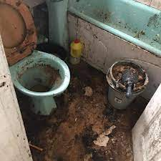
Example image - bathroom

Slide 76
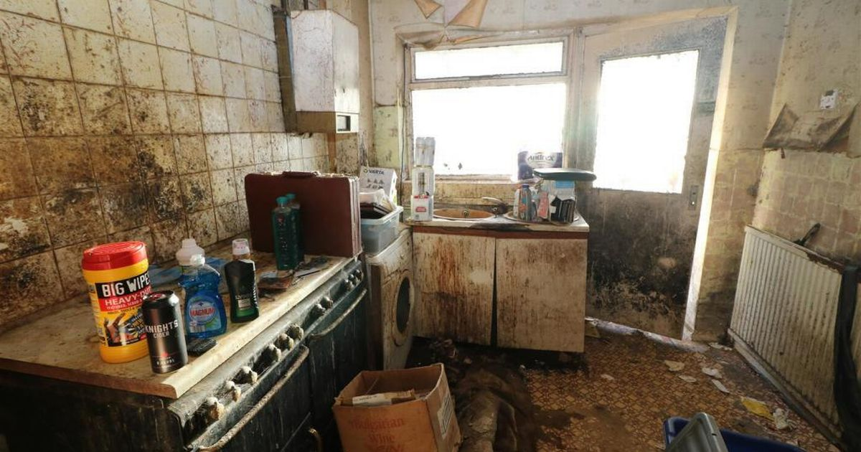
Example image - kitchen

Slide 77
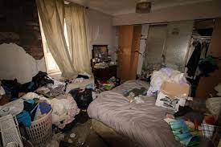
Example image - bedroom

Slide 78
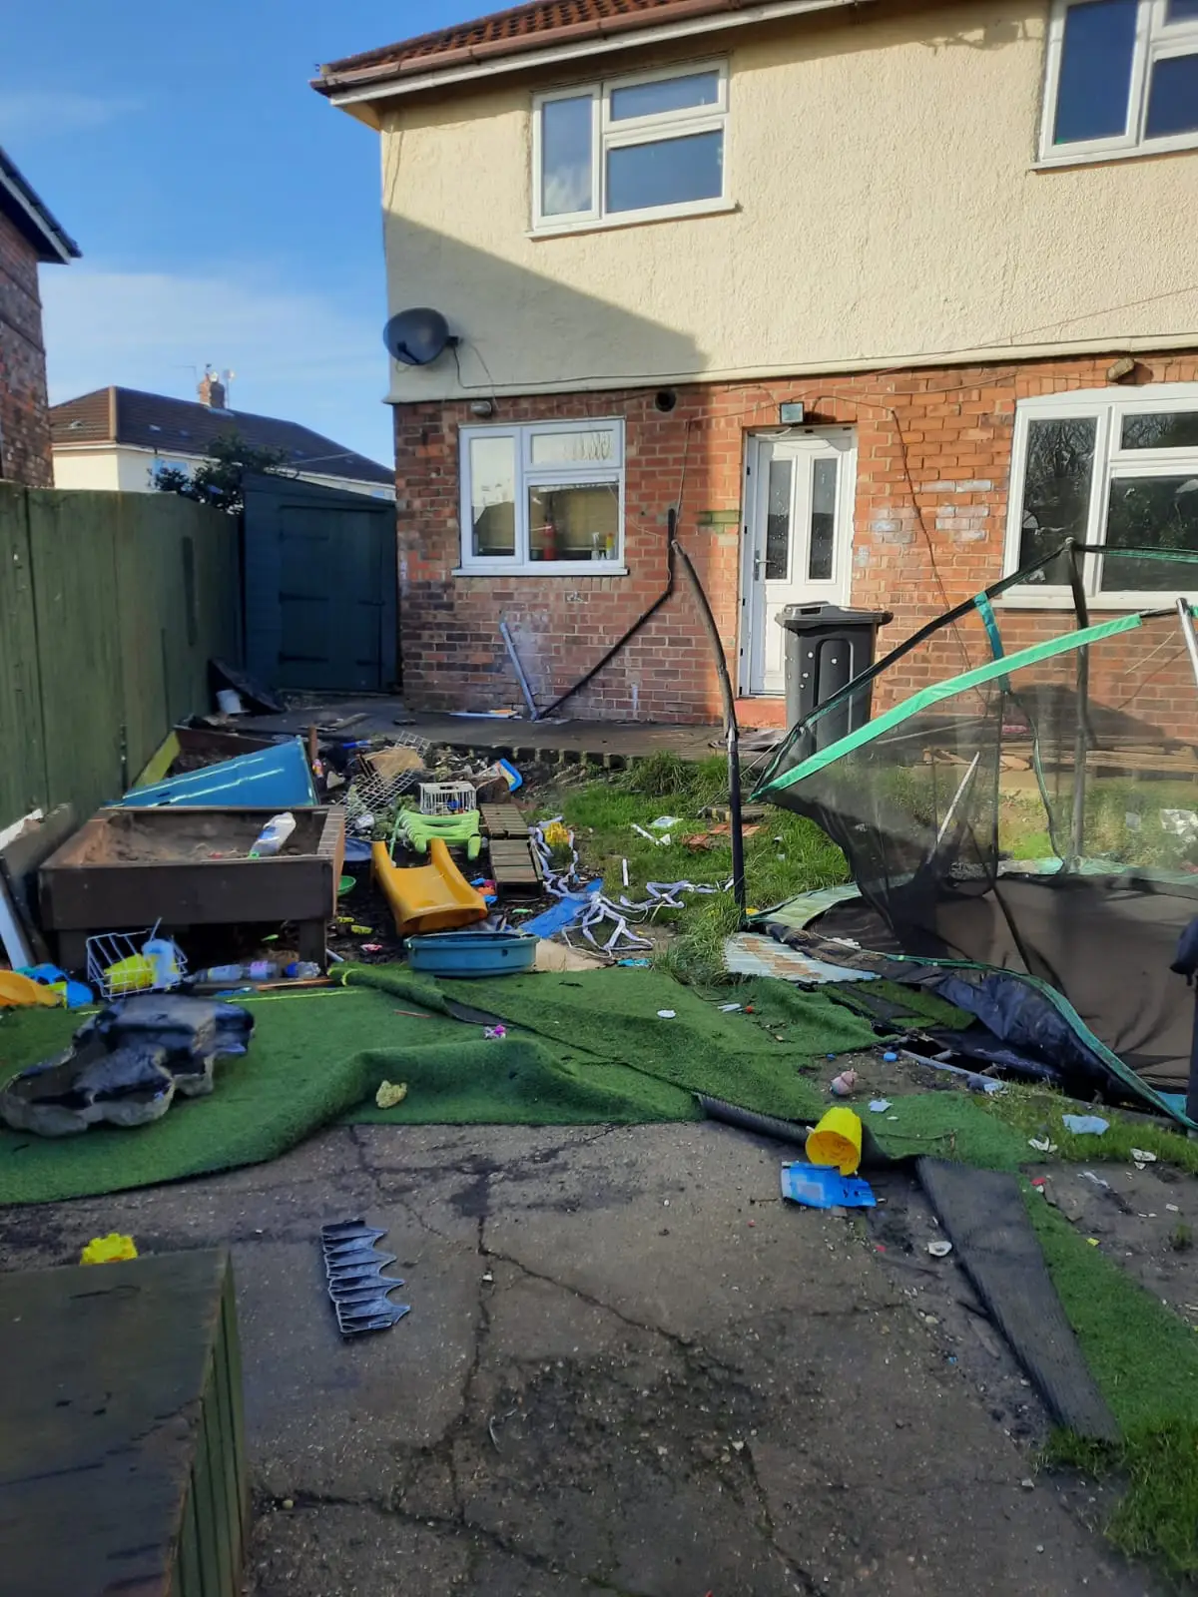
Example image - garden

Slide 79

Example image
Notes:
The trainer should ask: “who lives in a house like this?”
This is a picture of a famous artist’s room (Andy Warhol).
He has described how he would feel a sense of ‘excitement’ from buying things which, he feels, lead him to hoarding.

Slide 80

Do’s and don’ts
Do:
stay calm
be accessible and receptive
listen carefully
take it seriously
reassure the person that they are right to tell you
say you’ll need to pass the information on, and to whom
make a careful record of what was said and make sure these details are kept confidential
consult immediately with the named person in your organisation
Don’t:
react strongly (for example: saying “how disgusting”)
jump to conclusions especially about the abuser
speculate or accuse anybody
tell the person you will keep their secret
ask leading questions
make promises you cannot keep
stop a child or adult who is speaking freely
confront the alleged abuser
don’t delay in reporting
blame the person
Notes:
Aims: to give staff the skills and confidence to manage should a person confide in them that they have been harmed or abused.
This slide is optional. There are two ways to run this activity:
identify do’s and don’ts on flip chart paper
give the group cards that say ‘yes’ or ‘no’ and ask them to hold up the appropriate answer when the trainer asks the question. These cards are available to download in the appendix.
Trainer advises that if you're in a situation where a person tells you about any form of abuse they’re experiencing, there are a number of steps you can take:
listen carefully to the person
Try not to share your own views. If you react with shock or disbelief, it could cause the person to 'shut down', take back what they’ve said or stop talking.
let them know they've done the right thing
Reassurance can have a big effect on the person who may have been keeping the abuse secret.
tell them it's not their fault
Abuse is never acceptable.
don't talk to the alleged abuser
Confronting the alleged abuser about what the person has told you could make the situation a lot worse and place you in danger.
explain what you'll do next
Explain to the person you'll need to report the abuse to someone who’ll be able to help.
don't delay.
You must report the abuse the same day you hear about it.
The trainer should make sure these key points are covered:
if you can, keep a record of the discussion and what the person has said, using their exact words
Remember to add the place, date and time, and to sign your recording.
all records must be kept confidential, in a secure place and kept somewhere where other colleagues can’t see them
You mustn’t leave them lying around (for example: in a vehicle or on a desk).
you mustn’t share the records with anyone except your manager, senior manager, DSP or social services
organisations are subject to the GDPR laws (see earlier slide), and you must treat the data in these records in line with the law
make sure that any conversations with your line manager, DSP or social services are in a confidential setting where you won’t be overheard
it isn’t your responsibility to investigate.
Trained staff will investigate (if appropriate) and may involve other agencies such as the police.

Slide 81
Creating safe spaces
Support individuals to feel safe and comfortable to share their worries and concerns by:
  taking the time to listen
  creating opportunities for them to talk to people or children on their own, away from family members
  not avoiding difficult conversations if you have concerns
  not judging, blaming, dismissing or minimising
  raising awareness of abuse, harm, neglect or risks and give them information specific to them.

Slide 82
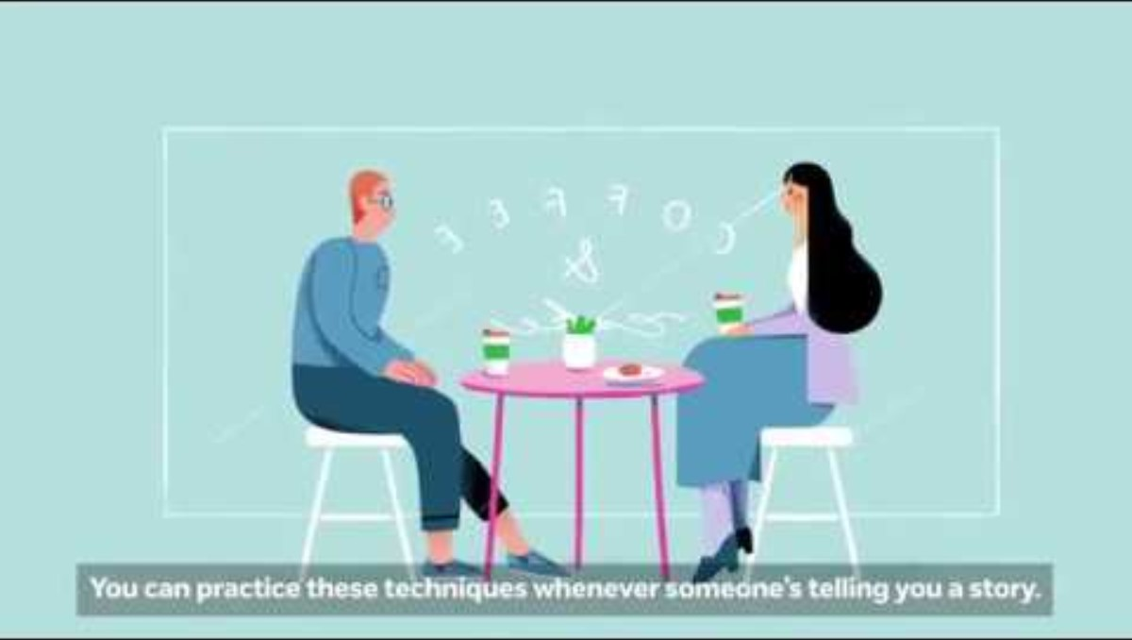
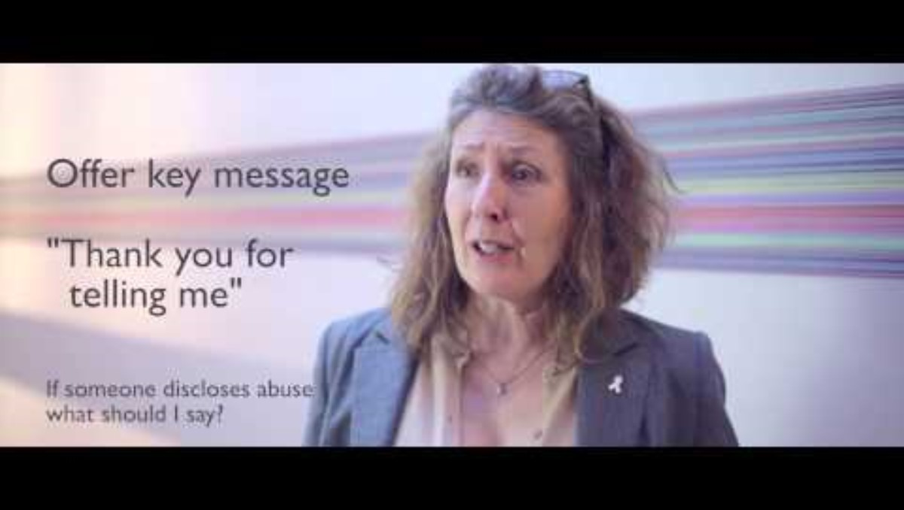
Responding to allegations
Children and young people
Violence against women, domestic abuse and sexual violence: how to respond to allegation
The Live Fear Free helpline is free to call and open 24 hours a day: 0808 80 10 800

Slide 83
DSP (designated safeguarding person)
The Wales Safeguarding Procedures identifies DSPs as ……
..the person within the agency or setting, with responsibility for supporting other staff and providing advice on safeguarding concerns.
The DSP should be consulted on whether a safeguarding concern should be raised with the local authority.
The DSP frequently coordinates immediate actions required.
Notes:
If they don’t have a DSP, Group B practitioners can call the local authority’s safeguarding team for advice and support.
The Wales Safeguarding Procedures suggest every agency should have a DSP responsible for safeguarding.
The DSP can give advice and guidance. They’re responsible for making sure that everyone follows the procedures for safeguarding concerns about a child or vulnerable adult (including allegations against members of staff).

Slide 84
Recording concerns, decisions
Submitting a duty to report (DTR) form
The National safeguarding training, learning and development standards say:
Group B practitioners need to know or observe:
how to record written information that is accurate, clear and relevant with an appropriate level of detail
the difference between fact, opinion and judgement, and why understanding this is important when recording and reporting information.
A record should be kept as soon as you become aware of any concerns, of all discussion and decisions (whether a DTR is submitted or not).
Notes:
The trainer should build on the points on this slide and encourage discussion about why these aspects are important.
The trainer should remind participants the need to check their internal policies, so they understand the expectations for recording and storing information.

Slide 85
Reporting
The safety of the individual at risk always comes first. Don’t delay acting and always report on the same day.
Contact your manager or Designated Safeguarding Person.
Contact social services for advice or to make a report.
If a child or adult is in immediate danger - Police – 999.
Make non-urgent reports by calling 101 or reporting to the police online.

Slide 86
Exercise
What information do you need to give?
Date and time
Your name and job role
Where the concern happened
Who was there
What you saw
What you heard
Facts, not your opinions
Notes:
Aim: To ensure that participants are aware of the basic information that will be needed if further exploration of the safeguarding concern is needed.
Activity: Trainer asks the group: “what information do you think it’s important to provide?”
The group should shout out the types of information they think is important to pass on to their manager, supervisor or designated safeguarding person if they’ve seen or heard something they are worried about.
After this, the trainer should reveal the answers on the slide. The trainer should make sure that each point is identified by the group or, if not, is covered in discussion.
The trainer should check if participants know the difference between fact and opinion and clarify this because participants need to be clear about the difference.
Facts are things or events that are known to have happened, a piece of information that can be verified or something that you have seen or heard yourself.
An opinion is a belief that you may have, but without having seen it or heard it, or a judgement that you may have made.
When you record details:
include details of the concern, all the discussions you’ve had with other people about it, and the decisions or actions agreed (and who’s responsible for doing them)
be brief and accurate, so anybody who isn’t involved can understand the report
be clear about what is fact, opinion or judgement
use the adult or child's own words where possible and relevant
store the records (whether escalated or not) securely, in line with your organisation's policies for storing personal, confidential records and information.
There’s a handout in the appendix about the information you should include in a report.

Slide 87
What happens next?
You or your DSP may need to fill in a report form to the relevant department or get further specialist advice.
You should know your own organisation’s procedure.
Once you’ve reported your concern, you may not need to be part of the rest of the process.
You may be contacted by social services or the police for further information.
Notes:
Aims: for participants to be aware of immediate next steps in the report process.
You may not receive feedback but can contact to request this.
The trainer should link this back to the duty to report.
The trainer should explain to participants that they may not receive any feedback about their concerns. Often, they won’t be involved at all after they raise a concern unless they’re needed.
Trainer should tell participants that raising concerns can sometimes be a very emotive experience. They may worry about whether they are doing the right thing, whether they may have got something wrong, or may feel that they don’t want to get involved.
The trainer should remind the group that it’s their responsibility to report a concern to either their manager or DSP. Managers or DSPs should reassure them that they’ve done the right thing and staff should feel listened to and get support from their manager or DSP.

Slide 88
Learning from safeguarding reviews: recurring themes
Regional Safeguarding Boards have a key statuory duty to carry out safeguarding reviews.
Safeguarding reviews are detailed reviews of the events leading up to an incident resulting in the death or significant harm of a child or adult at risk (where services were involved).
Safeguarding reviews aren’t criminal investigations, although a criminal investigation may also take place.
The primary focus of safeguarding reviews is to identify key learning to inform future practice.
The Single Unified Safeguarding Review (SUSR) is a single review process incorporating all reviews in Wales.
Notes:
Single unified safeguarding reviews (SUSRs). These help make sure that families get a swift and thorough review process.
The SUSR takes away the need for families to take part in several reviews. This will reduce the trauma and means we can act on things sooner.
The criteria for doing a SUSR needs to meet one of the following:
adult practice review
child practice review
domestic homicide review
mental health homicide review
offensive weapons homicide review.

Slide 89
Recurring themes emerging from safeguarding reviews
Information sharing
Multi-agency collaboration
Professional curiosity vs building trust
Hostile and uncooperative – see the Board’s multi-agency protocol
Lack of lived experience of child or adult at risk
Contextual safeguarding (extra familial)
Poverty compounding other family adversity
Fixed practitioner thinking
Practitioner mirroring family’s chaotic behaviour

Slide 90
Contact information
You must consult with your manager or DSP as soon as possible but always on the same day.
Where there are concerns that a child or adult is at risk, a report should be made to children's or adults’ social services.
Put your local contact information here…
If a person is in immediate danger dial 999.
You can also contact the Live Fear Free Helpline:
0808 8010 800
Notes:
The trainer should explain again to participants that they should speak with their manager as soon as possible and always on the same day.
The trainer should say that if their manager isn’t available, then they should contact the DSP.
The trainer should ask if participants know who their DSP is and advise them to find out if they aren’t sure. They should have all the important numbers, including their manager’s, in their phone.
Their manager or DSP will talk to them and can take the issue forward with social services if needed.
The trainer should explain that if there’s an immediate risk, they shouldn’t wait to speak to a manager or DSP – they should call the police or emergency services.
The trainer should give an example: “if you’re working in a property and you see a man hitting a woman with a child in the room”.
If neither their manager or DSP is available, they’ll need to telephone Children Services or Adult Safeguarding.

Slide 91
Essential steps
Believe that abuse can happen and never ignore a hunch
Share your concerns with your manager or other appropriate person
Don’t cover up for others
Make sure that you know the policy and procedures
Know the limits of your responsibility
Report and record your suspicions as soon as possible
Don’t tackle an alleged perpetrator yourself
If possible, let the individual you’re concerned about know what the process and next steps will be
Keep up-to-date
Notes:
This slide is taken from Wrexham social services.
This is a chance for the group to review the day’s learning outcomes, and the key messages about their responsibilities as ‘alerter’. It’s an opportunity to share reassurance and give a clear message about how to get more support and information.
The trainer may want to change the content and turn this into a handout.

Slide 92
Duty to yourself
You should:
look out for your own personal safety, for example: lone working
use supervisions to debrief
look out for vicarious trauma
ask for support and advice
keep an eye out for compassion fatigue and burnout
remind yourself of the true scale of abuse
meet your personal development needs. This includes:
  additional training
  mentoring
  shadowing
  continuing professional development (CPD)
  recognising that learning and development is ongoing and incorporates both informal and formal activity.
Notes:
Personal safety to consider, for example:
not confronting a perpetrator when managing a disclosure
What are your organisations lone working policies.
Later in the session, we come back to support, supervision and personal development.

Slide 93
Making this training work for you
Top tips for helping this learning to stay with you:
teach what you’ve learned to another person
use previous learning to promote new learning
get practical experience
look up answers rather than struggling to remember
understand how you learn best.
Notes:
This slide has some possible follow-up activities to help the group to really take in what they’ve learned. This could be the difference between hearing something (then forgetting it), and changing how we practice and approach things from now on. There are lots of options!
The trainer could ask attendees to share which of the follow-up activities they think they’ll do after today’s session, that will help them ‘to get better at safeguarding’ or embed (take in and use) today’s learning.
The activities could include:
put things into practice
finding out about something (for example: access the Threshold doc )
talk about safeguarding practice or processes with others (for example: in a team meeting or informally)
ask questions (for example: the DSP or safeguarding team)
sign up to train others
get to know members of the local safeguarding team or the DSP (if they don’t already know them)
download the Wales Safeguarding Procedures app.

Slide 94
Continuing learning and development
Group B practitioners new to safeguarding have to complete six hours of safeguarding learning and development within six months of starting their new role. That can include this session.
They should also look for ways to ‘embed’ their learning, followed by seeking to ‘refresh’ every three years. That should cover:
  violence against women, domestic abuse and sexual violence topics
  exploitation (such as modern day slavery)
  child sexual abuse
  mental capacity awareness
  suicide first aid and awareness
  child neglect
  self-neglect, hoarding and the Mental Capacity Act
  child poverty.
Notes:
Group B practitioners could learn more about safeguarding by attending additional sessions on specific topics, or local safeguarding network events.

Slide 95
Memorable principles for Group B
I’m a key part of the safeguarding process
I know when, how and who to report to
I’ll make sure the individual’s voice is heard

Slide 96
Learning outcomes
Describe how to work in ways that safeguard people from abuse, harm and neglect.
Explain factors, situations and actions that could lead or contribute to abuse, harm and neglect.
Understand legislation, national policies, codes of conduct and professional practice in safeguarding.
Know how to recognise and report different types of abuse, harm and neglect.
Notes:
The trainer should go through the learning outcomes to make sure that the session has met all the group’s needs.

Slide 97
Quiz
It’s against the law in Wales to hit a child
TRUE
Ending physical punishment in Wales: explainer video | GOV.WALES
Victims of neglect only come from low income families
FALSE
Name three different types of abuse
1. Physical abuse
2. Emotional abuse
3. Sexual abuse
‘Professional’ people are less likely to abuse
FALSE
It’s solely a local authority's responsibility to keep people safe from harm and abuse.
FALSE
Notes:
Aims: additional learning and to draw together and revisit learning from this training. To evaluate individual/small group progress.
Depending on the group’s individual learning needs, there are three ways to run this quiz:
as an individual exercise
as a small group, where one person in the group to reads the questions out and to records the answer (this is useful in groups with additional learning needs such as dyslexia)
as a whole group ‘shout out’ exercise.

Slide 98
Certain ethnic groups are more likely to commit sexual offences.
FALSE
Children under the age of one are the most likely age group to be killed by another person.
TRUE (followed by 16- to 24-year-olds, NSPCC).
Social services will share information with the public about any children or adults with protection plans.
FALSE
People with a disability are less likely to be abused.
FALSE (statistics show that disabled people are three times more likely to be abused than others).
Neglect is the most frequent reason for child protection reports in the UK.
TRUE

Slide 99
Name three vulnerabilities that increase risk of abuse, harm and neglect
1. Poverty
2. Drugs and alcohol
3. Mental health
Codes of Professional Practice only apply to the workplace.
FALSE
An adult must consent to a safeguarding report being made about them
FALSE
Financial abuse only applies to adults
FALSE

Slide 100
Questions
Notes:
The trainer should ask if anyone has any questions, and signpost to the services below for more advice or information.
Care Inspectorate Wales
If you have concerns regarding a regulated setting, you can contact Care Inspectorate of Wales on 0300 7900 126 or raise a concern via their web pages:
https://careinspectorate.wales/
and search “raise a concern”.
Local contacts to be added / included covering children and adult services
If you are concerned a child is at an immediate risk of harm, ring the police on 999.
NSPCC Helpline (24 hours a day): 0808 800 5000
Domestic Abuse
Live Fear Free Helpline (24 hours a day)
Gives advice and support to people experiencing domestic abuse, sexual violence and coercive control, or those worried about someone who may be experiencing or at risk of this type of abuse.
Helpline: 0808 8010 800 or text service: 07860 077333
E-mail: info@livefearfreehelpline.wales
A live chat service is also available 24 hours a day, seven days a week.
More information: https://gov.wales/live-fear-free

Slide 101
Thank you for listening
Please complete your evaluation form

