Slide 1
Group C safeguarding
Children and adults at risk

Slide 2
National safeguarding training, learning and development standards and framework Group C
This advanced level course aims to ensure participants are:
able to make decisions about keeping people safe and
know when they need to put protection processes in place.
Memorable principles:
I understand everyone’s roles and responsibilities in the safeguarding process
I show the ability to make clear and proportionate decisions
I understand that having voice and control are key to decision making and person-centred practice.

Slide 3
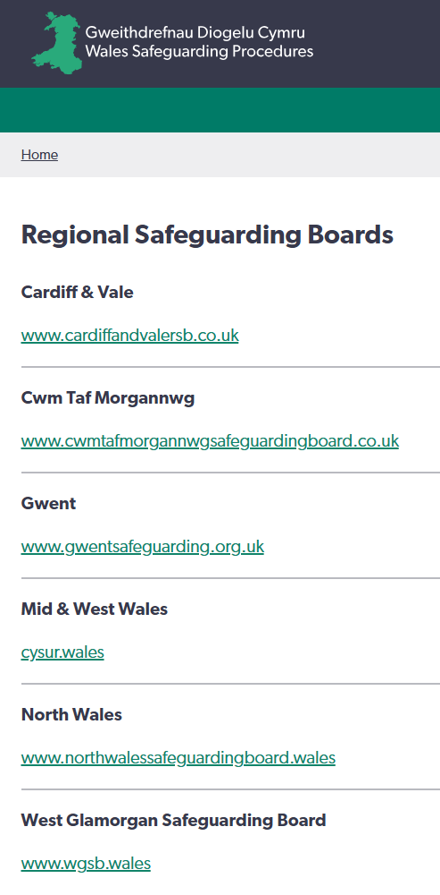
Regional Safeguarding Boards
multi-agency strategic boards of relevant partner agencies
oversee and co-ordinate multi-agency safeguarding arrangements across the region
comprised of representatives from local authorities, the local police body, local health board, NHS Trust, probation board, youth offending team and others.

Slide 4
Why am I here? This course is for those who have a higher level of safeguarding responsibility within their organisation
Group C practitioners:
are involved in protection planning and decisions around individuals in safeguardning processes
work routinely with other organisations
have direct responsibility for safeguarding:
in an assessing role linked to the safeguarding process and / or
at a level where they give advice about safeguarding to those in Group A and Group B and / or
in a setting they work in or manage and / or
people they spend a lot of time with unsupervised.

Slide 5
Learning
This course is part of the generic training everyone in Group C must do.
You will also need to do specific relevant training that will
be different for individual practitioners even within agencies and organisations
often be defined and required by professional or regulatory bodies at a national or agency level.

Slide 6
Learning outcomes Group C
According to the standards, Group C Practitioners should know:
legislation, national policies and codes of conduct and professional practice in relation to safeguarding
how to work in ways that safeguard people from abuse, harm and neglect
the factors, situations and actions that could lead or contribute to abuse, harm or neglect

Slide 7
Learning outcomes Group C
how to report, respond to and record concerns or allegations related to safeguarding
how to promote child and/or person-centred practice
how to take part in safeguarding processes
how to support others to safeguard people (for those with supervisory responsibility)
how to work with others to safeguard people
how to maintain professional accountability.

Slide 8
Learning themes
This course will focus on how to make clear and proportionate decisions using
professional curiosity
professional challenge
professional judgements
trauma informed practice
These are all key learning themes from practice reviews and reports.

Slide 9
Learning agreement
How will we work as a group to meet our learning outcomes?

Slide 10
Introductions

Slide 11
Duty to report – reasonable cause to suspect
A practitioner who has ‘reasonable cause to suspect’ a child/adult is at risk should make a report (referral).
Reasonable suspicion exists when there’s information that would satisfy an objective observer that the particular circumstances exist.
don’t need to establish on a balance of probabilities that a fact is established
based on professional judgement
lower threshold than ‘reasonable cause to believe’
information only needs to suggest that a person is experiencing or at risk of harm, abuse, or neglect, to prompt the need for intervention.
Group C practitioners have an increased responsibility to make sure staff/volunteers are complying with these duties (were relevant to role).

Slide 12

Duty of candour
Discussion:
How can/do you support staff to identify and report concerns and mistakes?
How is duty of candour reflected in organisational policies and procedures?
How can/does your service use this to set expectations?
We need to be accountable for our own work. A culture of openness, transparency and honesty is widely associated with good quality care and trauma informed practice.
Group C practitioners are expected to comply with this duty – especially where there has been a safeguarding concern.
If you’re a Designated Safeguarding Person (DSP) or manager, you’re also responsible for others complying with this duty.

Slide 13
Group C Practitioners are expected to routinely
help staff and volunteers reflect upon and overcome any barriers that may prevent them from reporting a concern (if applicable)
explore any subjective factors that may influence reporting
recognise and challenge practitioner bias, values and beliefs.

Slide 14
Supporting a Positive Culture
Group C Practitioners are expected to support a positive culture that extends to both the individuals receiving care and support and the workforce providing it.
Positive cultures:
protect, promote and support people’s rights
have compassionate leaders
share positive values and behaviours
have good relationships based on strengths
support learning, development and continuous improvement
make sure people and processes work together.

Slide 15
Supporting a Positive Culture
Part of supporting a positive culture is helping others to meet their safeguarding responsibilities by creating space for safeguarding conversations to happen confidently and clearly.
Two key ways to do this are:
identifying and helping staff/volunteers overcome barriers to reporting concerns
promoting a positive culture of open, honest communication, where practitioners feel safe to raise concerns and seek/offer peer advice and support- especially around safeguarding.

Slide 16

Referring to workbook #16
Share specific strategies or practical things you’ve done to:
understand what's stopping people from speaking up:
what practical things have you done (or could try) to help your team speak up?
remove or reduce those barriers:
what’s getting in the way—and how can you address it?
encourage clearer, more open conversations about safeguarding concerns or suspicions:
share and test ideas within your team or organisation.

Slide 17
Help people to overcome their barriers to reporting by:
providing quick, easy access to the DSP and managers
having clear, step-by-step processes to follow in policy and procedures
discussing in supervision, using reflective practice
enabling ‘informal’ conversations with colleagues
routinely discussing in staff/team meetings
reassuring that making a report is not making an accusation or making a judgement
reassuring that their role in safeguarding is a critical first ‘link’ in the chain of protection
reminding of the importance of sharing information.

Slide 18
Group C Practitioners are expected to routinely
help staff and volunteers reflect upon and overcome any barriers that may prevent them from reporting a concern (if applicable)
explore any subjective factors that may influence reporting
recognise and challenge practitioner bias, values, beliefs

Slide 19
Factors influencing our view
We need to recognise that responses to concerns can be shaped by a range of factors that detract away from the person and influence the way decisions are made about next steps.
These can be:
subjective factors (such as bias, values, past experience)
external factors (such as systemic barriers, resource limitations, operational issues).

Slide 20
Factors influencing our view
Referring to workbook #17
Discuss
When someone brings a concern to you or asks you for safeguarding advice, what are some factors that can detract away from the person at risk and influence the way decisions are made about next steps?
subjective factors (such as bias, values, past experience)
external factors (such as systemic barriers, resource limitations, operational issues)

Slide 21
Factors influencing our view
While formal supervision skills are needed for specific roles, all Group C practitioners are expected to provide informal support and advice to colleagues and seek it for themselves.
The key principles of
effective safeguarding supervision, for example reflective, challenging, supportive, accountable, and
peer support, for example mutual respect, shared learning, psychological safety
are crucial elements for professional accountability and well-being.
Safeguarding supervision
More specialised and risk-focused than general supervision, it’s designed
to help practitioners navigate the complexity, emotional impact, and legal responsibilities involved in safeguarding practice.
to promote safe, ethical, and accountable practice, especially where there is uncertainty or high risk.

Slide 22
Deciding whether to report
When identifying concerns or establishing care, support and safety needs, all practitioners should follow a similar process:
hypothesising and gathering information
making sense of the information
decision-making and planning
action/ intervention (5Ws)
evaluation and review.

Slide 23
Deciding whether to report
When identifying concerns or establishing care, support and safety needs, all practitioners should follow a similar process:
hypothesising and gathering information
making sense of the information
decision-making and planning
action/ intervention (5Ws)
evaluation and review.

Slide 24
Hypothesising
Hypothesising in a safeguarding situation is not about seeking a single truth - it is about exploring all the possibilities and seeking a better understanding of
the daily lived experience of the person of concern
the reasons (rationale) behind the concern
Even when we think we know a situation, we still need to explore the reason for someone’s concern to avoid making assumptions – we need to use professional curiosity.

Slide 25
Professional curiosity
You need to ensure professional curiosity is used whenever a safeguarding situation is being considered.
A strengths-based, child/person-centred approach that helps us to:
explore what is happening instead of making assumptions or accepting things at face value
be holistic and examine the big picture to provide a full range of options
apply critical evaluation to any information we are given.

Slide 26
Professional curiosity
connect information from different sources to predict what’s likely to happen in the future
assess potential risk by recognising when certain factors can increase the risk of harm
ensure decisions are based on fact
gain a real understanding of what a child’s daily life is really like
consider historical information
consider the potential of cooccurring risks
consider the whole family.

Slide 27
Hypothesising – case scenario part 1
What would you want to explore further? What questions would you ask the volunteer / manager?

Slide 28
Deciding whether to report
When identifying concerns or establishing care, support and safety needs, all practitioners should follow a similar process:
Hypothesising and gathering information
making sense of the information
decision-making and planning
action/ intervention (5Ws)
evaluation and review.

Slide 29
Gathering information
Information-gathering begins by considering ’what do I know?’ and should:
focus on the signs and indicators of possible abuse and/or neglect
be proportionate and sufficient to inform decision-making and determine appropriate actions
include detail, examples and rationale for concern
enable consideration of all the possible options for intervention / support
include the voice of the person at risk and insight into their daily lived experience.

Slide 30
Using curiosity and challenge when gathering information
“Be aware that reports do not take place in a vacuum. Be honest and reflect on the factors that might be influencing the way in which the report is couched(expressed).”
Wales Safeguarding Procedures
When gathering information about a concern, to ensure you have sufficient, objective information use curiosity and challenge to consider…

Slide 31
…the information being provided…
How much detail and evidence of concerns are there?
How much information was/is available to the person?
Does anything affect the type or amount of information they have at their disposal?
What type of information is it? - facts, observation, opinion, professional judgment, hearsay, disclosure?
Has the child/adult had a voice?
How was the information gathered?
What communication approaches were considered or used?
Is the information balanced with strengths?
Is it holistic/wider picture?

Slide 32
…the source of the information …
Does the person telling you about the concern seem to…
have already decided about the situation?
only be focussing on one aspect of the concern?
be selective in their interpretation of what is relevant or irrelevant?
have not looked for strengths?
be more worried that their relationship with the child/adult / family will be affected?
be ‘just following the procedures’ / taking a dismissive, ‘nothing to worry about’ approach?
be more concerned about meeting ‘threshold criteria’ than identifying what’s best for the person?

Slide 33
…what you might need to challenge.
Part of uncovering and gathering relevant, factual information is using professional curiosity to challenge the information and perspectives of others:
to ensure we understand why the person’s concerned
to consider all the potential possibilities in a holistic way
to reconsider a perspective
to test and revise hypotheses and assumptions
Challenge isn’t about questioning someone's judgement – it's about ensuring we understand why the person’s concerned, and we consider all the potential possibilities in a holistic way so we can consider what the most appropriate and effective safeguarding actions are.

Slide 34
What you might need to challenge
Challenge means using curiosity to explore someone's perceptions
Why do you think that?
What’s your reasoning?
What else have you thought about?
What else could it mean?
What else could it be?
Is anything else impacting the situation?
“In Safeguarding it is important to be constantly testing and revising hypotheses and assumptions. It is important therefore to create a working environment where professionals are actively encouraged to question judgements and feel safe to reconsider a situation.”
Reflection-and-Professional-Curiosity-Practice-Resource; catholicsafeguarding.org.uk

Slide 35
Gathering Information– case scenario part 2
Use curiosity and challenge to consider…
the information being provided and
the source of the information.
Is there anything you might want/need to challenge?

Slide 36
Reminder: record safeguarding discussions
The recording must include:
The date, time and names of those who took part in the discussion
The information shared and the sources
The rationale for the decision made, including decisions to take no further action
What actions will be undertaken and by who.
Any practitioner with concerns must document their concerns - whether further action is or is not taken.
Any discussion about the welfare of a child / adult at risk of harm - including those that occur within the organisation - must be recorded in writing.

Slide 37
Deciding whether to report
When identifying concerns or establishing care, support and safety needs, all practitioners should follow a similar process:
hypothesising and gathering Information
analysing and making sense of the information
decision-making and planning
action/ intervention (5Ws)
evaluation and review.

Slide 38
Professional judgement
Making sense of the information you have involves using professional judgement - applying:
your knowledge, skills and training
the child’s/adult’s voice, needs, wishes
your professional experience and reflective wisdom
professional standards, laws, codes of practice and procedures.

Slide 39
Professional judgement
Can you include professional judgement in your records, reports and referrals?
Yes - drawing on professional judgement is an important and essential element of deciding whether the child is at risk of significant harm.
But, when you include this in reports or records, you need to clearly distinguish what is fact, observation, or professional judgement, and substantiate these with facts and evidence.

Slide 40
Analysing and making sense of the information
Having gathered the information, the next stage in the process is deciding whether you have enough information to analyse it and make a professional judgement.
What does the information tell you about the child/adult and the situation?
Does it confirm or refute the original concern/hypothesis?
Do you need to further test, consult and/or consider an alternate hypothesis?
Case scenario part 3
What is your analysis?

Slide 41
Deciding whether to report
When identifying concerns or establishing care, support and safety needs, all practitioners should follow a similar process:
hypothesising and gathering Information
analysing and making sense of the information
decision-making and planning
action/ intervention (5Ws)
evaluation and review.

Slide 42
Decision-making and planning
In the same way that the information gathered should be proportionate, so should the response.
At this point you should be asking:
What do I need to do, considering my role and responsibilities to protect, care and support the child/adult at risk?

Slide 43
The following questions should be considered:
What does the information gathered tell me about risk of harm and protective factors?
Do I have enough information to make an informed decision about next steps, or should I gather more?
What are the wishes of the child/adult at risk? Their family/parents/carer?
What is required to protect the child/adult from harm without breaching the right to family life (when possible)?
If there are several options, what are the advantages and disadvantages of each.

Slide 44
Decision-making and planning – case scenario part 4
Do you agree with the decision/s made?

Slide 45
Deciding whether to report
When identifying concerns or establishing care, support and safety needs, all practitioners should follow a similar process:
hypothesising and gathering information
analysing and making sense of the information
decision-making and planning
action/ intervention (5Ws)
evaluation and review.

Slide 46
Action/intervention - 5Ws
Actions should be designed to ensure the child/adult is no longer at risk of harm and their care and support needs are being met.
Practitioners should be asking themselves: How will the identified actions - immediate and longer-term - contribute to keeping the person safe and improving the lived experience of the adult or child at risk of harm?
At this stage, the 5 ‘Ws’ should be considered with practitioners and the child/adult at risk and their family and carers to reach a shared understanding of the following...

Slide 47
Action/intervention - 5Ws
Why interventions are taking place and how they’re designed to achieve identified person-centred outcomes.
What interventions will be undertaken to achieve the desired outcomes and the rationale for these interventions.
Who is expected to do what - essential for everyone to understand exactly what is expected of them as part of the intervention and how these actions should achieve the desired outcomes.
When this will happen, including agreed timescales and measures of progress.
Where interventions will take place.

Slide 48
Action/intervention – case scenario Part 5
Do you think the identified actions are designed to:
ensure the child’s/adult’s safety - now and in the long-term?
improve the child’s/adult’s lived experience - now and in the long-term?
meet the child’s/adult’s care and support needs - now and in the long-term?

Slide 49
Appropriate safeguarding actions
For safeguarding to be effective, we need to decide upon and take the most appropriate steps to protect and support individuals.
This concept is embedded throughout the Social Services and Well-being (Wales) Act, Working Together to Safeguard People and the Wales Safeguarding Procedures.
Appropriate safeguarding actions are the steps practitioners take to identify, respond to, and prevent abuse, neglect, or harm and vary depending on the level of risk and the needs of the individual.

Slide 50
What are ‘appropriate’ safeguarding actions?
Timely
Diverse
Flexible
Proactive
Differential
Co-productive and inclusive
As a Group C practitioner, you’re expected to:
know what actions are expected in your role
recognise when safeguarding responses are needed
act promptly and appropriately, in line with your organisation’s policy and national guidance.

Slide 51
Co-productive relationships
Co-productive relationships are a fundamental element of a person-centred approach to safeguarding because they help everyone to:
establish what matters to the child/adult at risk, ensuring they feel respected and informed
understand the individual, their circumstances and their unique needs for care, support and safety.

Slide 52
Trust, rapport and emotional safety
Rapport a relationship in which people are able to understand each other's ideas or feelings well
Emotional safety having the mental security and comfort to be able to openly communicate discomfort, ideas and personal insecurities without fear of being punished, ridiculed or humiliated.
An essential element of co-production is developing positive relationships that support trust, rapport and emotional safety that:
encourage open communication and information sharing
support a trauma informed approach.

Slide 53
Trust, rapport and emotional safety
Discuss how you:
establish relationships that promote trust, rapport and emotional safety with individuals, families and carers
enable people to make decisions about what matters to them and stay in control of their lives
promote people’s voice at all times and listen to their lived experience
communicate complex or negative decisions respectfully and transparently
explain the rationale of a concern while maintaining rapport and acknowledging the person's feelings, even when they don't agree.

Slide 54
How do you do this for children/adults at risk?
getting to know them well enough to understand their experiences and patterns of behaviour
fostering their trust, gaining their confidence and increasing their self-esteem
helping them feel safe and comfortable to share their feelings and concerns
being flexible when responding to them
demonstrating that you take their preferences, needs and concerns seriously
being fair and consistent
placing a clear emphasis on their safety and welfare.

Slide 55
How we do this for parents/carers/colleagues?
being genuine, honest, transparent and open
having empathy and understanding
being clear about the purpose of support and how concerns are dealt with
establishing and managing boundaries
providing information appropriately to ensure they fully understand and can use it
working in partnership
managing expectations of what can/can’t be done
giving them time and opportunities to voice their opinions, ideas and concerns.

Slide 56
Multi-agency co-operation and collaboration
The Wales Safeguarding Procedures place a strong emphasis on multi-agency working, collaboration and co-operation, expecting you to:
be part of the wider safeguarding system
help make sure the principles of voice and control are achieved through the design and operation of services
ensure you’re familiar with the roles of different organisations and people involved in safeguarding children / adults at risk in the context of your setting/organisation
know when to liaise with other agencies about the assessment and management of safeguarding planning.

Slide 57
Multi-agency working
“The reality of safeguarding is that it is not a linear journey and the number of potential agencies who are involved with a child(or adult), family member or their environment at any one time is often underestimated.”
Risk, Response and Review: Multi-Agency Safeguarding; National Independent Safeguarding Board Wales
At what points might liaising with other agencies be a crucial and beneficial step in the safeguarding process?
How does multi-agency collaboration explicitly link to the goal of proactively reducing risk and preventing escalation?

Slide 58
Deciding whether to report
When identifying concerns or establishing care, support and safety needs, all practitioners should follow a similar process:
hypothesising and gathering Information
analysing and making sense of the information
decision-making and planning
action/intervention (5Ws)
evaluation and review.

Slide 59
Evaluation and review
Evaluation and review are necessary to see if outcomes have been achieved.
If the agreed outcomes have been achieved, the case may be closed.
If the outcomes haven’t been achieved, the process will need to be revised or start again.
Group C practitioners should ensure presumptions aren’t made that the risk of harm has reduced without evidence to support this.

Slide 60
Evaluation and review – case scenario part 6
What do you think of the actions being taken following the report (referral)?
If the agreed actions are achieved, do you think the case can be closed?
If the outcomes haven’t been achieved, what might need to be revised or done differently?

Slide 61
Contextual safeguarding
Contextual safeguarding expands the objectives of safeguarding by seeking to understand and respond to risks in social and environmental contexts such as:
schools/workplaces
neighbourhoods
peer groups
supported accommodation
day centres
online spaces
A contextual safeguarding approach:
encourages environmental and systemic responses
involves broader networks
includes place-based safeguarding and context disruption
provides a holistic, environment-aware response.

Slide 62
Contextual safeguarding
Contextual safeguarding is a way to address risk that occurs in wider social and community settings affecting both children and adults.
Think in terms of:
place
person
premises.
Engage with individuals and sectors who have influence in those wider contexts and
Recognise that the mapping, assessment of and intervention with environments, social networks, and risk locations are a critical part of effective safeguarding practice
Cross-sector partnerships and multi-agency working are essential (e.g. housing, education, youth justice, police, third sector, and adult care services).

Slide 63
Transitional safeguarding
Transitional safeguarding is an emerging approach that recognises the complex safeguarding needs of young people as they move from adolescence to adulthood—typically between ages 16 and 25 — and ensures that they are not left unsupported at a critical stage of their lives.
It seeks to bridge the gap between child and adult safeguarding systems and procedures to ensure continuity of protection and support.

Slide 64
Transitional safeguarding
A transitional safeguarding approach prioritises:
holistic, needs-based assessments
coordinated planning and joint working across services
proportional, preventative responses
multi-agency collaboration
trauma-informed, relationship-based approaches that span service thresholds.
While not yet a formal component of the Wales Safeguarding Procedures, its principles are increasingly being recognised and integrated into best practice.

Slide 65
Discuss (choose one)
How can/do specific individual characteristics and vulnerabilities interact with situational and contextual factors to increase a person's risk of abuse or neglect?
What are important considerations of proactive and safe transition planning for individuals moving between services, life stages (e.g., child to adult services), or settings?
What is the Group C practitioner's role in contributing to assessments and planning to ensure continuity of safeguarding and support through a transitional stage?

Slide 66
Completing a safeguarding report
(Hand out good example of a completed report form)

Slide 67
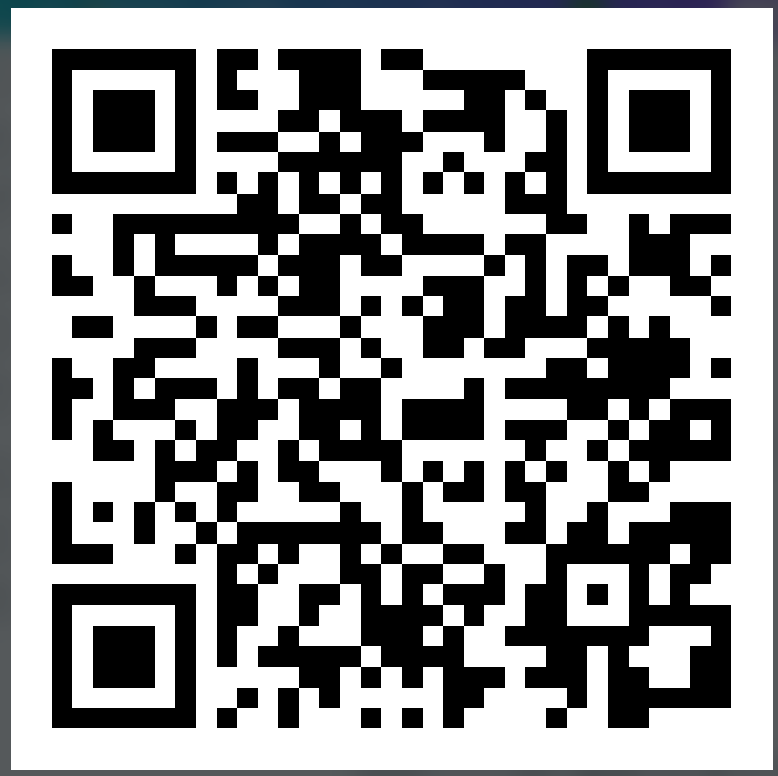
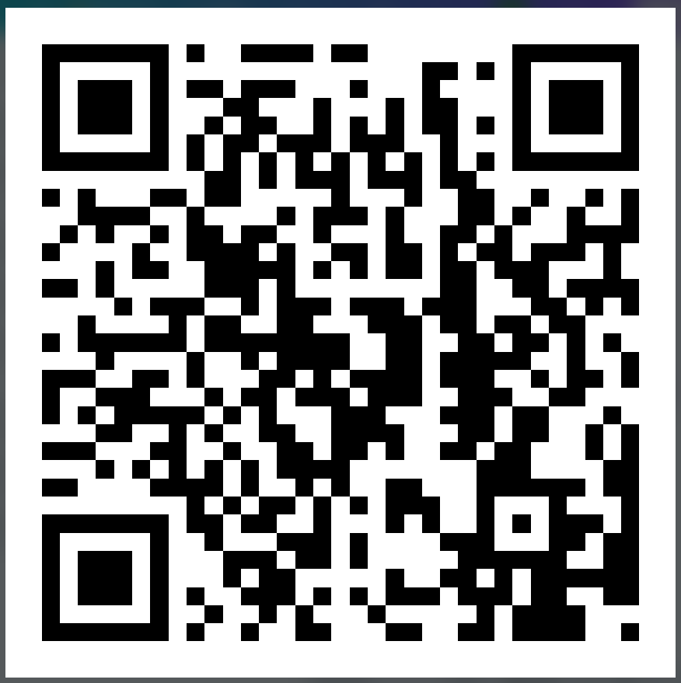
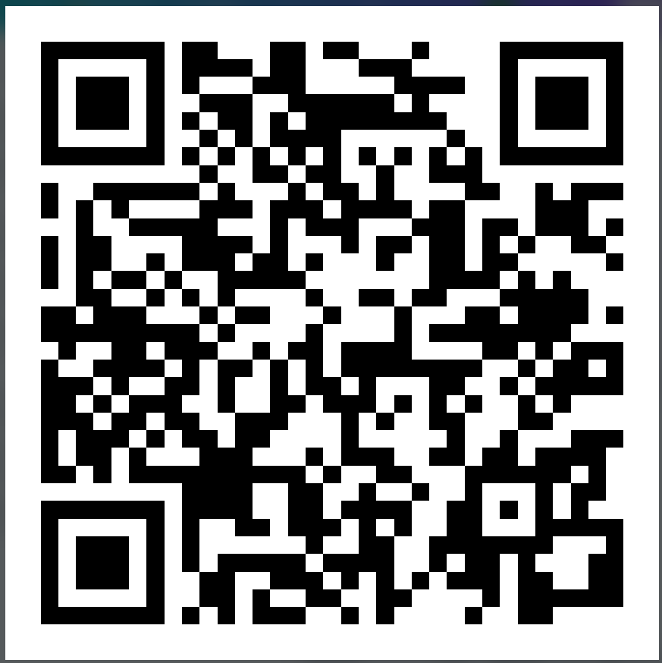
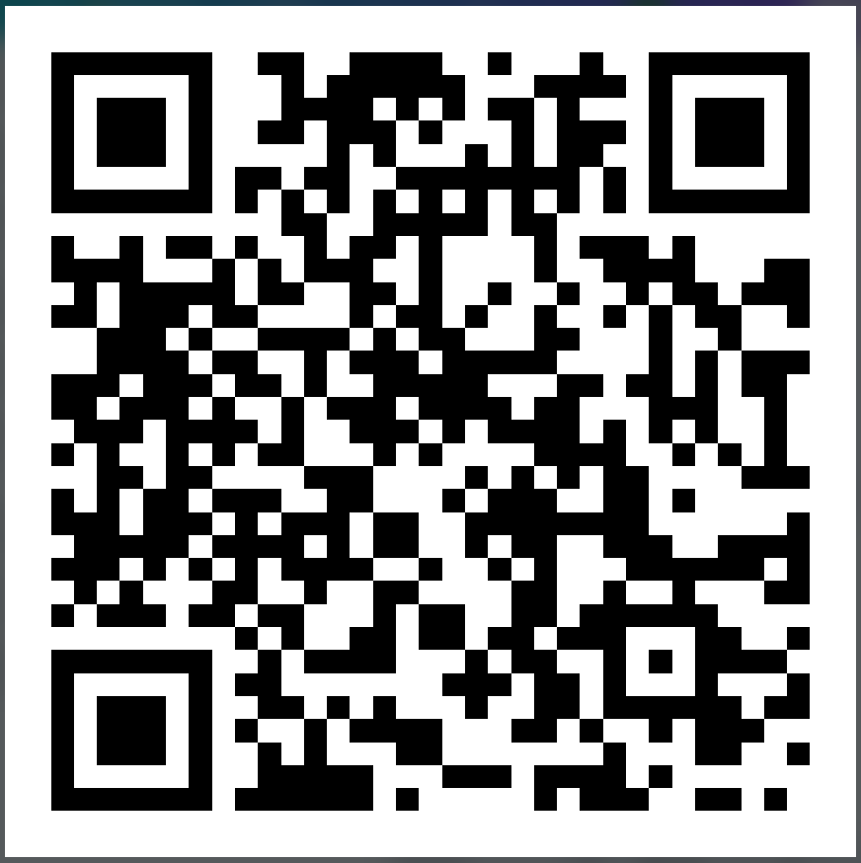
Completing a safeguarding report
Adults at risk
Children at risk
S2: Gathering information to make a report
S2:
Gathering information to make a report
S3.1: Information-gathering by the report-taker
S3.1: Responding to a report

Slide 68
What the report-maker should know following a report
The report-maker should receive written acknowledgement within seven working days.
If the report-maker hasn’t received this, they must contact social services again.
What should be clear following a report:
who took the report and their designation
what will happen next
the proposed initial action that will be taken by social services.
If social services decide not to take further action or re-directs the case to other sources of support that are more suitable, you should be provided with feedback on the decision and the reasons why.

Slide 69
Disagreeing with the decision made by social services
It is the responsibility of the individual practitioner to ensure that their concerns about a child/adult at risk of harm are taken seriously and followed through.
If a practitioner remains concerned, they must inform their own line manager and the DSP within their organisation.
Where there is a professional difference of opinion, refer to the Regional Safeguarding Board’s Protocol for Resolving Professional Differences.

Slide 70
Case scenario
Insert information for a case scenario activity here

Slide 71
Professional practice and development
As a Group C practitioner, you’re
responsible for your own continuing professional development opportunities
expected to support the safeguarding practice of others.
This includes using a variety of learning and development resources that will help you to:
reflect on learning
apply learning to your day-to-day work
share ideas and good practice after a learning activity
help work out what support or further development is needed.

Slide 72
Professional practice and development
As a Group C Practitioner, your learning and development should:
involve multi-agency learning and training opportunities where appropriate
use formal CPD logs or competency booklets to keep track of and evidence your learning and development meet the requirements of regulatory bodies
include reflective practice and other opportunities outside of usual training methods.
The main guides to learning, knowledge and training requirements:
National safeguarding training, learning and development standards
National safeguarding training, learning and development framework.

Slide 73
Professional practice and development
Your learning journey so far…
Pre-Course Video provided you with a refresh of key elements covered on Group B and offered support for completing the …
Pre-Course Workbook is to be used for ongoing reflection and learning, in addition to …
This live Group C course that highlighted fundamental elements of safeguarding knowledge and practice that all Group C practitioners have in common.
This has all been a foundation, which should be followed by further specific and specialised training.

Slide 74
Professional practice and development
Overall, you’re now expected to:
use supervision and support networks to reflect on your safeguarding practice
continually improve your safeguarding knowledge, skills and practice through training, CPD and independent learning
stay up to date with safeguarding legislation, codes of practice, and your setting’s safeguarding policies and procedures
self-assess your learning needs for your continuing professional development
undertake any additional training that’s relevant or specific to your role and responsibilities.

