Slide 1
Group C safeguarding
Adults at risk

Slide 2
National safeguarding training, learning and development standards and framework Group C
This advanced level course aims to ensure participants are
able to make decisions about keeping people safe and
know when they need to put protection processes in place
Memorable principles:
I understand everyone’s roles and responsibilities in the safeguarding process
I show the ability to make clear and proportionate decisions
I understand that having voice and control are key to decision making and person-centred practice

Slide 3
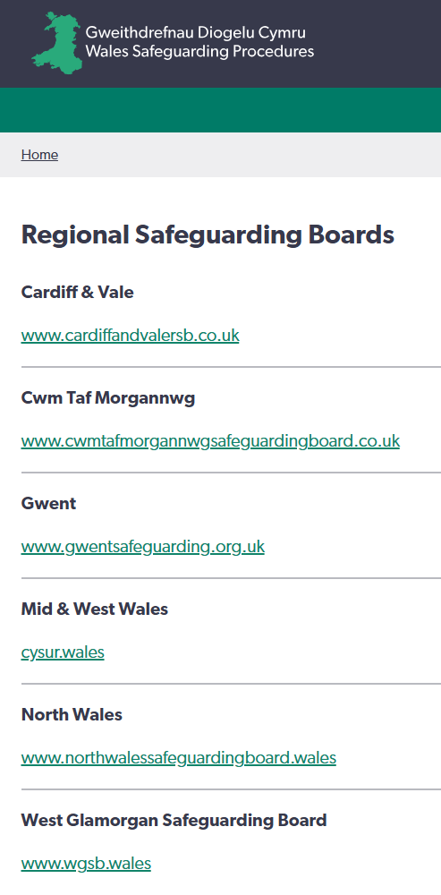
Regional Safeguarding Boards
multi-agency strategic boards of relevant partner agencies
oversee and co-ordinate multi-agency safeguarding arrangements across the region
comprised of representatives from local authorities, the local police body, local health board, NHS Trust, probation board, youth offending team and others.

Slide 4
Why am I here? This course is for people who have a higher level of safeguarding responsibility within their organisation
Group C practitioners are:
involved in protection planning and decisions around individuals in these processes
work routinely with other organisations
have direct responsibility for safeguarding:
in an assessing role linked to the safeguarding process and / or
at a level where they give advice about safeguarding to those in Group A and Group B and / or
in a setting they work in or manage and / or
people with whom they spend a lot of time unsupervised.

Slide 5
Learning
This course is part of the generic training everyone in Group C must do.
You’ll also need to do specific relevant training that will:
be different for individual practitioners even within agencies and organisations
often be defined and required by professional or regulatory bodies at a national or agency level.

Slide 6
Learning outcomes Group C
According to the standards, Group C practitioners should know:
legislation, national policies and codes of conduct and professional practice in relation to safeguarding
how to work in ways that safeguard people from abuse, harm and neglect
the factors, situations and actions that could lead or contribute to abuse, harm or neglect.

Slide 7
Learning outcomes Group C
how to report, respond to and record concerns or allegations related to safeguarding
how to promote child and/or person-centred practice
how to take part in safeguarding processes
how to support others to safeguard people (for those with supervisory responsibility)
how to work with others to safeguard people
how to maintain professional accountability.

Slide 8
Introductions

Slide 9
Learning agreement
How will we work as a group to meet our learning outcomes?

Slide 10
Roles and responsibilities after the report
Note on terminology:
As it’s the local authority social services department that responds to reports about an adult at risk of abuse or neglect, the term ‘social services’ will be used in these procedures rather than ‘local authority’.
For the purposes of these procedures a report to social services will be taken to also mean a referral.

Slide 11
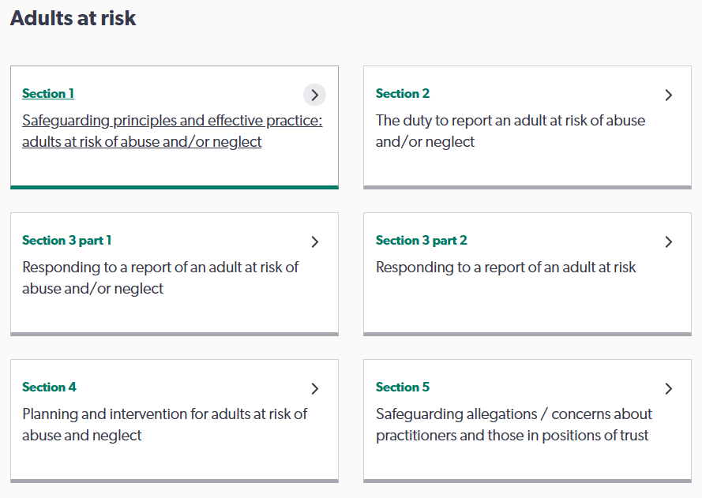
Roles and responsibilities after the report

Slide 12
The Process After a Report is Made
The process
Note:
This session is an overview of the process that all Group C practitioners may be expected to participate in.
For additional and specific roles and responsibilities, you’re expected to seek additional training.

Slide 13

Report received
The local authority has a duty to respond to a report about an adult who’s at risk of abuse and neglect.
Reports must always be regarded as serious and should be treated in the same way, without prejudice.
Enquiries should begin immediately, but aren’t the investigative part of the process - they don’t include formal investigations involving the police (although that may be the outcome).

Slide 14
Initial checks
On receiving a report, the report-taker needs enough information to:
be clear about the concern and the reason
establish whether immediate action is necessary
identify if police involvement if required
identify how and why concerns have arisen
establish if there are care and support needs
consider the mental capacity of the adult
determine if there is reasonable cause to suspect an adult is, or may be, at risk.

Slide 15
Information-gathering by the report-taker
If an adult at risk is already known to social services, a great deal of information may already be available, so the report-taker will consider any existing social services records on the adult at risk, the carers and/or past involvement by services.
Repeated unfounded reports
Sometimes, there may be repeated unfounded reports and further enquiries may not be in the best interests of the adult at risk.
When this happens, the decision not to make further enquiries and the reasons for this should be recorded after discussion with the line manager.

Slide 16
Initial decisions
*Immediate protection and urgent action is required
agencies with the relevant protection powers or with service responsibility must act quickly to secure the individual’s and others’ immediate safety.
1. No further action to safeguarding
No abuse or neglect has occurred
Report doesn’t involve abuse or neglect
One-off incident / very low of risk repetition.

Slide 17
Initial decisions
2. Section 126 enquiries are required
There’s reasonable cause to suspect the adult is at risk and further enquiries are necessary to establish whether abuse and/or neglect have occurred.
3. Adult has needs for care and support
needs assessment begins as soon as needs identified
can run alongside any enquiries into possible abuse and neglect
the report made and subsequent outcomes should inform any care and support plan.

Slide 18
Section 126 enquiries
Timescales
should normally be completed within seven working days from receiving the report.
should not be rushed – if an enquiry takes longer than seven working days, the reasons should be recorded.
when necessary, initial immediate action should be taken to protect an adult at risk.
if a strategy meeting / discussion is needed, you don’t have to wait the full seven working days.
* The safeguarding process can be concluded at any stage when appropriate actions have been taken to safeguard the adult at risk.

Slide 19
Section 126 enquiries
Include
checking general factual accuracy of report
collecting, reviewing and collating information obtained from the adult at risk and practitioners who know the adult and carers for an initial evaluation
determining what action should be taken
* Can be delegated to another agency if appropriate, but the duty to determine the outcome of the Section126 enquiries remains with social services, who have oversight of the case and remain the single point of contact.

Slide 20
Person-centred
All enquiries should be person-centred and consider:
the possibility the adult at risk is not making decisions freely
the need to involve an advocate
the need to carry out the enquiry sensitively, using a trauma informed approach to minimise distress
whether the alleged abuser is providing care or support for anyone else
the mental capacity of the adult at risk to make specific decisions at a particular time.

Slide 21
Active offer of advocacy
It’s essential that adults at risk are aware of their right to have an independent advocate to make sure their views and wishes are represented.
All practitioners have a legal duty to consider a person’s need for advocacy to enable them to participate in the safeguarding process.
This may be through independent professional advocacy or informal advocates such as family members/carers.

Slide 22
Mental capacity
All safeguarding considerations and decisions should consider the legal requirements of the Mental Capacity Act and associated Code of Practice.
The focus should be on the reduction of abuse or neglect, but should not limit the action that may be required to protect others who are at risk of harm.
The principle of the assumption of capacity doesn’t exempt practitioners from carrying out robust assessments and asking challenging and searching questions about people who are making choices that are problematic or manifestly not good for their well-being.

Slide 23
Gathering information
Remember!
Practitioners can override the duty of confidentiality where there are safeguarding concerns.
It’s important to consider the risks of not sharing information.
If there’s continued reluctance from a practitioner or partner to share information about a safeguarding concern, the matter should be referred to the Regional Safeguarding Board (RSB).
Effective s126 enquiries are dependent on gathering, sharing and analysing information about:
the concern and impact on the adult
how the adult perceives the abuse and/or neglect and what they want to happen
the context of the concern, including anyone else at risk.

Slide 24
S126 enquiry outcomes
Determination 1: immediate protection
when social services, the police, health or emergency services must act quickly to secure the immediate safety of the adult at risk or other adults/children at risk.
Determination 2: the adult is not at risk but may have care and support needs
individual should be advised and may be signposted to other agencies or services if appropriate, or may require an assessment.
Determination 3: adult at risk and action to protect needed
practitioners should ensure that multi agency discussion and planning takes place, through a strategy meeting/discussion.

Slide 25
If the adult at risk doesn’t want any action taken
First, consider:
Does the adult at risk have the mental capacity to make informed decisions about their own safety, bearing in mind the particular situation?
Are they aware of their options?
Are they making the decision free from pressure or duress from a third party?
Are there any public interest considerations?
Have they refused a care and support plan because of pressure or coercion from a third party?

Slide 26
If the adult at risk doesn’t want any action taken
Remember! In some circumstances, the wishes of the adult at risk may be overridden, such as:
high risk to their health and/or safety
others may be at risk
a crime is suspected or may have been committed against the adult
concerns relate to a failure in care, breach of regulation or professional code of conduct
coercion.
Then, record:
why no action is being taken
the findings of any initial screening
the protection arrangements offered
the work undertaken to understand the reasons for not accepting support.

Slide 27
Record of outcomes
The enquiries must be recorded in such a way that they’re available to social services in the future and include:
details of the concerns, person-centred outcomes and context
participation, including identities of all involved from point of concern onward
information provided during the enquiries and by whom
the enquiry process, including the identities of those who contribute information, were interviewed, and any documentary evidence
conclusion, including what action should be taken, evidence to support this conclusion and any possible future concerns that may arise and why.

Slide 28
Strategy meeting / discussion
A multi-agency forum to :
share information
ensure there’s an interim protection plan
consider the level of identified risk
specify roles and responsibilities, specific tasks required, issues of co-operation, communication and the best use of skills, expertise and resources
consider the wishes of the adult at risk
ensure any assessments are completed.
To determine the action to be taken to ensure the safety, care and support needs of the adult at risk are met.

Slide 29
Roles and responsibilities
Lead co-ordinator
employed by social services
qualified social worker (where possible )
arranges and chairs strategy meetings and adult protection conferences
monitors and reviews the progress of the care and support protection plan
determines whether outcomes achieved / termination of the adult safeguarding process.
Lead care and support protection plan practitioner
Actively engages with the adult at risk/advocate and takes the multi-agency lead in:
preparation, completion, review, delivery, revision of plan
co-ordinating completion of assessments
communication between all practitioners and the adult
preparing reports for review.

Slide 30
Roles and responsibilities
Practitioners attending the strategy meeting are referred to as the strategy group.
Responsibilities include:
agreeing roles and responsibilities
developing and implementing the care and support protection plan.
The strategy group must
work with the adult at risk
facilitate and promote shared decision-making
ensure the active offer of an advocate
ensure the wishes and feelings of the adult at risk are recognised and are proportionate in responding to risk.

Slide 31
Key considerations
Timescale
must take place as soon as practically possible and within seven working days of the conclusion of the Section 126 enquiries
By the end of the first strategy meeting there should be a plan which ensures that the adult at risk is safe from abuse and neglect.
Participation at a minimum includes:
adult protection personnel in police and social services
the practitioner making the report
practitioners from services working with the adult at risk, their family and carers
a doctor from the service who has/may be providing a medical examination.

Slide 32
Key considerations
Agenda
The adult at risk
Evidential issues
Perpetrator issues
Actions
Other issues
A record must be taken and saved with case notes.
Requires participants to:
share all available information
determine the course of action and timescales
agree on any assessment processes
establish how to share information with the adult at risk and who will do it
identify the needs of other adults and children at risk who may be in contact with alleged abusers.

Slide 33
Strategy meeting / discussion
outcomes
Determination 1 Immediate protection
⇩
Remove the adult from immediate risk
⇩
Further strategy meetings (as needed)
⇩
Case conference / Agree care and support
⇩
Part 4 Care and support protection plan (as needed)
⇩
Review and closure

Slide 34
Strategy meeting / discussion
outcomes
Determination 2 Adult not at risk but may have other needs for care and support services
⇩
Advise the individual that duties under Section126 have ended
⇩
Assessment under Part 3 of the Act (as appropriate)
⇩
Part 4 Care and support protection plan 
Review and closure

Slide 35
Strategy meeting / discussion
outcomes
Determination 3: Adult at risk and action to protect needed
⇩
Further strategy meetings (as needed)
⇩
Case conference / Agree care and support
⇩
Part 4 Care and support protection plan (as needed) 
Review and closure

Slide 36
Record of outcomes
Any information shared, all decisions reached, and the basis for those decisions, must be clearly recorded and circulated within one working day to all parties relevant to the discussion.
Information will be shared with practitioners who have a role in the adult safeguarding process and should be saved with case notes.
The outcome of the strategy discussion/meeting should be shared with the adult at risk, if safe to do so, unless a mental capacity assessment has indicated otherwise .
The lead practitioner is responsible for ensuring that information is shared as agreed at the strategy discussion/meeting.

Slide 37
Professional challenge
Disagreement with strategy decision
It’s essential to be able to constructively and critically challenge others’ practice and decisions.
If you disagree with the strategy meeting decision, you should make a representation to your own line manager and tell a senior manager responsible for safeguarding in social services and the police to seek an agreed consensus decision.

Slide 38
Options if unable to gain access to the adult at risk
the Court of Protection has the power to make an order under Section 16(2) of the Mental Capactity Act 2005
Section 115 of the Mental Health Act 1983 amended 1998
Section 135(1) of the Mental Health Act 2005
Common law power of the police to prevent, and deal with, a breach of the peace
section 17(1)(b) of the Police and Criminal Evidence Act (PACE);
Adult Protection and Support Orders (APSOs)
All attempts to resolve the situation should be made.
If the use of legal powers is necessary and justified, practitioners, in collaboration with their managers and legal advisor, should decide what powers are most appropriate for the situation.
Any decisions and the reasons for them should be clearly and fully recorded.

Slide 39
Adult protection conference
Held when ongoing actions are required to protect the adult at risk from abuse and neglect. The aims include:
sharing and discussing the outcome of s126 enquiries and any investigations
assessing on-going risk
to produce or revise the care and support protection plan to meet ongoing needs
identifying and agreeing any further actions required to protect the adult at risk
considering actions to be taken against the perpetrator
establishing whether adult at risk is satisfied with the outcome of the investigation.

Slide 40
Roles
Lead co-ordinator for social services ensures an adult protection conference is convened, chaired and a record is taken. Has discretion for all participation.
Chair ensures sufficient information is available for the conference to make an informed judgement.
Practitioners all those involved in supporting the adult at risk to be safe - attendance will vary depending on those involved with the adult at risk and at the discretion of the lead coordinator.

Slide 41
Responsibilities
Participants at the conference objectively analyse, in an inter-agency setting:
all the concerns and the information which has been obtained from the Section 126 enquiries and any investigations
the wishes and desired outcomes of the adult at risk
protective factors
any additional assessments required and/or completed
previous knowledge of involvement with services as an adult at risk.

Slide 42
Professional judgement
Participants then
make judgements and decisions about:
the likelihood of ongoing abuse or neglect
what future action is required to enable the adult at risk to achieve their personal outcomes
how their care, support and protection needs can be met
the intended outcomes.

Slide 43
Participation of the adult at risk
It’s important that the adult at risk’s attendance and active participation is facilitated in line with their specific needs. They should:
be involved and assisted to actively participate
help steer development of the care and support protection plan.
Important!
Attendance at the conference is not participation. The Chair needs to ensure ways are identified to support the adult to express their feelings and views effectively.

Slide 44
Active offer of advocacy
It’s essential that adults at risk are aware of their right to have an independent advocate so their views and wishes are represented.
All practitioners have a legal duty to consider a person’s need for advocacy to enable them to participate in the safeguarding process.
This may be through independent professional advocacy or informal advocates such as family members/carers.

Slide 45
Adult at risk who doesn’t wish to attend the conference
The adult at risk has the right to refuse to participate, or advise that no conference should take place.
The adult at risk should:
be consulted beforehand about their views, which should be shared at the meeting.
The reasons for their non-attendance should be recorded.
The meeting should decide and record:
who will feed back any decisions about the care, support and protection plan to the adult at risk
who the adult at risk can contact if they don’t agree with the plan or wish to comment on it.

Slide 46
Pre-conference reports
Each agency invited to attend the conference should provide the Chair with a written report two working days in advance that summarises:
basic information held about the adult at risk
up to date chronology of relevant involvement
involvement in current incident/cause for concern
any past concerns, who they were shared with, any actions taken, by who
frequency and nature of contact with the adult at risk
assessment of current issues/protective and risk factors
knowledge of adult at risk’s desired outcomes, wishes and feelings, values and beliefs.

Slide 47
Sharing reports with the adult at risk
Reports should be shared with the adult at risk before the conference, unless to do so would place them at further risk (for example, if the perpetrator has access to the report it may cause distress to the adult, or it’s not in their best interests).
It ‘s important that the adult at risk is aware of the content of any reports about them before to conference, enabling them to:
confirm they agree with the content
be prepared for what’s going to be shared with other agencies and at conference.

Slide 48
The agenda
A framework for managing the conference, the agenda can be divided into four stages:
1. Setting the scene details of the adult at risk, background to the concerns and summary of the Section 126 process.
2. Information-sharing from reports of those involved in the enquiries, wishes of the adult at risk and any other relevant information.
3. Assessing and making sense of the information to establish any further information required, including the outcome of any investigations and the implications for the adult at risk, assessment and agreement on severity of abuse and/or neglect.

Slide 49
The agenda
4. Decision-making and outcomes
decide whether any existing plans meet the adult at risk’s needs. If not, revise or develop a new care and support protection plan
decide whether legal advice and guidance is required
decide whether any statutory and/or regulatory action is necessary, such as a referral to regulators
decide which agencies will be involved in the delivery of the plan
decide whether a contingency plan is needed in case the agreed plan isn’t effective
decide how outcomes of the care and support protection plan will be measured and timescales.

Slide 50
Record
Record of adult protection conference
Records should detail and evidence the discussion and conclusion of the conference, and be shared with:
the adult at risk (where appropriate and safe)
all attendees and invitees to the meeting
all those contributing to the care and support protection plan
contract/commissioning teams as appropriate
relevant regulatory bodies, as appropriate.

Slide 51
Care and support protection plan
Devised by the strategy group, the care and support protection plan seeks to remove or reduce the risk of abuse or neglect.
The plan should focus on safeguarding by outlining care and support arrangements that specifically address protection and risk management, ensuring the adult at risk is protected from abuse or neglect and supported to achieve their personal outcomes, including services that promote recovery.
The local authority has responsibility for organising and co-ordinating the preparation of the care and support protection plan.

Slide 52
Roles and responsibilities
Lead co-ordinator for social services monitors and reviews progress of the care and support, protection plan and determines whether outcomes have been achieved.
Lead care and support protection plan practitioner actively engages with adult at risk/advocate and takes multi-agency lead.
Members of strategy group agree roles and responsibilities and developing and implementing the care and support protection plan.

Slide 53
Roles and responsibilities
Further meetings should ensure the care and support protection plan is being delivered and is achieving the agreed outcomes, or where it isn’t there’s agreement as to what changes need to be made.
All practitioners have a duty to inform the lead co-ordinator of significant events relevant to the adult at risk and to make a new report in the event of further risk or concerns being identified.
Concerns that an adult at risk is not being adequately protected must be brought to the immediate attention of their manager and designated safeguarding person.
Concerns that the plan is not working should be escalated to the lead co-ordinator. If this does not lead to a satisfactory outcome, then the Regional Safeguarding Board professional differences procedures must be followed.

Slide 54
Review
(may not always be needed)
Purpose
to ensure the strategy group has completed the actions in the plan
to ensure the adult is safe from abuse and neglect and care and support needs are met
to decide whether a plan is still needed.
Timescales
should be person-centred, reflecting the individual circumstances and protection needs
at a minimum, reviews of care and support protection plans should take place at no more than six-week intervals.

Slide 55
Review
(may not be always be needed)
What evidence is there that the care and support protection plan:
should continue and/or be revised to protect the adult at risk from abuse and neglect
is no longer required because the adult is safe from harm
It’s essential that evidence about quality changes to their lived experience, in terms of feeling and being safe, are central to decision-making.

Slide 56
Conclusion
The process concludes when there’s evidence that:
the adult is no longer at risk of abuse or neglect
or
the risks have reduced and can be managed adequately and appropriately by a single agency process
*If the adult safeguarding process ends but later the risk increases or abuse or neglect occur, a new report and enquiries should be completed.

Slide 57
Section 5: safeguarding allegations / concerns about practitioners and those in positions of trust
This section will be updated when Section 5 is launched

Slide 58
Section 5: safeguarding allegations / concerns about practitioners and those in positions of trust
S5
What
Why
When
Who
How
This section will be updated when the procedures are finalised

Slide 59
Section 5: safeguarding allegations / concerns about practitioners and those in positions of trust
Section 5 of the procedures provides guidance on managing allegations and concerns about people whose work, either in a paid or voluntary capacity, brings them into contact (directly or indirectly) with children or adults at risk, or are a trusted individual/person occupying a position of trust.
S5
What
Why
When
Who
How

Slide 60
Section 5: safeguarding allegations / concerns about practitioners and those in positions of trust
Protecting those at risk
S5
What
Why
When
Who
How
Promoting safe practice
Consistency and fairness
Meeting legal duties
Coordinating responses

Slide 61
Section 5: safeguarding allegations / concerns about practitioners and those in positions of trust
Complaint, concern or allegation?
Complaint Dissatisfaction / objection to something considered unfair, unacceptable or not meeting the standards expected.
Concern
Quality of care, poor practice, suitability.
Allegation
These procedures must be considered when it has been alleged that a person who works (directly or indirectly) with children/ adults at risk has…
S5
What
Why
When
Who
How

Slide 62
Section 5: safeguarding allegations / concerns about practitioners and those in positions of trust
behaved in a way that has harmed or may have harmed a child/adult at risk
possibly committed a criminal offence against or related to a child/adult at risk
behaved towards a child/ren or adult/s at risk in a way that indicates they may pose a risk of harm to children or adults at risk
behaved in a way in their personal life that indicates a potential risk to children or adults at risk within their identified employment/volunteering.
S5
What
Why
When
Who
How

Slide 63
Section 5: safeguarding allegations / concerns about practitioners and those in positions of trust
It’s important to establish the role the individual fulfils and the nature of the allegation/ concerns being reported.
Roles:
those whose work, either in a paid or voluntary capacity, brings them into contact (directly or indirectly) with children or adults at risk
those occupying a position of trust
those who have caring responsibilities for children or adults in need of care and support and their employment/voluntary work brings them into contact with children or adults at risk.
S5
What
Why
When
Who
How

Slide 64
Section 5: safeguarding allegations / concerns about practitioners and those in positions of trust
Nature:
Staff/volunteers of all
relevant partner agencies
regulated settings
those working within regulated activities and registered/regulated professionals
sports group leaders
other roles that bring the individual into contact with children/adults at risk
must be considered within these procedures.
S5
What
Why
When
Who
How

Slide 65
Section 5: safeguarding allegations / concerns about practitioners and those in positions of trust
The reporting person should
clearly highlight that this is a safeguarding allegation/concern in relation to a practitioner / person in position of trust
(where possible) send accompanying documentation clearly outlining what immediate safeguarding action has been taken to protect any children and adults at risk.
S5
What
Why
When
Who
How

Slide 66
Section 5: safeguarding allegations / concerns about practitioners and those in positions of trust
Question 1:
Is the person alleged to have…
behaved in a way that has or may have harmed a child or adult with care and support needs?
committed a criminal offence against a child or adult with care and support needs?
committed a criminal offence which may have a direct impact on a child or adult with care and support needs?
behaved towards someone with care and support needs in a way that indicates they’re unsuitable to work with people with care and support needs?
S5
What
Why
When
Who
How

Slide 67
Section 5: safeguarding allegations / concerns about practitioners and those in positions of trust
Question 2:
Is the person a practitioner or person in a position of trust? i.e., are they employed, volunteering or a student in a role:
working specifically and directly with children or adults with care and support needs?
that may not involve working specifically and directly with children or adults with care and support needs, but is in a position of trust because of their role?
not working directly with children or adults with care and support needs – but may bring them into contact with them in certain circumstances of a position of trust?
S5
What
Why
When
Who
How

Slide 68
Concern/allegation identified
Immediately - Notify and discuss with line manager / Designated Safeguarding Person and make a written record of allegation
Within 24 hours - Make report to social services /Local Authority Designated Officer (LADO) / Designated Officer for Safeguarding (DOS) using appropriate form and implement initial safeguarding measures
3. Within 48 hours - LADO/DoS reviews and makes
Threshold decision :
Threshold not met: employer handles through internal policies and rationale recorded
Threshold met: proceed to strategy discussion.
S5
What
Why
When
Who
How

Slide 69
Section 5
4. Within two to three working days of threshold decision –
Strategy discussion
Multi-agency meeting (Police, social services, employer, regulator) to assess immediate risks, share initial information, decide whether to progress to professional strategy meeting
5. Within five working days of strategy discussion -
Initial professional strategy meeting (PSM)
To determine investigation plans, risk management, safeguarding, employer actions, and communication. Includes social workers, employer, HR, police, regulators, and others, as appropriate.
S5
What
Why
When
Who
How

Slide 70
Section 5
6. Ongoing investigation(s)
Parallel inquiries take place (criminal, disciplinary, regulatory, child/adult protection) and interim safeguarding reviewed regularly.
7. Further PSMs (if needed)
To review investigation outcomes, adjust safeguarding plans, prepare for conclusion.
8. As soon as investigations conclude - Conclusion PSM
S5
What
Why
When
Who
How

Slide 71
Section 5
Conclusion actions:
Decision:
Substantiated / Unsubstantiated / Unfounded / Malicious
If the individual poses an ongoing risk:
Immediately after outcome where required -
DBS / regulatory referral
Referral made to regulated activity providers and personnel suppliers.
S5
What
Why
When
Who
How

Slide 72
Section 5: safeguarding allegations / concerns about practitioners and those in positions of trust
Wales Safeguarding Procedures – Section 5
Pointers for Practice: Decision Making Guidance
Pointers for Practice: Managerless Organisations
Process flowchart
Process steps and timescales.

