Slide 1
Group C safeguarding
Children and young people

Slide 2
National safeguarding training, learning and development standards and framework
Group C
This advanced level course aims to ensure participants are:
able to make decisions about keeping people safe and
know when they need to put protection processes in place.
Memorable principles:
I understand everyone’s roles and responsibilities in the safeguarding process
I show the ability to make clear and proportionate decisions
I understand that having voice and control are key to decision making and person-centred practice.

Slide 3
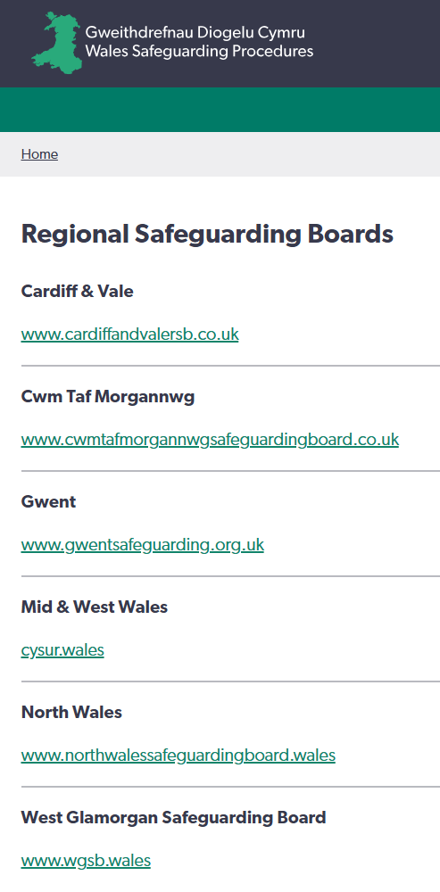
Regional Safeguarding Boards
multi-agency strategic boards of relevant partner agencies
oversee and co-ordinate multi-agency safeguarding arrangements across the region
comprised of representatives from local authorities, the local police body, local health board, NHS Trust, probation board, youth offending team and others.

Slide 4
Why am I here?
This course is for those who have a higher level of safeguarding responsibility within their organisation
Group C practitioners are those who:
are involved in protection planning and decisions around individuals in these processes
work routinely with other organisations
have direct responsibility for safeguarding:
  in an assessing role linked to the safeguarding process and / or
  at a level where they give advice about safeguarding to those in group A and group B
  and / or
  in a setting they work in or manage and / or
  people with whom they spend a lot of time unsupervised.

Slide 5
Learning
This course is part of the generic training everyone in Group C must do.
You will also need to do specific relevant training that will:
be different for individual practitioners even within agencies and organisations
often be defined and required by professional or regulatory bodies at a national or agency level.

Slide 6
Learning outcomes
Group C
According to the standards, Group C practitioners should know:
legislation, national policies and codes of conduct and professional practice in relation to safeguarding
how to work in ways that safeguard people from abuse, harm and neglect
the factors, situations and actions that could lead or contribute to abuse, harm or neglect.

Slide 7
Learning outcomes
Group C
how to report, respond and record concerns or allegations related to safeguarding
how to promote child and/or person-centred practice
how to take part in safeguarding processes
how to support others to safeguard people (for those with supervisory responsibility)
how to work with others to safeguard people
how to maintain professional accountability.

Slide 8
Introductions

Slide 9
Learning agreement
How will we work as a group to meet our learning outcomes?

Slide 10
Roles and responsibilities after the report – children and young people
Note on terminology:
As it is the local authority social services department that responds to reports about a child at risk of abuse, neglect or harm, the term ‘social services’ will be used in these procedures rather than ‘local authority’.
For the purposes of these procedures a report to social services will be taken to also mean a referral.

Slide 11
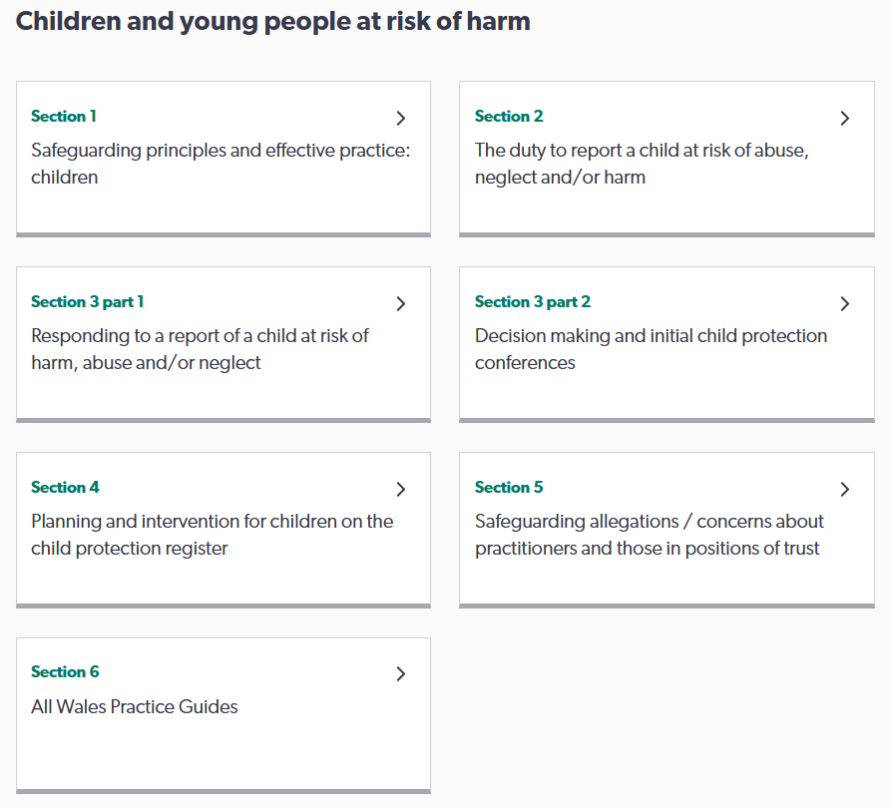
Roles and responsibilities after the report – children and young people

Slide 12

The process after a report is made
Report received
Note:
This session is an overview of the process that all Group C practitioners may be expected to participate in.
For additional and specific roles and responsibilities, you are expected to seek additional training.
Initial decision
Strategy discussion / meeting
S47 enquiries
Child protection conference
Child protection register
Care and support protection plan
Monitor and review
Conclusion

Slide 13

Report received
All reports regarded as serious and treated the same way - within 24 hours the report taker needs to:
establish the nature of the harm and whether it is significant.
gather and consider all information to determine whether the concerns raised provide a reasonable cause to suspect child is suffering or is likely to suffer significant harm.

Slide 14
Multi-agency
The report taker may need to contact other practitioners and services to gain sufficient information to determine the initial decision.
Where requested to do so, each agency or practitioner has a duty to co-operate and contribute all the relevant information and not be selective.
Remember: the safety and welfare of the child takes precedence over the need to maintain professional confidentiality.

Slide 15
Initial checks
The social services team must decide and record next actions within 24 hours.
If the report appears to constitute a criminal offence against a child, they must always discuss with the police immediately.
If the report constitutes an allegation of regulatory or care standards failure, they must discuss with their relevant safeguarding lead and follow their Regional Safeguarding Boards’ professional concerns protocol.

Slide 16
Child is not at risk, but their needs for care and support should be assessed
Report taker considers referral for a needs assessment
Consent sought from family to initiate the assessment
No further action to safeguarding
Report taker considers referral for a needs assessment and/or referral /signposting to early help services
Family advised of relevant early help services
Initial decisions
Immediate protection and urgent action is required
Reasonable cause to suspect that a child is at risk of significant harm
a strategy discussion/meeting should be held to initiate S47 Enquiries under The Children Act 1989.

Slide 17
Informing the report maker
If the decision is that there are no concerns about suspected significant harm, the report maker should be notified of this outcome and the reasons for the decision should be provided.
The practitioner who reported the concern should:
keep regular communication with the child to identify whether circumstances change
consider signposting to relevant services
record in writing the decision and reasons
if concerns continue or circumstances change, make another report.

Slide 18
Professional challenge
Effective safeguarding practice involves the use of professional challenge.
All practitioners have a responsibility to constructively and critically challenge the practice and decisions of others when disagreements about the welfare and best interests of a child arise.
If you disagree with the decision, and remain concerned about the child, you must inform your line manager and your designated safeguarding person (DSP).
“It is the responsibility
of the individual practitioner to ensure that their concerns about a child at risk of harm
are taken seriously and followed through.”
-Wales Safeguarding Procedures

Slide 19
Strategy discussion /meeting
Aim:
to gather sufficient information to determine whether S47 enquiries should be initiated and how they should be undertaken
Timescale:
within 24 hours of initial screening decision / immediately if out of hours
Note:
more than one strategy meeting/discussion may be appropriate, depending on the circumstances of the case.

Slide 20
Multi-agency participation
The report maker:
appropriate personnel from police and social services
community-based health practitioners
a consultant paediatrician
practitioners from education / childcare
other practitioners as appropriate.
All practitioners are expected to
remain open-minded and not pre-judge whether the child has been abused and neglected or the part played by the parent or carer
be authorised to make decisions on behalf of their organisation
share all relevant and available information
agree on any subsequent assessment process
establish how information is to be shared with the family and by whom
identify the needs of others who may be affected
not be afraid to challenge other practitioners.

Slide 21
Strategy decision
The child is not suffering or at risk
of suffering significant harm
The child is
suffering or at risk
of suffering
significant harm
“If a practitioner disagrees with the strategy discussion / meeting decision, he/she should make representation to their own line manager.
Consider use of Regional Safeguarding Board Resolution Protocols.”
– Wales Safeguarding Procedures
outcome recorded
family informed.
S47 enquiries initiated
family informed.
Any information shared, all decisions reached, and the basis for those decisions, must be clearly recorded and circulated
within 24 hours to all relevant parties.

Slide 22
Section 47 enquiries
Timescale:
need to be conducted within 10 working days of the strategy discussion/meeting that decided to initiate them
Aims:
establish whether a child is suffering or is likely to suffer significant harm and requires intervention to safeguard and promote their well-being
gather enough information to determine what is in the best interests of the child to protect them and promote their well-being.

Slide 23
Section 47 enquiries: roles and responsibilities
Social worker / Social services
focuses on the well-being and safety of the child
identifies actual and potential risk of significant harm
responsible for leading/managing the Section 47 enquiry.
should consult with the parent/carer, but consent for S47 enquiries is not required
must explain purpose of S47 enquiries to the parent / carer and answer questions openly, unless doing so would affect the safety and welfare of the child.

Slide 24
Section 47 enquiries: roles and responsibilities
Practitioners have a duty to co-operate and help enquiries:
understand what information is being asked of you, the concern, that S47 enquires are being undertaken and possible actions resulting from this
gather and provide information allowing informed analysis and professional judgement
establish whether the child is at risk due to parenting capacity and why.

Slide 25
Practitioners working with the child / young person
“The voice of the child is central to understanding the abuse, neglect or harm the child has or is experiencing.
It is important, therefore, that their lived experience, wishes and feelings are given due consideration.
-Wales Safeguarding Procedures
recognise children often have a clear perception of what’s needed to ensure their safety and well-being
help them understand how they can be involved and contribute to decisions
enable them to access advocacy services and other sources of support
keep them appropriately informed about decisions being made.

Slide 26
Practitioners working with the parent / carer
Practitioners are required to establish whether the child/ren are at risk of significant harm because of the parenting capacity of their parent/s or carer/s and why this might be the case.
-Wales Safeguarding Procedures
Practitioners are expected to provide:
further information about the child/family’s current situation
any actions/services which would be of immediate benefit
chronology outlining relevant involvement with the family
information about child/ren’s health and development, parenting capacity, adult-orientated issues, socio-economic factors
summary of service involvement and impact

Slide 27
The S47 enquiries conclude when an informed decision is made that the child or children is or is not at continuing risk of significant harm.
Concluding Section 47 enquiries
there may be substantiated concerns that a child has suffered abuse, neglect or harm,
but also need to be clear if there is continuing risk of abuse, neglect or harm.
there may substantiated concerns about harm,
but also need sufficient evidence to indicate significant harm.

Slide 28
Section 47 determinations
Determination 1:
Concerns of significant harm are not substantiated.
Consider:
need for care and support
benefit of early help services
regular re-assessments
management of future reports.
Practitioners
remain vigilant and make further reports in the usual way if there is a change in circumstances that indicate child is experiencing or at risk of harm.
It is the responsibility of the social worker leading the s47 enquiry to inform the family of the outcome of the enquiries i.e. the ‘determination’ and the implications of that decision.

Slide 29
Section 47 determinations
Determination 1:
Concerns of significant harm are not substantiated, but the child may have unmet care and support needs.
Consider:
plan for ensuring the child’s future safety and well-being
whether a care and support assessment is appropriate.
Determination 2:
Concerns of significant harm are Substantiated, but the child is not at continuing risk of significant harm.
Practitioners
signpost to preventative or early help services.
*A decision not to hold a child protection conference in such circumstances must be taken carefully and be child-centred and evidence-based.
It is the responsibility of the social worker leading the s47 enquiry to inform the family of the outcome of the enquiries i.e. the ‘determination’ and the implications of that decision.

Slide 30
Section 47 determinations
Determination 1:
Concerns of significant harm are not substantiated, but the child may have unmet care and support needs.
Social services should convene an initial child protection conference to decide on further protection actions required.
Determination 2:
Concerns of significant harm are substantiated, but the child is not at continuing risk of significant harm.
Report maker / practitioners
Practitioners must continue safeguarding and not delay safeguarding action because a child protection conference is pending.
Determination 3:
Concerns substantiated, and the child is judged to be at continuing risk of significant harm.
It is the responsibility of the social worker leading the s47 enquiry to inform the family of the outcome of the enquiries i.e. the ‘determination’ and the implications of that decision.

Slide 31
Aim: make decisions about the child’s future safety, well-being and development
Timing: within 15 working days of the last strategy discussion/meeting
Duration: no more than 2 hours
Child protection conference

Slide 32
Who - children at the conference
To secure child-centred practice, the voice of the child should always be heard at the conference through:
attendance
a presentation
an advocate
conference reports.
“This means understanding their daily lived experience, their wishes and feelings.
It is important that practitioners recognise that attendance alone at a conference is not participation or giving the child a voice.”
- Wales Safeguarding Procedures

Slide 33
Who - parents/carers at the conference
“Except if there are specific reasons to exclude them, parents/caregivers must always be actively encouraged to attend the child protection conference, because they should have a significant contribution to make.”
- Wales Safeguarding Procedures
support and encourage their attendance
provide practical help for transport, childcare or other responsibilities
arrange a visit to the venue
arrange to meet specific needs
encourage them to bring a supporter.

Slide 34
Who - practitioners at the conference
Who attends?
Those who have a significant contribution to make, arising from their practitioner expertise and/or their knowledge of the child or family.
All who have been invited must give priority to attending and have enough information and evidence to:
objectively analyse the situation
make professional judgements about the risk of significant harm
decide what future action is required to safeguard and promote the well-being of the child.

Slide 35
Pre-conference:
reports
All relevant agencies must
submit a written report to the chair 48 hours before the conference that focus on
  providing relevant, proportionate information to enable decision-making
  their knowledge of how socio-economic factors and parenting capacity are impacting the health and development of child
discuss and explain their reports with families at least the day before the conference, using communication methods commensurate with the needs of the various family members.

Slide 36
Pre-conference:
tasks
Practitioners should ensure they are able to:
summarise key points of their report
openly discuss professional concerns
identify ways to improve the child’s daily lived experience
make full contribution to discussion and decision making
share all appropriate information and evaluate risks
challenge / voice dissenting views.

Slide 37
At the conference
Information sharing and confidentiality
Participating practitioners have a duty to co-operate and contribute all the relevant information held on their records
Any doubt about sharing information should be discussed with the chair before the conference.
Information received during the safeguarding process must be treated in strict confidence.
All practitioners contribute to decision-making :
analysis of the implications of all information presented
consideration of and agreement about level of risk
recommendation for how risks can be managed
contribution to outline of care and support protection plan.

Slide 38
Reaching a decision
Decision making should be informed by analysing and making sense of the information shared at the conference.
The practitioners attending a conference are part of the decision-making process – they should express a view and cannot abdicate their responsibility
The views of the child and family must be taken into account, but it is the practitioners at the conference who will make the decision.
Conferences will strive to reach a consensus for or against registration, and the category/categories of registration.

Slide 39

Conference decisions
Child is not at continuing risk of significant harm but may have needs for care and support
Child is at continuing risk
of significant harm
decision by consensus
decision by consensus
parents encouraged
to continue with wellbeing assessment to determine what care and support might best help to promote the child’s well-being.
Child protection register
Care and support protection
plan

Slide 40
Child protection register
Lists all children in a local authority area who are suffering or likely to suffer significant harm and are currently subject of a care and support protection plan.
To alert all practitioners working with a child to risk of harm from abuse or neglect
To confirm care and support protection plan in place and must be complied with
To confirm that a social worker and a core group of practitioners are working with the child and family
Police, health practitioners, education and all other relevant organisations must be able to obtain this information both in and outside office hours.

Slide 41
Care and support protection plan
Ensures the child is safe, prevents further harm, and promotes the child’s well-being and development.
All Group C practitioners have a duty
to assist in contributing to outcome-focused planning that supports longer-term safety and wellbeing
to ensure the child/family understands how they will be supported to reach desired outcomes
to inform the names social worker (care and support protection plan co-ordinator) of relevant significant events or changes of circumstance to the child.

Slide 42
The plan should include
what work needs to be done, why, when and by whom
specific, achievable, child-focused outcomes intended to safeguard and promote the well-being of the child
realistic strategies and specific actions to achieve those outcomes
any support/therapeutic services which are required
developmental needs of the child and what services are required to meet those needs
clearly identified roles and responsibilities of practitioners and family members
the only measurement of success is quality
improvement to the daily lived experience of the child

Slide 43
Core
group
A multi-agency group of practitioners with responsibility for developing and delivering the care and support, protection plan.
All members
have equal ownership of and responsibility for the detailed care and support protection plan and should co-operate to achieve its aims.
have a responsibility to challenge and report concerns where they believe the plan is not protecting the child
meet at monthly - six weekly intervals.

Slide 44
By the end of the conference:
Parents and practitioners should be clear about:
the evidence of harm which resulted in the child becoming the subject of a care and support, protection plan
what needs to change
what is expected of them as part of the plan for protection and promoting the child’s well-being
the respective roles and responsibilities of family members and different organisations in implementing the plan

Slide 45
Review
conference
The review conference is tasked with making the decision as to whether a child on the register continues to be at risk of significant harm.
The first should be held within three months of the initial conference; further review conferences should be held regularly, at least every six months.
Every review conference should explicitly consider the safety, well-being and development of the child against the outcomes set out in the care and support protection plan and determine whether the child is at continued risk of significant harm.

Slide 46
Decision making
Participants include:
all practitioner members of the core group
family members
the child and/or their advocate (if appropriate)
any other relevant agencies such as those present at the initial child protection conference.
All participants consider:
Has the risk of harm to the child been reduced to the extent that the child is no longer at risk of significant harm?
Is the child likely to remain safe from harm without the continuation of the care and support protection plan?
What evidence do we have to support our judgements?
What are the parent/carers’ views on registration?

Slide 47


Review conference
Is the child at continuing risk of significant harm?
Yes
No
Does category for registration
remain the same?
Close
Care and support protection plan
No
Yes
update and remain on child protection register
update and continue
care and support
protection plan
remain on child protection register
continue
care and support
protection plan
De-register
Conclusion

Slide 48
Section 5: safeguarding allegations / concerns about practitioners and those in positions of trust
This section will be updated when the

Slide 49
Section 5: safeguarding allegations / concerns about practitioners and those in positions of trust
S5
What
Why
When
Who
How
This section will be updated when the procedures are finalised

Slide 50
Section 5: safeguarding allegations / concerns about practitioners and those in positions of trust
Section 5 of the procedures provides guidance on how to manage allegations and concerns about those whose work, either in a paid or voluntary capacity, brings them into contact (directly or indirectly) with children or adults at risk, or are a trusted individual/person occupying a position of trust.
S5
What
Why
When
Who
How

Slide 51
Section 5:
Safeguarding allegations / concerns about practitioners and those in positions of trust
Protecting those at risk
S5
What
Why
When
Who
How
Promoting safe practice
Consistency and fairness
Meeting legal duties
Coordinating responses

Slide 52
Section 5: safeguarding allegations / concerns about practitioners and those in positions of trust
Complaint, concern or allegation?
Complaint
Dissatisfaction / objection to something considered unfair, unacceptable or not meeting standards expected.
Concern
Quality of care, poor practice, suitability.
Allegation
These procedures must be considered when it has been alleged that a person who works (directly or indirectly) with children/ adults at risk has:
S5
What
Why
When
Who
How

Slide 53
Section 5: safeguarding allegations / concerns about practitioners and those in positions of trust
behaved in a way that has harmed or may have harmed a child/adult at risk
possibly committed a criminal offence against or related to a child/adult at risk
behaved towards a child/ren or adult/s at risk in a way that indicates they may pose a risk of harm to children or adults at risk
behaved in a way in their personal life which indicates a potential risk to children or adults at risk within their identified employment/volunteering.
S5
What
Why
When
Who
How

Slide 54
Section 5: safeguarding allegations / concerns about practitioners and those in positions of trust
It’s important to establish the role the individual fulfils and the nature of the allegation/ concerns being reported.
Roles:
those whose work, either in a paid or voluntary capacity, brings them into contact (directly or indirectly) with children or adults at risk
those occupying a position of trust
those who have caring responsibilities for children or adults in need of care and support and their employment/voluntary work brings them into contact with children or adults at risk.
S5
What
Why
When
Who
How

Slide 55
Section 5: safeguarding allegations / concerns about practitioners and those in positions of trust
Nature:
Staff/volunteers of all
relevant partner agencies
regulated settings
those working within regulated activities and registered/regulated professionals
sports group leaders
other roles that bring the individual into contact with children/adults at risk
must be considered within these procedures.
S5
What
Why
When
Who
How

Slide 56
Section 5: safeguarding allegations / concerns about practitioners and those in positions of trust
The reporting person should
clearly highlight that this is a safeguarding allegation/concern in relation to a practitioner / person in position of trust
(where possible) send accompanying documentation clearly outlining what immediate safeguarding action has been taken to protect any children and adults at risk.
S5
What
Why
When
Who
How

Slide 57
Section 5: safeguarding allegations / concerns about practitioners and those in positions of trust
Question 1:
Is the person alleged to have:
behaved in a way that has or may have harmed a child or adult with care and support needs?
committed a criminal offence against a child or adult with care and support needs?
committed a criminal offence which may have a direct impact on a child or adult with care and support needs?
behaved towards someone with care and support needs in a way which indicates they are unsuitable to work with people with care and support needs?
S5
What
Why
When
Who
How

Slide 58
Section 5: safeguarding allegations / concerns about practitioners and those in positions of trust
Question 2:
Is the person a practitioner or a person in a position of trust? For example, are they employed, volunteering or student in a role:
working specifically and directly with children or adults with care and support needs?
which may not involve working specifically and directly with children or adults with care and support needs, but by virtue of their role is in a position of trust?
not working directly with children or adults with care and support needs – but may bring them into contact with them in certain circumstances of a position of trust?
S5
What
Why
When
Who
How

Slide 59
S5
What
Why
When
Who
How
Concern/allegation identified
Immediately: notify and discuss with line manager / DSP and make a written record of allegation
Within 24 hours: make report to Social Services / LADO / DoS using appropriate form and implement initial safeguarding measures
3. Within 48 hours: Local Authority Designated Officer (LADO) / Designated Officer for Safeguarding (DoS) reviews and makes a threshold decision.
Threshold not met: employer handles through internal policies and rationale recorded.
  Threshold met: proceed to strategy discussion.

Slide 60
S5
What
Why
When
Who
How
4. Within two to three working days of threshold decision: strategy discussion
Multi-agency meeting (police, social services, employer, regulator) to assess immediate risks, share initial information, decide whether to progress to a professional strategy meeting
5. Within five working days of strategy discussion: initial professional strategy meeting (PSM)
To determine investigation plans, risk management, safeguarding, employer actions, and communication. Includes social workers, employer, HR, police, regulators, others as appropriate.

Slide 61
S5
What
Why
When
Who
How
6. Ongoing investigation(s)
Parallel inquiries take place (criminal, disciplinary, regulatory, child/adult protection) and interim safeguarding reviewed regularly.
7. Further professional strategy meetings (if needed)
To review investigation outcomes, adjusting safeguarding plans, prepare for conclusion.
8. As soon as investigations conclude: conclusion from professional strategy meeting

Slide 62
S5
What
Why
When
Who
How
Conclusion actions:
Decision:
Substantiated / unsubstantiated / unfounded / malicious
If individual poses ongoing risk:
Immediately after outcome where required -
DBS / regulatory referral
Referral made to regulated activity providers and personnel suppliers.

Slide 63
Section 5: safeguarding allegations / concerns about practitioners and those in positions of trust
Wales Safeguarding Procedures – Section 5
Pointers for practice: decision making guidance
Pointers for practice: managerless organisations
Process flow chart
Process steps and timescales.

