Slide 1
Welcome to Group C safeguarding course
This course is one step in a pathway to standardising safeguarding in Wales.
This includes standardisation of our ethos, key values, principles and approach to safeguarding in every sector, for everyone.

Slide 2
Group C safeguarding course
Pre-course session
This session is one part of the Group C training requirement.
It aims to:
provide you with a refresh of key elements covered in Group B training
offer support for completing the pre-course workbook.

Slide 3

Welcome to Group C safeguarding course
At certain points there will be opportunities to stop and turn to your accompanying workbook.

Slide 4
Group C safeguarding course
Workbook
The workbook is one part of the Group C training requirement.
It aims to prepare you for discussions that will take place on the live Group C course.
Completion of the workbook is a pre-requisite for attendance on the live course.

Slide 5

Group C safeguarding course
Live Group C sessions
The live sessions are intended to enable you to address and discuss fundamental elements of safeguarding knowledge and practice that all Group C practitioners have in common.
The sessions are a foundation, which should be followed by further specific and specialised training.

Slide 6
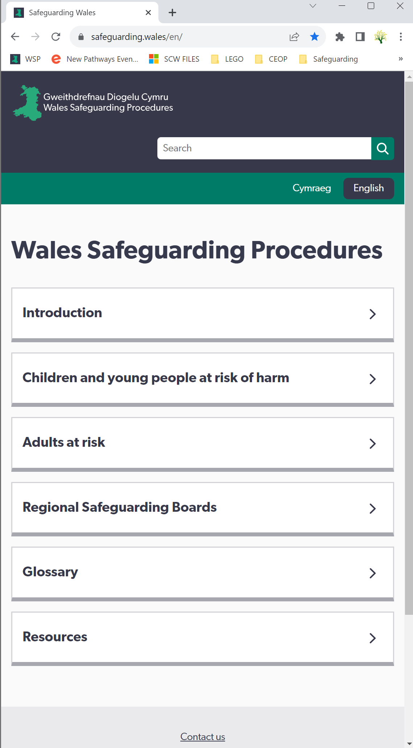
Group C safeguarding course
The primary resource for this course and all safeguarding in Wales is the Wales Safeguarding Procedures .
There are more details on all procedural information there.
You’ll also need to refer to your own safeguarding policies and procedures.
As a Group C practitioner, you’re expected to ensure all staff and volunteers:
have quick access to the Wales Safeguarding Procedures
are able to use the procedures in a practical way.

Slide 7
Outline
Background
Ensuring voice
Policies and procedures
Responding to a concern
Child/Person-centred safeguarding
Working to keep you and others safe
Legislation, statutory guidance, national policies and codes of conduct and professional practice

Slide 8


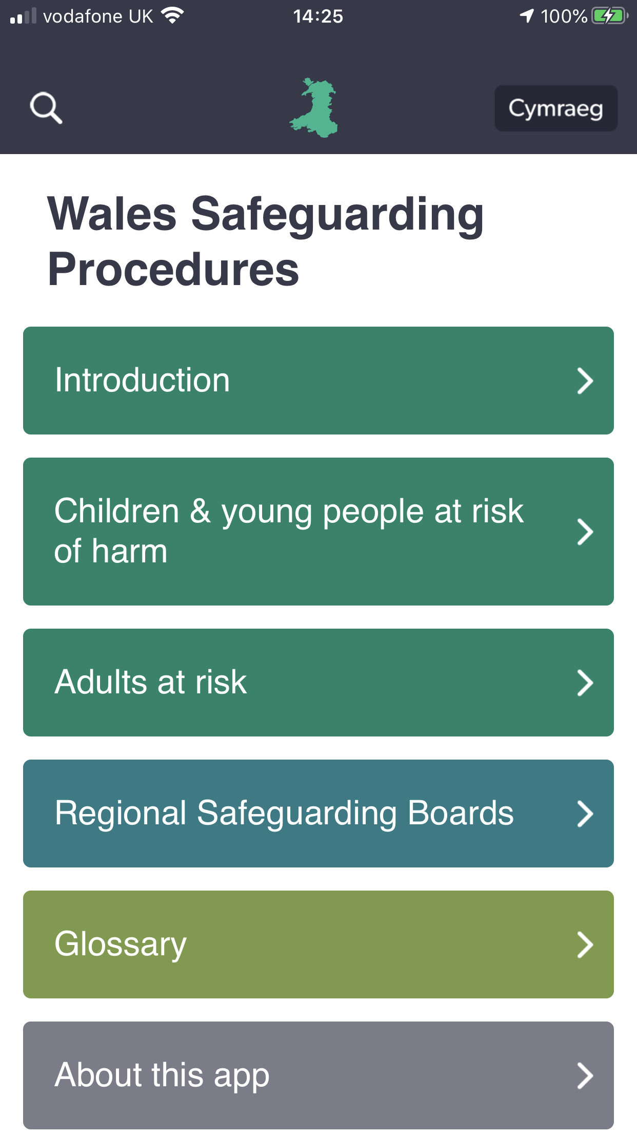
How did we get here?
Wales Interim Policy & Procedures for the Protection of Vulnerable Adults from Abuse 2010 (updated 2013)
Wales Safeguarding Procedures 2020
All Wales Child Protection Procedures 2008
Social Services and Well-being Act (Wales) 2014
Duty to report
Adult at risk
Child at risk

Slide 9
Duty to report and at risk
Duty to report includes ‘reasonable cause to suspect’ that there’s a child/adult at risk and means:
a lower threshold than ‘reasonable cause to believe’
actual abuse, neglect or other kinds of harm don’t need to happen before you intervene
risk of abuse or neglect may come from one concern or many different factors, including context and transitional periods
you don’t need to establish on a balance of probabilities that a particular fact is established
you should consider early support to safeguard someone at risk to prevent actual abuse, neglect or harm

Slide 10
From ‘vulnerable adult’ to adult at risk
‘Wales Interim Policy & Procedures for the Protection of Vulnerable Adults from Abuse’ (POVA) focused on safeguarding anyone who:
was“over 18 years of age who is or may be in need of community care services by reason of mental or other disability, age or illness and who is or may be unable to take care of himself or herself, or unable to protect himself or herself against significant harm or serious exploitation.”
had learning disabilities
had mental health problems, including dementia
were older with support/care needs
were physically frail or had a chronic illness
had a physical or sensory disability
misused drugs or alcohol
had social or emotional problems
had an autistic spectrum disorder

Slide 11
From ‘vulnerable adult’ to adult at risk
Wales Safeguarding Procedures focus on safeguarding:
“anyone over 18 years of age who is experiencing or is at risk of abuse or neglect and has needs for care and support (whether or not the authority is meeting any of those needs), and as a result of those needs is unable to protect himself or herself against the abuse or neglect or the risk of it.”
We don’t use POVA in Wales anymore.
We now use a much broader definition for safeguarding that means anyone can be an adult at risk at any point in their lives and require safeguarding intervention.

Slide 12
How did we get here?
Wales Interim Policy & Procedures for the Protection of Vulnerable Adults from Abuse 2010 (updated 2013)
Wales Safeguarding Procedures 2020
All Wales Child Protection Procedures 2008
Social Services and Wellbeing Act (Wales) 2014
Duty to Report
Adult at Risk
Child at Risk

Slide 13
How did we get here?
Wales Interim Policy & Procedures for the Protection of Vulnerable Adults from Abuse 2010 (updated 2013)
Wales Safeguarding Procedures 2020
All Wales Child Protection Procedures 2008
Social Services and Wellbeing Act (Wales) 2014
Duty to Report
Adult at Risk
Child at Risk
Notes:
(click through)

Slide 14

How did we get here?
National Safeguarding Training, Learning and Development Standards and Framework 2022
Group A Safeguarding Training E-Learning 2024
Wales Safeguarding Procedures 2020
Group C Safeguarding Training Nov 2025
Wales Trauma Informed Practice Framework 2022
Single Unified Safeguarding Review (SUSR) 2024
Group B Safeguarding Training
Nov 2024

Slide 15

Please turn to questions 1 to 4 in your workbook.

Slide 16
Safeguarding Practice
The Wales Safeguarding Procedures were a significant shift in safeguarding practice:
from a process-driven approach to one focused on improving people’s experiences and outcomes
from prescriptive procedures to a strong emphasis on using professional judgement
from addressing superficial concerns to using professional curiosity to seek root causes, patterns of behaviour, and meaningful impact
from being service-focussed (where people were seen as ‘objects of concern’ and safeguarding was a process done ‘to’ them) to being person-centered ( seeing a unique individual and planning with them).

Slide 17

Child-centred / Person-centred Safeguarding

Slide 18
Child-centred and person-centred safeguarding
Using a child-centred / person–centred approach is a key principle underpinning safeguarding practice in Wales.
It enables us to follow the safeguarding principles while upholding the rights of people.
Part of your role as a Group C practitioner is to ensure all staff and volunteers keep their focus on the child/adult at risk, whatever other needs or issues come to light, by…

Slide 19
Child-centred and person-centred safeguarding
Actively seeking their views, wishes and feelings and working with the child/adult at risk to find the best way to meet needs
Ensuring their voice is heard when working with them, their family/carers and other practitioners
Promoting and respecting their dignity, characteristics, culture, beliefs
Enabling them to be as involved as possible in decision making and empowering them to express concerns
Prioritising their best interests and rights.

Slide 20
Child-centred or person-centred safeguarding
Whenever there are safeguarding concerns, it’s best practice to use a child/person-centred approach to engage with the child or adult at risk, which means:
doing what will most benefit the person while listening to their views as far as possible - not just what is easiest or most convenient
more than just protection - it includes their emotional well-being, dignity, relationships, autonomy, and rights
additional considerations under the MCA for social workers and certain health practitioners.
Child/person-centred approaches to working with risk need consideration of the unique circumstances, case-by-case professional judgment, transparent documentation, and often multi-agency collaboration.

Slide 21
Ensuring rights
Part of your role as a Group C practitioner is to ensure all staff and volunteers support people’s rights when there’s a safeguarding concern, including:
Rights of children and young people at risk
Right to protection from harm
Right to be heard and Involved
Right to advocacy
Right to information and to be informed, in a way they understand, about safeguarding processes and decisions affecting them
Right to privacy and confidentiality and for their personal information to be handled sensitively.

Slide 22
Ensuring rights
Part of your role as a Group C practitioner is to ensure all staff and volunteers support people’s rights when there’s a safeguarding concern, including:
Rights of adults at risk
Right to Protection from abuse and neglect
Right to have their physical, mental, emotional, and social well-being respected during safeguarding processes
Right to advocacy, participation and consent
Right to information, support and clear, accessible information about safeguarding concerns, their rights, and the procedures involved
Right to liberty and family life (Article 8 European Convention on Human Rights)

Slide 23
Voice through advocacy
Advocacy plays a crucial role in enabling voice and ensuring the rights of individuals who may have difficulty representing themselves in safeguarding processes.
Advocacy promotes representation, makes sure decisions reflect the child’s/adult's wishes and protects their rights.
Advocacy needs to be considered whenever there are barriers to someone’s ability to engage and fully participate.

Slide 24
Voice through advocacy
Potential barriers to engage and fully participate include the ability to:
understand relevant information
retain information long enough to be able to weigh-up options and make decisions
weigh up information, to fully participate and express preferences for or choose between options
communicate their views, wishes and feelings, to help the decision-making process and to make priorities clear.
Remember
All children and young people are entitled to an active offer of advocacy from a statutory Independent Professional Advocate (IPA) when they become subject of child protection enquiries leading to an initial child protection conference or become looked after.

Slide 25
Voice through advocacy
Self-advocacy
Informal advocacy (family, friends, neighbours)
Collective advocacy
Peer advocacy
Citizen advocacy (a trained or supported volunteer citizen advocate)
Independent volunteer advocacy (an independent, unpaid advocate)
Formal advocacy (advocacy role of staff in health, social care, etc.)
Independent professional advocacy (IPA) (a professional, trained advocate; specific to supporting an individual in relation to their care and/or support needs)

Slide 26
Intersect: Mental Capacity Act and Wales Safeguarding Procedures
Mental Capacity Act (MCA) and Wales Safeguarding Procedures
While they serve different legal purposes, they often intersect in real-world safeguarding practice.
Understanding where and how they overlap is essential for making ethical, lawful, and person-centred decisions for people age 16 and over.
For example:
A person may not have the capacity to make a decision as to whether a report (referral) should be completed,
but they may be able to indicate where they would like any subsequent interventions to take place and who they would like to be present.

Slide 27
Key messages to remember…
Safeguarding is decision-specific, not person or group specific.
Both MCA and the Wales Safeguarding Procedures require presumption of capacity unless proven otherwise.
Best interests decision-making must involve the person at risk where possible.
You must assess capacity (MCA) while also initiating a S47 or S126 safeguarding enquiry (WSP) when abuse or neglect is suspected.
While the MCA supports autonomy, safeguarding may require override when risks justify it.
Advocacy plays an important role in both.

Slide 28
Key messages
Adults with care and support needs may be able to protect themselves from abuse, neglect and exploitation by others.
Frailty, age or disability, for example, don’t automatically preclude an individual from protecting themselves.
Mental capacity assessments are always situation specific.
Practitioners should always seek to respect the personal wishes and autonomy of the adult.
Practitioners should make sure that the person is aware of any risks and the potential impact on their safety and well-being, and encourage them to develop strategies to protect themselves.
But, there needs to be a professional judgement about the ability of an adult to make an informed choice.

Slide 29
Key messages
Area | Mental Capacity Act 2005 | Wales Safeguarding Procedures | Intersection in practice
Consent | Must be gained if adult has capacity | Consent needed unless others are at risk, or coercion suspected | Consent principles respected, but overridden if safeguarding requires immediate action
Capacity Assessment | Decision-specific; supports autonomy | Not dependent on capacity for enquiries | Both may occur in parallel; lack of capacity triggers best interest decision-making
Adult Participation | Involve adult as far as possible, even if lacking capacity | Central to safeguarding process | Adult should be supported or represented (e.g. via IMCA)
Advocacy | IMCA required if no appropriate person for best interests decisions | Independent advocacy promotes voice and representation | Advocacy used to uphold rights in both legal frameworks
Right to Refuse Help | Must be respected if person has capacity | Intervention still considered if risks justify it | Balancing autonomy with protection when serious harm is suspected

Slide 30
Please turn to questions 5 to 7 in your workbook.

Slide 31

Safeguarding policies and procedures

Slide 32
Duty of candour: volunteering all relevant information to persons who have, or may have, been harmed by the provision of services, whether or not the information has been requested, and whether or not a complaint or a report about that provision has been made.
Group C practitioners are expected to ensure everyone complies with their duty of candour – especially where there has been a safeguarding concern.
On the Group C course you’ll discuss:
1. How do you demonstrate your commitment to ensuring that the duty of candour is embedded within your organisational culture, practice, policies and procedures, and service expectations?
2. How can/do you support staff to identify and report concerns and mistakes?
3. How is duty of candour reflected in organisational policies and procedures?
4. How can/does your service use this to set expectations?

Slide 33
‘Did not attend’ vs ‘Was not brought’
As part of our Trauma Informed Approach in Wales, we’re becoming more aware of how the language and terminology we use can affect perceptions of risk.
One example of this is the terminology used when someone hasn’t attended an appointment - the phrases “did not attend” and “was not brought” are often used in safeguarding, particularly in health, education, and social care settings, to describe someone’s absence from an appointment or setting.
Each term carries different implications, and can have a significant effect on professional understanding, accountability, and action.
To make sure potential indicators of unmet need or increased risk aren’t missed, it’s important that you ensure everyone in your organisation understands the importance of knowing and following clear organisational procedures for proactively following up on non-attendance and non-engagement.

Slide 34
‘Did not attend’ vs ‘was not brought’
‘Did not attend’ (DNA)
Imprecise in safeguarding contexts, especially for children.
Places responsibility on the child/adult at risk, even when this is not in their control.
Obscures potential neglect or barriers — may overlook caregiver responsibility or safeguarding concerns.
‘Was not brought’ (WNB)
Person-centred language - Considers view of child/adult at risk
Promotes professional curiosity: Why were they not brought? Is there a pattern? Could this indicate neglect?
Highlights caregiver responsibility
Uncovers barriers to engagement
Supports better documentation and escalation when needed
Supports the need for information sharing with other practitioners

Slide 35
Please turn to questions 8 to 16 in your workbook.

Slide 36

Responding to a concern

Slide 37
Barriers to reporting concerns
Group C practitioners are expected to enable and encourage staff and volunteers to reflect upon, identify and overcome any barriers to reporting a concern.
This should be part of your regular, documented review of your safeguarding practice.

Slide 38
Responding to concerns
Group C practitioners also have a professional responsibility to recognise that their own responses to concerns can be shaped by factors that can detract away from the person at risk and influence the way decisions are made about next steps.
These may include:
subjective factors such as background, personal views, level of experience or unconscious bias
external factors like systemic barriers, resource limitations or operational issues.

Slide 39
Information sharing
Group C practitioners have a duty to ensure successful inter-agency co-operation in protecting people that’s rooted in the exchange and sharing of relevant information (a duty placed on all partner agencies).
“Information sharing is central to good safeguarding practice … When information is not shared in a timely and effective way, decisions about how to respond may be ill informed and this can lead to poor safeguarding practice and leave (people) at risk of harm.”
All Wales Practice Guides

Slide 40
Confidentiality in safeguarding
Information Commissioner's Office (ICO) and the Wales Safeguarding Procedures refer to confidential information as personal data that’s protected by law and must be handled appropriately to safeguard individuals’ rights.
Information that relates to an identified or identifiable individual
Sensitive personal information, such as:
racial or ethnic origin, health data, sex life or sexual orientation, genetic and biometric data, religious or philosophical beliefs, political opinions.

Slide 41
Confidentiality in safeguarding
We must respect confidentiality, but not at the expense of safeguarding.
Information can and should be shared with other practitioners / organisations
When there is a risk of significant harm to a child or adult at risk
Without consent if necessary, provided the sharing is proportionate and in line with legal duties
“Where there is a concern that a child or adult at risk is suffering or is likely to suffer harm, the overriding objective must be to protect them from harm.”
– Wales Safeguarding Procedures

Slide 42
Boundaries of confidential information
UK law, GMC guidelines, ICO guidelines and the Caldicott principles
do not prevent sharing personal information for the purposes of safeguarding
do provide a framework so relevant and proportionate personal information is shared safely and appropriately when necessary.
Group C practitioners are expected to:
use their professional judgement when making decisions about what information to share and when
follow their organisation’s procedures and any information sharing agreements in place.

Slide 43
Boundaries of confidential information
“In exceptional circumstanes, personal information can be lawfully shared without consent where there is a legal requirement or the professional deems it to be in the public interest.
One of the exceptional circumstances is in order to prevent abuse or serious harm to others.”
Working Together to Safeguard People - Volume 1
The safety and welfare of a child/adult at risk always takes precedence over the need to maintain professional confidentiality.
Be sure to record any request and your response in writing, making sure the nature and legitimate purpose for sharing is clear.

Slide 44
Please turn to questions 17 to 20 in your workbook.

Slide 45

Working in ways that keep you and others safe

Slide 46
Working in ways that keep you and others safe
As a Group C practitioner, you’re expected to work in ways that keep you and others safe from abuse, harm or neglect.
This includes making sure there are policies and strategies in place to assess and manage risks to practitioners' safety when working with individuals or in potentially challenging environments, including lone working.

Slide 47
Working in ways that keep you and others safe
This may include making sure staff and volunteers understand and follow:
job descriptions and codes of conduct
organisational policies and procedures
contracts/service level agreements
government guidelines
legislation

Slide 48
Working in ways that keep you and others safe
Whistleblowing is a vital process for identifying risks to people's safety.
Part of your role as a Group C practitioner is to help make sure all staff and volunteers are:
aware of their duty to report concerns about the behaviour of others
aware of your organisation’s whistleblowing procedures
encouraged and able to raise a concern about any form of misconduct.

Slide 49
Please turn to questions 21 to 23 in your workbook.

Slide 50

Legislation, statutory guidance, national policies and codes of conduct and professional practice

Slide 51
Legislation, statutory guidance, national policies and codes of conduct
There’s a great deal of legislation, statutory guidance, national policies, standards and codes of conduct that must be referred to and complied with when safeguarding.
As a Group C practitioner, it’s important to know which ones are particularly relevant for your role and for your service or organisation.
You should also be aware of how your safeguarding practice and the safeguarding policies and procedures of your organisation integrate with them to support people’s right to be protected from abuse, harm and neglect.

Slide 52
Professional practice and development
As well as being responsible for your own safeguarding practice and development, Group C practitioners are expected to support the safeguarding practice of others.
This can be done by:
carrying out regular, documented reviews of your safeguarding practice to identify gaps in knowledge, experience or skills
continually improving safeguarding knowledge, skills and practice through training, CPD and independent learning.

Slide 53
Please turn to questions 24 to 27 in your workbook.

Slide 54

Next steps

Slide 55
Group C course
Pre-course session
This resource is one part of the Group C training requirement.
Its aim was to:
provide you with a refresh of key elements covered on Group B
offer support for completing the pre-course workbook.

Slide 56
Group C course
Workbook
This resource is one part of the Group C training requirement.
Its aim is to prepare you for discussions that will take place on the live Group C course.
Completion of the workbook is a pre-requisite for attendance on the live course.

Slide 57
Group C course
The live Group C course
is intended to address and discuss fundamental elements of safeguarding knowledge and practice that all Group C practitioners have in common.
It’s a foundation, which should be followed by further specific and specialised training is expected .

Slide 58
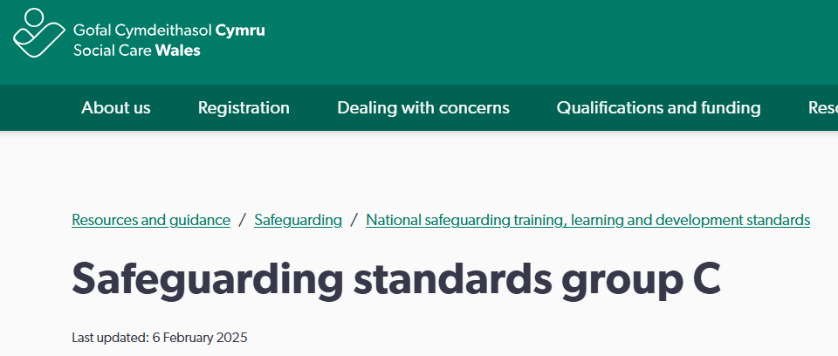
More information
There’s more information about Group C roles, responsibilities and training, knowledge and skills requirements on the Social Care Wales website:
https://socialcare.wales/resources-guidance/safeguarding-list/national-safeguarding-training-learning-and-development-standards/safeguarding-standards-group-c

