Slide 1
Leadership resources

Slide 2
Module one
Introduction to the Social Services
& Well-being (Wales) Act 2014

Slide 3
Overview
A set of resources that can be used by strategic leaders, managers and Regional Partnership Boards to help them understand their duties and responsibilities under the Social Services and Well-being (Wales) Act and to make best use of that Act in their respective organisations and communities
Notes:
Facilitator Notes
‘Getting in on the Act’ is a programme of support and resources that has been developed to support strategic leaders and senior managers, including Regional Partnership Boards, in implementing the Social Services and Well-being (Wales) Act 2014 (the Act).

Slide 4
Aimed at …
Directors and senior managers in local authorities (including housing, education and social services)
Elected members
Senior managers for partnership in local health boards
Senior managers in partner organisations and relevant third sector organisations
Lead board members in local health boards
Representatives of people with care and support needs, and carers involved in Regional Partnership Boards
Notes:
Facilitator Notes
These resources are relevant to the full range of partners involved in making the Act work effectively across Wales.

Slide 5
They cover…
Module 1: Introduction to the Social Services and Well-being (Wales) Act 2014
Overview of the Act, its principles and intentions
How it relates to other legislation
Module 2:
Part 9 – Co-operation and
What’s required by the Act
Roles and responsibilities
Module 3: Making Regional Partnership Boards work
Good practice governance
Decision making
Managing stakeholders
Module 4: Strategic transformation
Key themes of the transformation agenda
Tools for transformation
The leadership task
Module 5: The leadership challenge
Overview of the aims and principles of the Act
Collaboration and integration agenda
Opportunities for wider agencies to support this and the leadership challenge they face
Notes:
Facilitator Notes
The full suite of materials incorporates five modules in total:
Module 1 gives a general introduction to the Act and is relevant to the full range of partners involved in making the Act work effectively across Wales.
Modules 2, 3 and 4 are designed specifically to support Regional Partnership Boards. They cover the roles and responsibilities of partner agencies in delivering the aims and objectives of the Act and the associated leadership tasks including improving partnership and integration, managing transformation, culture change and integration and placing people at the heart of their care and support.
Module 5 is for leaders working across the wider health and social care system in Wales, and specifically, not those who are members of Regional Partnership Boards.

Slide 6
Each module…
Module 1: Introduction to the Social Services and Well-being (Wales) Act 2014
Overview of the Act, its principles & intentions
How it relates to other legislation
is designed to be used flexibly with Boards, partner agencies and their stakeholders
includes PowerPoint slides with facilitator’s notes and suggested discussion points
includes supplementary materials such as checklists, self-assessments and examples
Module 2:
Part 9 - Co-operation and
What’s required by the Act
Roles and responsibilities
Module 3: Making Regional Partnership
Boards Work
Good practice governance
Decision making
Managing Stakeholders
Module 4: Strategic Transformation
Key themes of the transformation agenda
Tools for transformation
The Leadership Task
Module 5: The Leadership Challenge
Overview of the aims and principles of the Act
Collaboration and integration agenda
Opportunities for wider agencies to support this and the leadership challenge they face
Notes:
Facilitator Notes
Each module includes a set of PowerPoint slides, which are intended as a set of standalone ‘tools’. They are written for learning facilitators and include suggested group discussions, points of reflection and examples that facilitators can use either in their entirety or to pick and choose from as they see fit when designing a learning programme based on the PowerPoint presentation.

Slide 7
Additional resources
Care Council for Wales Information and Learning Hub (http://www.ccwales.org.uk/getting-in-on-the-act-hub/)
Social Services Improvement Agency Interactive Guide to Implementation of the Social Services and Well-being (Wales) Act (http://www.ssiacymru.org.uk/home.php?page_id=8914)
Notes:
Facilitator Notes
Further information and resources can be found at these two websites.

Slide 8
Module one
Introduction to the Social Services
& Well-being (Wales) Act 2014

Slide 9
Module objectives
To understand the principles of the Act in relation to people, well-being, prevention and collaboration
To understand its structure and content, and other key legislation that will impact on its implementation
Notes:
Facilitator Notes
Remind participants that this is intended to give a brief and generic overview of the Act.
Possible discussion activity – What is the purpose of this training session for you? What do you hope will be different as a result of this training?
It is helpful at the start of a session to identify who is in the room – their professional background, role and organisation. The questions above can help you understand participants’ motivation. It is important to encourage people to think about: their individual motivation (what they want to change and why), their responsibilities, and supports in their workplace that will help them use this learning.

Slide 10
Contents
Introduction to the aims and principles of the Act
The Act in relation to other key pieces of legislation:
The Well-being of Future Generations (Wales) Act 2015
The Regulation and Inspection of Social Care (Wales) Act 2016
The Local Government (Wales) Act 2015
Notes:
Facilitator Notes
Give a brief outline of what module one is going to cover.

Slide 11
Introduction to the Act
The Act came into force in April 2016
It replaces many previous laws and gives effect to the policy set out in Sustainable Social Services for Wales: A Framework for Action
It brings in new duties and covers adults, children and carers
Notes:
Facilitator Notes
Draft guidance on repeals and transitions in relation to the Act can be found here.
The Act addresses issues and challenges faced by public services in Wales, which were highlighted by the 2011 White Paper Sustainable Social Services for Wales: A Framework for Action, such as demographic changes and increased expectations from those who access care and support.

Slide 12
Social Services and Well-being (Wales) Act In a nutshell...
Puts people at the centre of their care and empowers them to maximise their own well-being
Shifts the focus to prevention by encouraging people to use their own, family and community resources
Encourages partnership working and collaboration between organisations that provide care and support
People
Well-being
Prevention
Collaboration
Notes:
The Act came into force on 6 April 2016. It aims to reform and simplify the law, and repeals and replaces many previous laws and guidance relating to care and support.
The Act builds on the White Paper Sustainable Social Services for Wales: A Framework for Action and a broad political consensus to change and modernise the law for care and support in Wales.
The Act brings in new duties for local authorities, local health boards and other public bodies, and covers adults, children and carers. It brings a completely new approach to care and support, where help is provided earlier to prevent the need for intensive and costly care down the line.
Explain that the Act has at its heart four key principles, which you will talk through shortly.

Slide 13
The parts of the Act
1. Introduction
2. General Functions
3. Assessing the Needs of Individuals
4. Meeting Needs
5. Charging and Financial Assessment
6. Looked After and Accommodated Children
7. Safeguarding
8. Social Services Functions
9. Co-operation and Partnership
10. Complaints and Advocacy
11. Miscellaneous and General
Notes:
Facilitator Notes
The Act is made up of 11 parts which all, except Part 1, have regulations, codes of practice or statutory guidance that underpin them and give more detail.
Part 1 is an overview of the whole Act and defines some key terms such as ‘carer’
Part 2 includes the well-being and other overarching duties. Module Two focuses on Part 9
Part 3 defines the circumstances in which an authority must assess a person’s needs for care and support or a carer’s needs for support, and how assessments are carried out
Part 4 defines the national eligibility criteria and how people’s needs should be met
Part 5 identifies how local authorities may charge for providing or arranging care, support, or preventative services
Part 6 sets out local authority responsibilities under the Act for looked after children, arrangements for leaving care, and secure accommodation for children
Part 7 brings in new, statutory safeguarding arrangements, including a duty to report an adult or child at risk and for authorised officers to apply to the court for an “adult protection and support order”
Part 8 specifies the social services functions of local authorities and provides grounds for intervention by Welsh Ministers where they have failed
Part 9 requires local authorities to promote co-operation with their relevant partners, and imposes a duty to co-operate with each other. It also establishes Regional Partnership Boards
Part 10 provides for complaints about social services and new rights to complain about private social and palliative care. It also provides for advocacy services so that individuals can engage and participate; or arrange an independent advocate in certain circumstances
Part 11 brings a range of provisions and notably the duty to meet the care and support needs of individuals in the secure estate, such as prison or youth detention

Slide 14
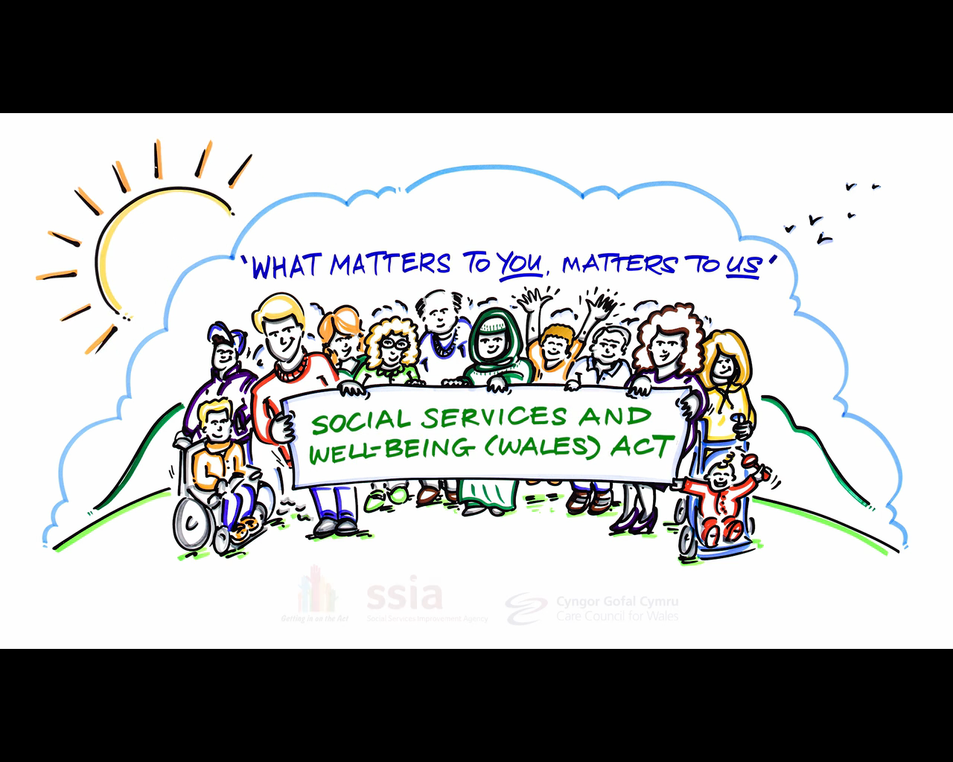
1. People
Notes:
Facilitator Notes
Explain that you will now talk through each of the of the four principles in turn – 1) People, 2) Well-being, 3) Prevention and 4) Collaboration.
One of the key aims of the Act is for people to be at the centre of decisions and to be supported to have choice and control of their lives.
This picture is taken from a short animated film developed by the SSIA called ‘what matters to you, matters to us’. It shows that to give people a strong voice in, and control over, their care and support you need to tap into the resources that people themselves, their families and the community, have. People – children, young people, adults and carers, their families and their communities – are rich assets and have skills, expertise and capabilities.

Slide 15
1. People
A culture shift from the way in which services have often been provided, to an approach based on an equal relationship between practitioners and people who need care and/or support
A requirement to work co-productively with groups and communities, to foster direct engagement through new or existing networks or forums with service users, or groups representing service users (eg. citizen panels)
Notes:
Facilitator Notes
What matters are the outcomes that are important to the individual. This will mean working ‘with individuals’ rather than ‘doing to them’.
At an individual level practitioners must take a co-productive approach. Co-production refers to a way of working whereby practitioners and people work together as equal partners to plan and deliver care and support.
Evidence suggests people want to be more actively engaged as partners, that services frequently underestimate their willingness, and that the potential impact of harnessing this contribution could have huge economic value and lead to better outcomes.

Slide 16
1. People
Enables people to take control and make well-informed choices
Vital component of prevention
Helps people’s full participation
Notes:
Facilitator Notes
Providing high quality and timely information and advice is central to the success of the vision for the care and support system set out in the Act.
Not only does information and advice help to promote people’s well-being by increasing their ability to exercise choice and control, it is also a vital component of preventing or delaying people’s need for care and support, and carers’ needs for support. Providing high quality and timely information and advice should be considered to be a preventative service in its own right.
Without access to timely advice and information, people don’t understand what they are entitled to from the state, can’t make the best decisions about funding care, and are unable to choose the best quality care and / or support for the situation in which they find themselves. In other words, without it they can’t fully participate in their own care and support.

Slide 17
2. At the heart of the Act Well-being
A person exercising functions under this Act must seek to promote the holistic well-being of people who need care and support and carers, and not be limited just to their own specialist interest
Notes:
Facilitator Notes
Everything that is in the Act is included to promote people’s well-being. People have a responsibility for their own well-being – supported by their families, friends and communities, but they may also need support to achieve well-being. Professionals and agencies are there to provide some of this.
Part 2 of the Act requires “any persons exercising functions under the Act to seek to promote the well-being of people who need care and support and carers who need support.” This duty applies to practitioners when, for instance, carrying out assessment or providing information and advice.
Possible discussion activity – You could ask participants – in pairs or small groups – to jot down how they think of well-being for themselves, and what priority would they rank the factors that influence their own well-being. Then, direct people to a ‘Well-being Handout’ which gives the definition of well-being used in the Act. Ask them how their definition compares to the one in the handout. Are those factors the same or different to what might be experienced by people who need care and support, and if so, what makes the difference?
Well-being is defined by eight common aspects, for example, the “suitability of living accommodation” and two more that are specific to either children or adults, for example, the “physical, intellectual, emotional, social and behavioural development” for a child; and “participation in work” for an adult. While they all have equal importance, some aspects of well-being are likely to be more relevant to one person than another which requires a flexible approach for each individual.
Part 2 of the Act requires “any persons exercising functions under the Act to seek to promote the well-being of people who need care and support, and carers who need support.”
Promoting well-being includes focusing on preventing the need for care and support and stopping people’s needs from escalating as well as providing people with the information, advice and assistance they need to take control over their day-to-day life.
Possible discussion activity – You could ask participants – in pairs or small groups – to jot down how they think of well-being for themselves, and what priority would they rank the factors that influence their own well-being. Then, direct people to a ‘Well-being Handout’ which gives the definition of well-being used in the Act. Ask them how their definition compares to the one in the handout. Are those factors the same or different to what might be experienced by people who need care and support, and if so, what makes the difference?

Slide 18
3. Prevention
Preventative
Intensive
More well-being support
Increased level of early intervention/prevention services
Better access to information, advice and community resources
Less need for intensive managed support
Notes:
Facilitator Notes
This is a diagrammatic representation of the principles and assumptions underpinning the Act. The key assumption is that through an increased level of effective earlier intervention/preventative services, including better access to information and advice for everyone, and well-being support for those who need some help (the left-hand side of the care and support spectrum), more people will be able to be supported without need for managed intensive support. Hence the dotted line moves to the right: fewer citizens will need care and support planning for managed, complex care.
The Act attempts to rebalance the focus of care and support to prevention and earlier intervention – increasing preventative services within the community to minimise the escalation of needs to a critical level. The Act also recognises carers’ vital input and aims to help them maintain their caring role, which of course will often help the people they care for to postpone the need for more managed, complex care.
Promoting prevention needs to happen at a strategic, operational and individual level by local authorities and their partners. The Part 2 Code of Practice identifies ways that local authorities can ‘do’ prevention on a strategic level by setting out tools, methodologies, services and behaviours. This will require a robust population assessment and good partnership working to collect, analyse and act on information about the needs and outcomes that are important to the population.

Slide 19
3. Prevention
To help prevent, delay or reduce needs for care and support
To promote the upbringing of children by their family
To minimise the effect of people’s disabilities
To help prevent abuse or neglect
To enable people to live as independently as possible
To reduce the need for: care or supervision orders; criminal proceeding against children; taking children into local authority care or secure accommodation
Notes:
Facilitator Notes
Local authorities must ensure a range and level of preventative services. Local health boards must also take a preventative approach to help achieve these aims.
Links to the duty to undertake a population assessment, which should help local authorities identify the current range of preventative service available.
This alone is not enough. Crucially, local authorities will need to promote a culture of prevention, identify those who may benefit from preventative services, and promote re-ablement. Staff should feel empowered to work with service recipients to deal with issues preventatively.
However, prevention is wider than social services. All areas of local authorities (e.g. housing, leisure and education) and local health boards must take a preventative approach that helps to achieve the bullet points above, collaborating where appropriate.

Slide 20
4. Collaboration
There should be an integrated approach to the development of services, care and support, which focus on opportunities for prevention and early intervention
This applies to the NHS, local authorities, the private and voluntary and community sectors
Notes:
Facilitator Notes
Local authorities should work with a range of partners to develop and deliver preventative services. All areas of the local authority (e.g. housing, leisure and education, as well as social care) must take a preventative approach in collaboration.
Requirements on local authorities to promote the integration of care and support with health and health-related provision, with a view to improving well-being, prevention and raising quality.
Partnership arrangements to be prescribed through regulations both between local authorities, and between local authorities and local health boards.

Slide 21
4. Collaboration: Why is it needed?
To improve care and support, ensuring people have more say and control
To ensure joint leadership of the assessment and responses to people's needs, and to eliminate duplication of effort
To improve outcomes, and health and well-being
To provide co-ordinated, person-centred care and support
To make more effective use of resources, skills and expertise
Notes:
Facilitator Notes
There are many different elements that make up a person’s well-being. In terms of assistance to improve well-being, therefore, people often need support from a broad mix of health and social care services, from a variety of organisations. Its in their best interests if those services work closely together.
The benefits of collaboration are widely acknowledged and have been recognised in order to achieve more than individual partners can achieve on their own.

Slide 22
4. Collaboration: What are the priorities?
Bring together key partners to determine where the integrated provision of services, care and support will be most beneficial to people within their region
Older people with complex needs and long-term conditions
People with learning disabilities
Carers, including young carers
Integrated family support services
Children with complex needs (disability/illness)
Care homes’ pooled budgets
Notes:
Facilitator Notes
Regional Partnership Boards will need to prioritise the integration of services in relation to these particular population groups.

Slide 23
What changes will you see in response to the Act?
An in-depth shared regional population assessment with shared plans for working across agencies to meet needs more effectively
Better quality information, advice and assistance for the public to help them make good health, well-being and care choices
A wider range of community, well-being and preventative services, particularly delivered through social enterprises, aimed at supporting people’s well-being in the community
More constructive and mature relationships with the independent sectors including a market sufficiency analysis
More effective early help services for those beginning to struggle
Notes:
Facilitator Notes
Talk through some of the key practical implications of the Act.

Slide 24
What changes will you see in response to the Act?
More holistic, proportionate assessments and record keeping, reduced bureaucracy
Assessments in partnership, based on the individual’s overall situation
Stronger regional safeguarding arrangements for children and adults, and duties on professionals to report suspicions
Clearer advocacy requirements
Regional Partnership Board ensuring more pooled budgets and integrated provision
More pooled budgets and integrated health and social care services

Slide 25
Other relevant legislation
The Well-being of Future Generations (Wales) Act 2015
The Regulation and Inspection of Social Care (Wales) Act 2016
The Local Government (Wales) Act 2015
Notes:
Facilitator Notes
Let the audience know that you will briefly go through other legislation which complements the Social Services and Well-being (Wales) Act.

Slide 26
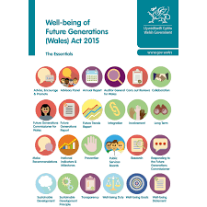
Well-being of Future Generations (Wales) Act 2015
Aims to …
improve social, economic, environmental and cultural well-being of future generations in Wales
Who?
Welsh Ministers
Local authorities
Local health boards
Public Health Wales NHS Trust
Velindre NHS Trust
National park authorities
Fire and rescue authorities
Natural Resources Wales
Higher Education Funding Council for Wales
Arts Council of Wales
Sports Council of Wales
National Library of Wales
National Museum of Wales
Notes:
Facilitator Notes
This new law will mean that, for the first time, the public bodies listed must do what they do in a sustainable way. They need to make sure that when making their decisions they take into account the impact they could have on people living their lives in Wales in the future.

Slide 27
Well-being of Future Generations (Wales) Act Two underpinning elements
Well-being duty:
Sustainable development principle:
Each public body listed in the Act must work to improve the economic, social, environmental and cultural well-being of Wales
They must set and publish well-being objectives and take action to achieve those objectives
They must act in a manner which seeks to ensure that the needs of the present are met without compromising the ability of future generations to meet their own needs
This includes through long-term planning, prevention, integration, collaboration and engaging/involving the public

Slide 28
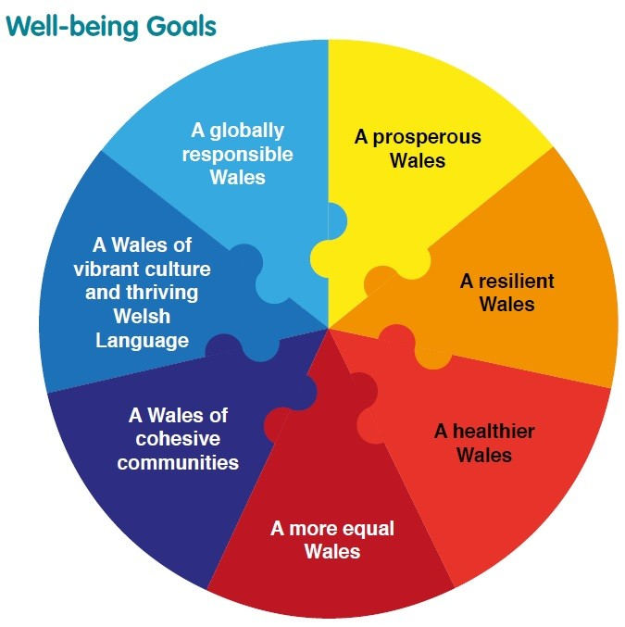
Well-being of Future Generations (Wales) Act National well-being goals
Notes:
Facilitators Notes
The Act puts in place seven well-being goals:
A prosperous Wales: An innovative, productive and low carbon society that recognises the limits of the global environment and therefore uses resources efficiently and proportionately (including acting on climate change); and that develops a skilled and well-educated population in an economy which generates wealth and provides employment opportunities, allowing people to take advantage of the wealth generated through securing decent work.
A resilient Wales: A nation that maintains and enhances a biodiverse natural environment with healthy functioning ecosystems that support social, economic and ecological resilience, and the capacity to adapt to change (for example, climate change).
A healthier Wales: A society in which people’s physical and mental well-being is maximised and in which choices and behaviours that benefit future health are understood.
A more equal Wales: A society that enables people to fulfil their potential no matter what their background or circumstances (including their socio-economic background and circumstances).
A Wales of cohesive communities: Attractive, viable, safe and well-connected communities.
A Wales of vibrant culture and thriving Welsh language: A society that promotes and protects culture, heritage and the Welsh language, and which encourages people to participate in the arts, and sports and recreation.
A globally responsible Wales: A nation which, when doing anything to improve the economic, social, environmental and cultural well-being of Wales, takes account of whether doing such a thing may make a positive contribution to global well-being.

Slide 29
Well-being of Future Generations (Wales) Act Relationship with SSWb Act
Set of well-being goals and an assessment of well-being in the local area, linked to the Social Services and Well-being (Wales) Act population assessment
Clear agenda for preventing problems arising
Strong focus on integration and collaboration
Involving people in achieving the well-being goals
Develop local well-being statements and report annually on progress against their well-being objectives
Local Public Service Boards by local authority area
Notes:
Facilitator Notes
Describe some of the common themes across both Acts.

Slide 30
Well-being of Future Generations (Wales) Act Public Service Boards
Each Public Service Board will include the local authority, the local health board, three Welsh fire and rescue authorities, the national resources body for Wales
Each Public Service Board must also invite Welsh Ministers; the chief constable for the police area within the local authority area; certain probation services; at least one body representing relevant voluntary organisations; and the police and crime commissioner for a policing area
Notes:
Facilitator Notes
The Act will reform integrated community planning by establishing Public Service Boards, with the aim of reducing duplication and streamlining the number of statutory plans and strategies that local authorities and their planning partners need to produce.

Slide 31
Well-being of Future Generations (Wales) Act Public Service Boards must...
assess the state of the economic, social, environmental and cultural well-being in its area
set objectives that are designed to maximise the Public Service Boards’ contribution to the well-being goals
consult on and publish a Local Well-being Plan setting out how it will meet its objectives
carry out an annual review of their plan showing their progress

Slide 32
Well-being of Future Generations (Wales) Act PSB links with Partnership Boards
Assessment of the well-being of the local area (which varies across Wales)
Role in ‘place-shaping’
Ensuring services are developed with sustainability in mind
Assessing the impact of activities on the local area

Slide 33
Regulation and Inspection of Social Care (Wales) Act 2016
Aligns with the Social Services and Well-being (Wales) Act 2014 and seeks to ensure that social services in Wales are sustainable
Builds on the success of regulation in Wales and reflects the changing world of social care
Places service quality and improvement at the heart of the regulatory regime and strengthens protection for those who need it
Regulation will move beyond compliance with minimum standards, and focus more on the quality of services and the impact they have on people receiving them
Notes:
Facilitator Notes
This Act aims to improve the quality of care and support in Wales and strengthen protection for citizens.

Slide 34
Regulation and Inspection of Social Care (Wales) Act What does it deliver?
Greater accountability on social care providers and an outcomes-based approach to regulation of care and support
The regulator can press for improvement across one care setting or a provider’s entire range of services
Easier for the regulator to act where care is considered beyond repair.
Ensures annual reports are produced and published by all providers of social care in Wales so that performance can be scrutinised and compared
Introduces a new requirement for local authorities and Welsh Ministers to report on the stability of the care sector, now and in the future
Social Care Wales will combine responsibility for workforce regulation, workforce development and service improvement within one body

Slide 35
Regulation and Inspection of Social Care (Wales) Act What does it deliver?
Reflects the fundamental principles of the Social Services and Well-being (Wales) Act and provides the legislative framework for regulation and inspection
Focus on outcomes and looks beyond compliance to quality of provision
It has five significant areas of provisions:
Service regulation
Local authority social services
Market oversight
Social Care Wales
Workforce registration
Notes:
Facilitator Notes
Describe some of the links between both Acts.
This Act supports the aims of the Social Services and Well-being (Wales) Act 2014 which enshrines the rights of people using care and support services into law.

Slide 36
Regulation and Inspection of Social Care (Wales) Act What should you expect to see?
Greater transparency of services, including information on workforce and how staff are developed, financial information, and records of complaints and actions taken
Greater involvement of citizens, people with care and support needs and their carers/families in service provision and design
Flexibility in the service models offered, including user-led services, social enterprises and co-operatives
Better information sharing between providers and commissioners to inform what care is needed to meet the needs of local people
Notes:
Facilitator Notes
Talk through some of the key practical implications of the Act.

Slide 37
Local Government (Wales) Act 2015
Preparation for a number of voluntary local government mergers in 2018
Streamline delivery arrangements and reduce complexity
Generate the scale and capability to sustain and improve services
Strengthen the governance, scrutiny and delivery of services
Develop the right leadership, culture and values for public services
Improve the performance and performance management of services
Notes:
Facilitator Notes
This Act is the first of two proposed bills that will deliver local government reform in Wales. The purpose is to establish new counties by the merger of existing counties and county boroughs, to establish a new and reformed legislative framework for local government democracy, accountability, performance and finance, and to establish a statutory Public Services Staff Commission.

Slide 38
Local Government (Wales) Act 2015 How?
Reduce number of authorities from 22 to 12 principal local authorities, and integrate service delivery through aligning health board and police force boundaries
Voluntary mergers from 1 April 2018 and abolition of existing boundaries from 31 March 2018

Slide 39
Local Government (Wales) Act 2015 Links with SSWb Act?
Greater emphasis on working across boundaries
Significant changes in organisational, local and regional structures
People moving into newly defined roles and jobs
Whole system change, providing challenges for keeping the ‘show on the road’ versus opportunities for real transformation of public care services

Slide 40
Discussion
What are the key leadership priorities or challenges facing partners in implementing the Act in the next period?
How can partners use the Act to help achieve your strategic priorities?
What impact will the other new legislation have on the delivery of the SSWb Act? What other challenges will it bring?
Notes:
Facilitator Notes
Suggest 15 minutes discussion in pairs or small groups followed by 10 minutes feedback as a whole group.
Bring the presentation to a conclusion reminding participants about the aims of the legislation for individuals and the cultural shift to a new way of working. Reinforce the “doing things differently” message, changing the care and support system, and early intervention and prevention.

