Slide 1
Assessing and Meeting the Needs of Individuals in the Secure Estate

Slide 2
Aims and learning outcomes
This training explores Part 11, Chapter 1, of the Act and how it applies to adults in the secure estate
By the end of the training participants will:
  Understand the aims and ethos of the Act
  Be aware of the duties and powers under the Act
  Have explored the care and support pathway for adults in the secure estate
  Understand the implications of assessing and meeting the care and support needs of adults in the secure estate
  Understand the need for effective working across agencies, including a consideration of values, culture and communication
  Reflect on the implications of the Act

Slide 3
Contents
Introduction and overview of the Act
Adults in the secure estate
Care and support pathway: pre-sentence and on reception
Care and support pathway: assessing and meeting needs in the secure estate
Care and support pathway: pre- and post-release
Summary

Slide 4
Introduction
The Social Services and
Well-being (Wales) Act was implemented on 6 April 2016
It replaces many previous laws and gives effect to the policy set out in Sustainable Social Services for Wales:
A Framework for Action
It brings in new duties and covers adults, children and carers
People
Well-being
Prevention
Collaboration
Notes:
[FACILITATOR’S NOTE: This slide has animation. The bullets on the left appear when the slide opens. The first click will show the box and first bullet point within the box (People). The second click will bring in the second bullet point (Well-being), etc.]

Slide 5
The parts of the Act
1. Introduction
2. General Functions
3. Assessing the Needs of Individuals
4. Meeting Needs
5. Charging and Financial Assessment
6. Looked After and Accommodated Children
7. Safeguarding
8. Social Services Functions
9. Co-operation and Partnership
10. Complaints and Advocacy
11. Miscellaneous and General

Slide 6
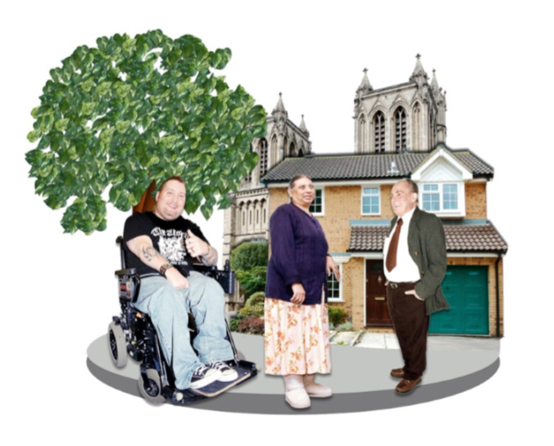
The well-being duty
Responsibility for well-being must be shared with people who have needs for care and support
A person exercising functions under this Act must seek to promote the well-being of people who need care and support, and carers who need support
Notes:
[FACILITATOR’S NOTE: This slide has animation. The picture and quote box will show when the slide opens. The first click will show the top right sentence.]

Slide 7
Other overarching duties
Views, wishes and feelings of the individual
Promote and respect the dignity of the individual
Provide support to enable them to participate
Characteristics, culture and beliefs
Best placed to judge their own well-being
Promote the adult’s independence where possible

Slide 8





Human rights in custodial settings

Slide 9
Adults in the secure estate

Slide 10
Adults in the secure estate
Mental health
Very high levels of alcohol misuse
Increasing numbers of older people
Physical disabilities
Learning difficulties
Women prisoners – release and resettlement challenges

Slide 11
The secure estate
Agencies:
  National Offender Management Service (NOMS)
  National Probation Service (NPS)
  Community Rehabilitation Company (CRC)
  Youth Offending Teams (YOT)
  Health provision
  Local authorities
Provision:
  Prisons
  Approved premises
  Bail accommodation
  Youth detention
Notes:
[FACILITATOR’S NOTE: This slide has animation.]

Slide 12
Which local authority is responsible for adults?
All adults detained in Wales
Local authorities in Wales with secure estate establishment(s) within their boundaries
All adults detained in England
Local authorities in England with secure estate establishment(s) within their boundaries
Notes:
[FACILITATOR’S NOTE: This slide has animation.]

Slide 13
Portability and cross-border arrangements
Release from or transfer within the
secure estate
The responsible local authority may change
Continuity of care
The ‘sending’ local authority notifies the ‘receiving’ local authority
Cross-border arrangements
Principles of cross-border continuity of care within
the United Kingdom
Notes:
[FACILITATOR’S NOTE: This slide has animation.]

Slide 14

Transition
Which local authority is responsible for young people who become 18 in the secure estate?
  The local authority where the prison is located
  OR
  The home local authority for care leavers

Slide 15
Exemptions
Direct payments
Preference for accommodation
Property protected
Be a carer

Slide 16
Care and support pathway:
Pre-sentence and on reception

Slide 17
Pre-sentence
National Probation Service
Completes pre-sentence report (PSR)
National Probation Service
Identifies any care and support needs while completing the PSR
Ask the adult’s home local authority for details of any existing care and support plan
Does the person appear
to have needs for care
and support?
If yes, consider
a referral to the adult’s home local authority if released
If yes, notify the secure estate establishment if sentenced

Slide 18
On reception in the secure estate
Secure estate staff
Undertake first night screening and Basic Custody Screening Tool (BCST) within 72 hours
Health staff
Undertake preliminary health screening and second healthcare initial assessment within
72 hours
Make enquiries to the adult’s home local authority
Does the person appear to have needs for care and support?
If yes, refer to local authority with secure establishment within its boundary
Notes:
[FACILITATOR’S NOTE: This slide has animation.]

Slide 19
Care and support pathway:
Assessing and meeting needs in the secure estate

Slide 20
Assessing the needs of individuals
The right to an assessment based on
the appearance of need for care and support, regardless of the level
of need
Aims to simplify assessments through
a single process for children and adults
in the community or secure estate
Personal circumstances
Personal outcomes
Barriers to achieving outcomes
Strengths and capabilities
Risks
Notes:
[FACILITATOR’S NOTE: This slide has animation.]

Slide 21


What matters conversations
A focus on personal outcomes
Sharing power and speaking as equals
Exploring what is important to the person seeking care and support

Slide 22
Advocacy
Might this person experience barriers in participating fully?
Can they be better supported to enable them to overcome barriers?
[Reasonable adjustments under the Equality Act 2010]
☑ Provide support
and make adjustments
Yes
Yes
Do they still experience barriers in participating fully?
Is there an ‘appropriate individual’ – a carer, friend or relative – that can support them to participate fully?
☑ Agree ‘appropriate individual’
Yes
Yes
☑ Duty to arrange for independent professional advocate
No
Notes:
[FACILITATOR’S NOTE: This slide has animation.]

Slide 23
Meeting the needs of individuals
Safeguarding:
If safeguarding issues or concerns are identified, report them
Advocacy:
If people need help
to participate, ensure assistance or advocacy is available
Local authority assessment
Does the person have needs for care and support?
If needs are not eligible
Signpost to information, advice and assistance (IAA) and preventive services
If needs are eligible
Develop a care and support plan, and share with individual and key partner agencies
If a care and support plan already exists
Consider re-assessment
IAA service
Preventive services
Local authority to work with the individual, and the secure estate while they are detained, to deliver the care and support outlined in the plan
Notes:
[FACILITATOR’S NOTE: This slide has animation.]

Slide 24
Care and Support (Eligibility) (Wales) Regulations 2015 – adults
The need arises from the adult’s physical or mental
ill-health, age, disability, dependence on alcohol or drugs, or other similar circumstances
Ability to carry out self-care or domestic routines
Ability to communicate
Protection from abuse or neglect
Involvement in work, education, learning or in leisure activities
Maintenance or development of family or other significant personal relationships
Development and maintenance of social relationships and involvement in the community
Fulfilment of caring responsibilities for a child
As a result the adult is not able to meet that need, either alone, or with the support of willing others, or with the assistance
of services in the community
As a consequence they are unlikely to achieve one or more personal outcomes unless the local authority provides or arranges care and support

Slide 25
Format and content of plans
Principles
Well-being, person-centred and outcome-based
Clear and concise
Format of plans
Based on NMDS
Agreed by the local authority and health board
Content of plans
Outcomes
Actions and how monitored
Need for support and resources
Welsh language built in
Safeguarding
Integrated

Slide 26
Care and support pathway: pre- and post-release

Slide 27
Pre-release preparation
NPS / CRCW
Instigate release preparation meeting…
to consider adult’s resettlement plan
Release Preparation Meeting
Considers accommodation, care and support, and health needs
NPS / CRCW makes referrals as appropriate
Adult’s home local authority undertakes
an assessment or review of the plan
Housing
Undertake a housing assessment
Health staff
Undertake health needs assessment

Slide 28
Homelessness pathway milestones
Prior to custody
  Prevent loss of accommodation if possible
Upon reception
  Basic Custody Screening Tool parts 1 and 2 includes housing risk
12 weeks prior to release
  NPS / CRCW review the individual resettlement plan
66 days prior to release
  NPS / CRCW undertake critical review of accommodation
7 days prior to release
  Make offer of suitable accommodation
Day of release
  Home local authority can provide relief duties

Slide 29
Summary

Slide 30
Summary of responsibilities for adults with care and support needs
Stage | Agency | Responsibility
Pre-sentence | National Probation Service (NPS) | Complete pre-sentence report
On reception | Secure estate | Undertake screening
On reception | Health | Undertake health assessment
In custody | Local authority | Assessment and care planning
Pre-release | Community Rehabilitation Company Wales | Instigate release preparation
Pre-release | Housing | Undertake housing assessment

Slide 31

Summary
The setting and procedures may be very different, but the principles and duties in the Act all apply
Being person-centred, promoting well-being, and taking a preventive approach are key principles
Use of the national eligibility criteria to ensure consistency of process
Interagency collaboration and partnership working
are crucial
Effective planning and preparation for release

