Slide 1
Part 1: Awareness
Notes:
This slide to be shown as participants enter the room.

Slide 2

Notes:
This slide may be shown when welcoming everyone to the course and performing introductions. Before starting the course, it is common for the facilitator to provide instruction on:
Location of facilities
Fire alarms and exits
Use of mobile phones
Taking of notes
Arrangement of groups
Tea/coffee break
Course evaluation forms
The exact details required here will depend on the venue. The presenter should know if a fire alarm test is due but should anyway indicate fire exits and procedures, the location of toilets and arrangements for the break and the organisation of seating within the room.
The availability (or not) of a hearing loop should be noted. People with a visual impairment should be invited to come closer to the front. It may be necessary to ask if everyone is warm enough, or if they want any windows to be opened.
If translation facilities are to be provided, then people who will require translation should be invited to collect a headset and to check that they are functioning correctly.

Slide 3
Introduction
Notes:
Today is about the difference that technology can make to people’s everyday lives.
This short introductory section provides a brief overview of how the course is structured and describes its learning objectives.
It concludes with a short discussion of how we all use technology everyday to make our life easier or better.

Slide 4
Course programme
Session 1 – Introduction and the Welsh context
Session 2 – Assistive technology and technology enabled care
Break
Session 3 – Example applications with case studies
Session 4 – Keeping up to date and future trends
Review, question and answer
Notes:
The course has been split into four sessions each of approximately 45 minutes.
Sessions two and three are separated by a 15 minute refreshment break.
Please refer to the Facilitator Guide for more information on course structure and timings.

Slide 5
Learning objectives (1)
Realise that technology is all around us and is used to make life safer and easier for everyone
Understand why we need to consider the use of technology to help people to live fulfilling lives
Be inspired by the ways that different services and products can be used to support independent living
Notes:
The main aim of this course is to make participants aware of the range of technologies that are available to support everyone, from children to older people.
It should also inspire them to think more about the potential of technology to improve people’s well-being and quality of life.

Slide 6
Learning objectives (2)
Be able to recognise different options for support using technology based on a person-centred approach
Find out about local service provision and referral routes
Be aware of future developments and how to keep up to date with the latest developments
Notes:
The main aim of this course is to make participants aware of the range of technologies that are available to support everyone, from children to older people.
It should also inspire them to think more about the potential of technology to improve people’s well-being and quality of life.

Slide 7
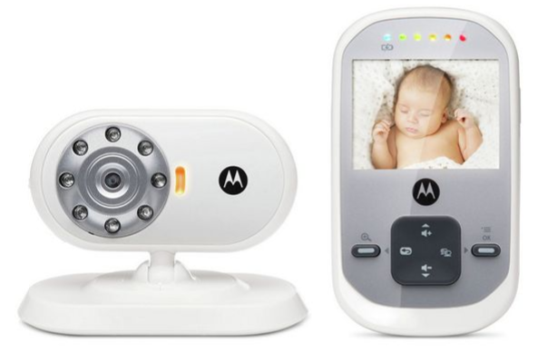
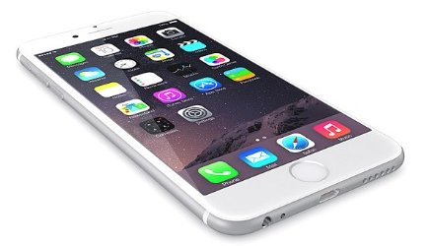
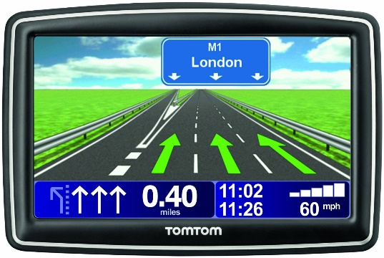
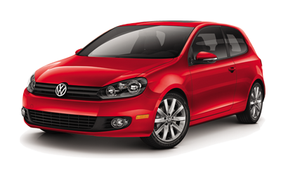
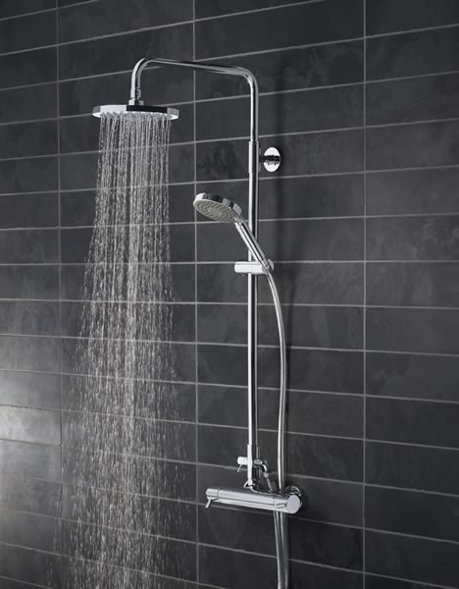
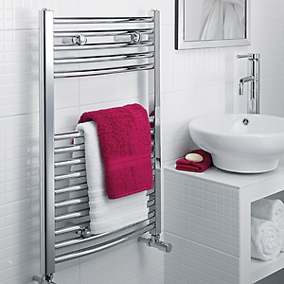
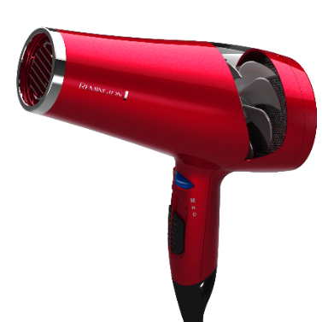

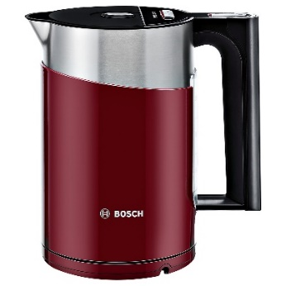
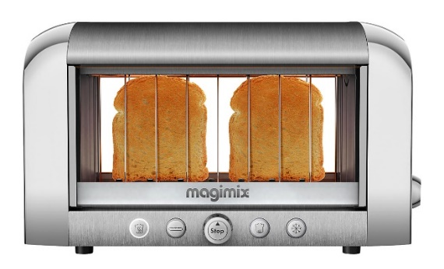
The difference technology can make for
Who else?
Children
Technology can help
everyone
get on with their lives!
People with learning disabilities
People with sensory needs
Who?
You and me!
People with cognitive impairments
Older people
Technology is integrated into our lives.
Often we don’t even notice it!
Carers
Notes:
This slide is animated. With this slide, there is an opportunity to make a little joke about how often people are on their smartphones to check the news/emails/messages or social media – the smartphone image is designed to shake in-between various other tasks performed in the morning.
Technology can and does make a real difference to people’s lives every single day. Where would we be without all those gadgets and apps that help make our lives easier, more convenient or more fun? Stop and think for a moment about the technology you’ve already used today… Maybe it started with a bedside alarm clock (or an app on your smartphone) – or perhaps you were woken by the crying of your baby which is transmitted to your bedside using a baby-monitor. So, you switch on the light on in your bedroom, and appreciate how nice and warm it feels thanks to the central heating. After a nice warm shower you take the towel off your towel heater to get warm and dry. Maybe you used a hairdryer to dry your hair while checking the news and weather for the day quickly on your smartphone. Perhaps you flicked through some of your messages or e-mails and your calendar to see what events you had on today. A quick game of Crossy Road or Candy Crush perhaps before heading downstairs to make a nice cup of coffee with your shiny espresso machine which you drink with a nice warm piece of toast that popped out of your electric toaster…
Then you get into your car to drive to the training today, maybe you used your GPS navigation to find it – and relied on the ultrasound parking sensors to avoid bumping the car when parking! You get the point by now I’m sure. We all use technology to make our lives easier. We just take so much of it for granted, sometimes we don’t even consider it to be ‘technology’ anymore; especially when we compare it to the most recent Internet connected thingamajig in our gadget collection – and the fact that it rarely goes wrong!
It is important to recognise the contribution technology can make to support a broad range of people who have care and support needs. The list on the slide provides examples of different groups of people but clearly there are many other people with care, support, health or housing needs who could benefit.

Slide 8
Session 1: The Welsh context
Notes:
The first session sets the context to the course by discussing some background drivers relevant to Wales.

Slide 9
Population of Wales is approximately = 3,092,036
The number of people who provide unpaid care in Wales…
Dependency ratio
Between 2014 and 2039 …
Approximately
6 per cent
of those aged 65 and over
live alone
(that’s nearly 400,000 people)
(highest proportion of older people in the UK)
The population is ageing, and local authority funding is falling
292,000 (44 per cent)
384,056
0-15
65-74
90+
75-84
Care capacity
Aged 16 - 64
Aged 65+
Demand
85-89
16-64
( £8.1 billion a year )
The number of people needing care, and those needing care for longer
95,000 (5 per cent)
65+ | 85+ | 90+
614,747 | 78,866 | 28,825
20% | 3% | 1%
Source: ONS Compendium of UK statistics: population and migration (7 February 2014)
Notes:
This slide is animated and shows that an estimated 384,056 people provide unpaid care to family and friends in Wales, saving the state £8.1 billion a year.
Not only are more people caring but they are caring for longer. Since 2001, the number of people providing 20-29 hours of care a week has increased by almost a third (31 per cent) and those providing 50 hours of care or more a week has increased by nearly a quarter (23 per cent). The number of people needing care, and those needing care for longer periods of time, has increased significantly since 2001.
Wales has a population with the highest proportion of older people in the UK. The population of Wales is approximately 3.1 million of which approximately 615,000 people are aged 65 or over. Of these approximately 197,000 are aged between 75 and 84 and about 79,000 are aged 85 or over. Approximately 6 per cent of those aged 65 and over live alone.
The number of people in Wales aged 16-64 is projected to decrease by 95,000 (5 per cent) between 2014 and 2039; whilst over the same period the number of people aged 65 and over is projected to increase by 292,000 (44 per cent). These figures are used to calculate the dependency ratio (i.e. the ratio of the number of people of working age to the number of people of state pension age). It provides an indication of the number of people of working age who will be able to support and care for older people. The chart shows quite dramatically the projected fall in the dependency ratio for Wales over this period.
We need to look at working smarter with the resources that we have at our disposal.
Technology will have a part to play alongside carers and care and support services.

Slide 10
Consequences of an ageing population…
More people will have:
  Long term conditions such as dementia, diabetes and depression
  Physical, sensory or cognitive disabilities
  Reduced confidence to live independently, and with good quality of life
What do we look for?
Source: Alzheimer’s Society Dementia UK update 2nd edition (November 2014)
Source: Age UK, Later life in the United Kingdom (February 2016)
Source: Welsh health survey, 2005/06
Notes:
This slide is animated. Different charts appear on each click.
Because the population of Wales is ageing, it will lead to a big increase in the number of people suffering form various long-term conditions, including dementia, which shows an enormous age dependence. In the same way, both eyesight and hearing decline with age.
These deficits mean that people wont be as independent as they would like and this may have an impact on their quality of life.
The challenge is to identify what the issues are for people.

Slide 11
Living independently – the key factors
Security
News and information
Shopping for groceries
Using the telephone
Dressing
Bathing
Relationships
Leisure
Preparing meals
Getting beyond walking distance
Activities of daily living
Instrumental activities of daily living
Quality of life
Managing finances
Personal grooming
Transferring
Using the toilet
Entertainment
Safety
Managing medications
Doing light housework
Company
Giving care
Walking
Eating
Washing clothes
Education
Comfort
Notes:
The Activities of Daily Living identify fundamental functions in our daily lives. Many individuals require support and assistance to undertake these tasks whilst living in their own home or within a care home. However, support to achieve such fundamental functions is not sufficient to enable and ensure individuals’ well-being and a good quality of life.
The tasks identified as the Instrumental-Activities of Daily Living are also important aspects associated with living independently. The slide demonstrates that there are many different elements which are important to people’s well-being and quality of life.
What is important to individuals and families will be different. People’s circumstances, their strengths and capabilities and the outcomes they want will vary. In order to support people to have a good quality of life it is important to recognise that this involves much more than meeting basic functions and needs.
11

Slide 12
Drivers for changing care and support
Focus on personal well-being outcomes
Family members not living locally
Higher expectations
Changing attitude to positive risk taking
Improving technologies at lower costs
Costs of care and support
Notes:
There are a number of drivers which influence the changing approach to care and support, including legislation and policy across health and social care. These place the individual or citizen at the centre of care and support and requires a shift to develop more responsive and sustainable systems. Personal well-being outcomes is the focus of the Social Services and Well-being (Wales) Act 2014 – there is more detail on this in the next slide.
Current care provision will be unsustainable without change, due to:
Increased demand as the population ages;
Many people living without family members living locally to provide support;
Increased expectations of care and support; and
Changing attitudes about people’s rights to take risks.
However, technology is improving and responding to people’s needs, while costs are decreasing, making it more accessible to individuals and organisations who support people.

Slide 13
Possible care and support options
Care or nursing home
Respite foster care
Employ carers (domiciliary care or personal assistants)
Support from family or friends (informal care)
Find alternative (risky) ways of coping
Use technology or community equipment
Notes:
Many people can find some daily living tasks difficult due to illness, disabilities or where they live. Care and support needs can be met in a variety of ways in response to what matters to people and the outcomes they want.
A move into a care home works for some people, but most individuals wish to stay in their own home, living independently with support, such as from Social Care workers or personal assistants. They may provide support to undertake some daily living tasks and help people with their shopping, paying bills or going to work.
As we know family or friends often provide the most care and support. When none of these solutions is available (or wanted), people try to cope by finding alternative ways of doing things. For example, if they can’t walk upstairs they might sit on a stair and lift themselves up step by step. This is a high risk approach and is likely to lead to accidents sooner or later.
An alternative is to use technology to make these domestic tasks simpler and safer. Some, such as walking aids and toilet frames, are issued through community equipment services, but others are more specialised and may not be available through traditional sources, even though they are extremely cost-effective.

Slide 14

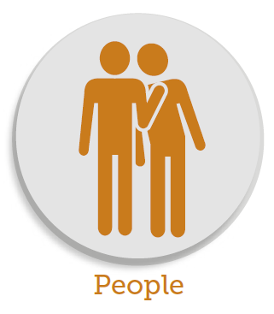
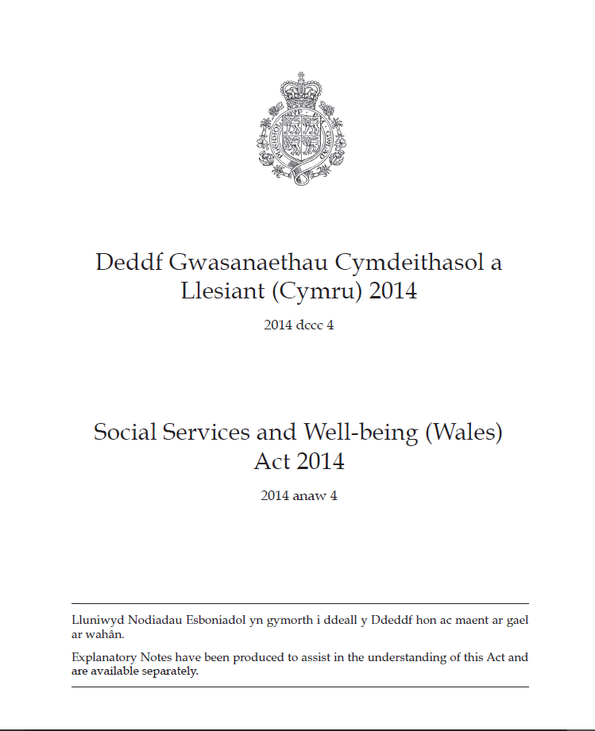


The Social Services and Well-being (Wales) Act 2014
April 2016
Notes:
This slide is animated. The Social Services and Well-being (Wales) Act 2014 came into force in April 2016. It is the new legal framework that brings together and modernises social services law.
The Act supports people who have care and support needs to achieve well-being
People are at the heart of the new system by giving them ‘voice and control’ about their care and support
Partnership and co-production drives service delivery
Services will promote the prevention of escalating need and the right help is available at the right time
The Act is supported by:
Regulations – Secondary legislation where further detail is required
Codes of Practice – Guidance to help people and organisations to work within the law
The Act imposes duties on local authorities, health boards and Welsh Ministers that require them to work to promote the well-being of those who need care and support, or carers who need support. The Social Services and Well-being (Wales) Act 2014 changes social care services in Wales:
Providing easy access to information and advice is available to all
Carers have an equal right to assessment for support to those who they care for
People have control over what support they need, making decisions about their care and support as an equal partner
Less emphasis on prescribed ways of doing things
New proportionate assessment focuses on the individual
Helping people to achieve desired outcomes, rather than assessing suitability for services
Powers to safeguard people are stronger
A preventative approach to meeting care and support needs is practised
Local authorities and health boards come together in new statutory partnerships to drive integration, innovation and service change
Further information and resources on the Act is available at the Care Council for Wales’ Information and Learning Hub www.ccwales.org.uk/getting-in-on-the-act-hub.

Slide 15


Person-centred care
is…
Person-centred
Strengths-based
Skill acquisition
Collaboration
Community integration
Quality of life
Community-based
Empowerment/choices
Least restrictive
Preventive
Abilities
is not…
Practitioner-based
Problem-based
Deficit focus
Professional dominance
Acute treatment
Cure/improvement
Facility based
Dependence
Episodic
Reactive
Goals
Interests
Care is personalised
Care is coordinated
Care is
enabling
Values
Family
Person is treated with … dignity, compassion and respect
Notes:
This slide is animated.
The Social Services and Well-being (Wales) Act 2014 requires the adoption of person-centred care principles.
This includes looking at people’s preferences, their abilities and interest, goals, families, and values in working out their care and support needs.
This means empowering the individual to improve their quality of life through a more preventive and collaborative approach which embraces their own strengths and assets. This, quite rightly, leads to higher expectations and personalised provision including the ability to take risks based on informed consent.
It also encourages the use of technology – especially as devices have become smaller, lighter, more reliable and more aesthetically pleasing.

Slide 16
What are the barriers to new approaches?
Discuss …
Notes:
This is an opportunity to ask participants what they perceive to be the barriers to adopting new approaches?
Changing from the traditional ways of delivering care and support to a new model is not easy for many reasons, including a widely-held belief that it is all about reducing care and support services. There are many pressures on the system, including difficulties in recruiting, training and paying for care staff, and the practical issues involved in trying to meet people’s individual needs. Although people know that technology can make life easier and simpler, they are often unfamiliar or uncomfortable with the terms and the technology itself. They might rely on their children to show them how to do things, especially tasks relating to computers or mobile phones.
Prompts to support discussion:
People don’t like changes to routine - they link change with reduction in care and support services
Concern that it will replace direct care and support services
Lack understanding of unsustainable pressures on the system including increasing cost of care
They may be scared of terminology and of technology itself (especially computers)

Slide 17
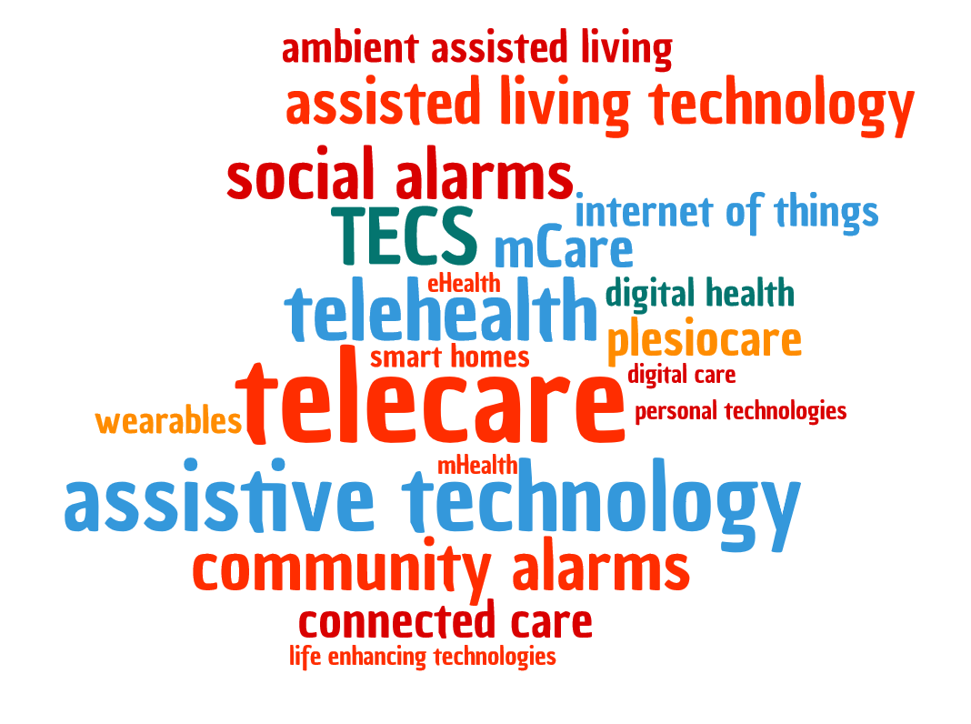
Technology terminology
What’s in a name?
Notes:
To overcome the fear of technology, people need to understand that the terms are only words, and many of them are used wrongly even by the experts!
This cloud of words includes most of the terms used to describe technologies and services used to support people. Hopefully, they will all be mentioned before the end of the course, and they will no longer be frightening.
They are all listed in the Glossary of terms that accompanies this course.

Slide 18
Exercise – the technology we use everyday
Split into teams of three or four, each with sets of small post-it notes.
You have 10 minutes to think of as many items of technology that you might have in your home.
Write each item on a separate post-it note and group them according to the room where they are most likely to be found.
Notes:
This game, which is fully described on the slide, is aimed at making participants appreciate that technology is all around them in their homes. A small prize may be offered to the team which names the largest number of devices. Alternatively, it could be the largest number found in a specific room such as the bedroom or the kitchen. The facilitator can merge the contributions of the individual groups highlighting the ones which only one team thought of. The facilitator can also have their own product ideas which may be unusual and related to care and support. These might be an electronic reclining bed or chair or an electronic potato peeler or tin opener.
Please refer to the Facilitator Guide for more information.

Slide 19
Session 2: Assistive technology and technology enabled care
Notes:
Before the start of the second session, participants could be asked for any questions before moving on.

Slide 20
Assistive technology
Technologies (devices or systems) that help people to get on with their lives by helping them to…
Perform everyday tasks more easily
Make tasks or activities safer
Help carers provide care at times when it is needed
Reduce anxiety for individuals and their carers
Improve independence and enhance quality of life
Give individuals the confidence to get on with their lives
Notes:
In the previous session, the term “technology” was demystified by making it clear that it is already everywhere in the home helping to make life (and its tasks) easier or more enjoyable.
Assistive technologies is the term given to a special group of technologies that can help people to be more independent. Actually, nearly all technologies are assistive – it’s just that some technologies seem to be made only to satisfy the needs of (for example) older or disabled people. One day, perhaps we could drop the word “assistive” and only use “technology” to describe devices and systems that support carers, individuals and everyone else concerned with its use.
Examples include …
Perform tasks more easily e.g. answer the door using an intercom.
Make tasks safer e.g. supporting an individual with dementia to keep going out for their morning walk, knowing that if they become confused or lost, they can use their GPS-enabled device to speak with someone and ask for help to guide them home or to call out a family member to come and get them. Alternatively, it could be that a young person with a learning disability is provided with a video-based door intercom, allowing them to check who is at their front door before allowing access.
Help carers provide care at times when needed e.g. the parent of a child with epilepsy who has night seizures can sleep better knowing an epilepsy bed sensor will raise the alarm. So the parent is better rested to provide better quality care when needed at night and during the day.

Slide 21
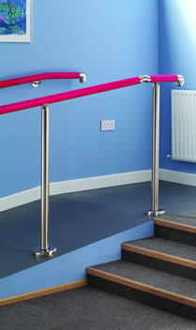
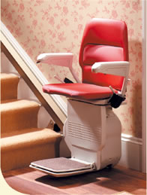
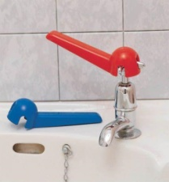
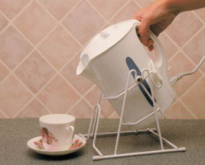

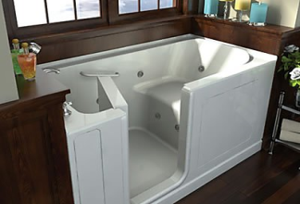
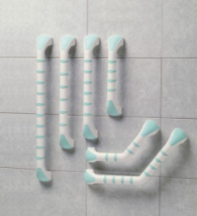
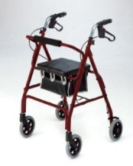
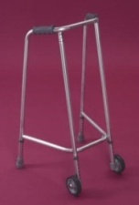
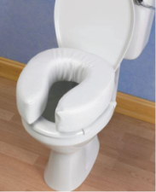
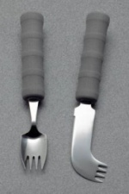
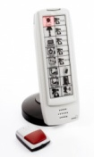
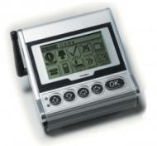
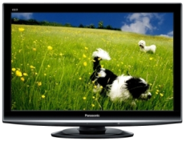
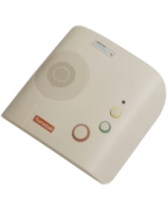


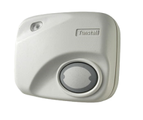
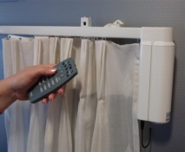
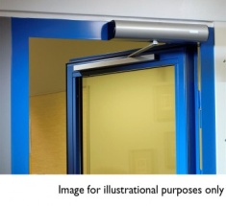

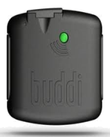
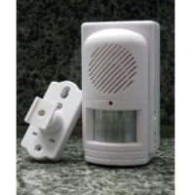
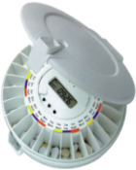
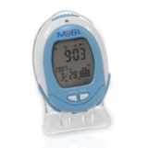
Assistive technology (AT) groups
quick to provide
Fixed AT
Portable AT
mainly mechanical
mainly electronic
Electronic AT
Connected AT
slow to provide
Notes:
This slide is animated.
It is about the four groups of assistive technology that are available:
home adaptations such as a stair lift, grab rails and level access showers (which are fixed in a property)
portable devices that are small enough to be carried around or moved when someone moves house (such as walking aids and tap turners)
electronic systems that can provide replacement or enhanced function (such as environmental controllers, hearing aids and exoskeletons)
and connected technologies that allow support at a distance when necessary.
The four groups can be split with a horizontal line to separate mainly mechanical devices on the top from mainly smart electronic devices on the bottom.
They can also be split with a vertical line - to the left there are those large and expensive systems that can take a long time to design and install, while to the right there are the smaller devices that can be taken off a shelf quickly.
Clearly, if someone is stuck in hospital waiting for a solution to their needs, items on the right can be provided within a few hours enabling someone to go home quickly.
It is the connected technologies that have emerged in recent years as having the potential to transform the way that people are supported. These technologies have benefited from rapid improvements in electronic design, local intelligence and in wireless, digital telecommunication techniques.
We will be focusing mainly on the connected care quadrant – although there is some overlap with the other quadrants.

Slide 22
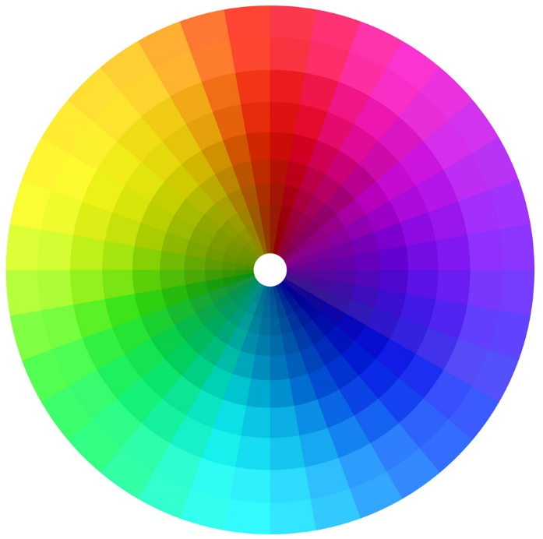
A spectrum of technology enabled care
information and
entertainment
medical monitoring
and alarms
medication
dispensing
tele-coaching
e-services
wearables/
quantified-self
communication
activity and well-being
monitoring and alerts
safety confirmation/
proactive calling
personal and
activity alarms
reminders, prompts,
planning and scheduling
smart home
applications
navigation
home
security
Notes:
This slide is animated and shows a spectrum of technology enabled care applications.
It illustrates some examples of the different applications and systems from the provision of information and means to communicate through to alarm-based systems and more sophisticated monitoring that will lead to prediction and prevention.

Slide 23
Benefits of tech-enabled care
Individuals | Carers | Social care | Housing providers | Health economy
Increased choice in managing risk | Improved peace of mind | Reduced/delay admissions to care homes | Reduced voids in sheltered housing | Reduced hospital admissions and readmissions
Support for self-care and prevention | Reduces anxiety | Improved assessments of needs and risks | Increased demand for shared housing | Improved medication / therapy compliance
Improved quality of life | Improved quality of life | Fewer delayed transfers of care | Fewer incidents of accidental damage | Fewer ambulance call outs and A&E presentations
Increased independence | Increased independence | Reduction of loneliness and social isolation | New roles for wardens and support staff | Improved access to specialists and 2nd opinions
Improved access to services | More opportunities for respite | Reduced demand for homecare | Improved security of properties | Shorter hospital stays and rapid discharge
Notes:
This slide is animated and features a table that is hidden when first shown and which is slowly revealed to show how connected technology services such as telecare can be used to satisfy the needs of different stakeholders.
This is why they are so important in delivering the sort of transformation that will be required if we are to meet the expectations of improved but affordable services in the future.
N.B. ‘Voids’ is the term used for difficult to fill vacancies (often old or small sheltered units, perhaps in unpopular areas).

Slide 24
The process for providing telecare
Referral
Assessment
Technology recommen-dation
Installation
Monitoring
Response
Review
Notes:
This slide is animated.
It shows a service being set-up and delivered around the needs of the individual.
It begins with the referral usually from the individual, their family, or a health, social care or housing professional who recognises that someone has care and support needs or is at risk of losing their independence
An assessment involves looking at the individual holistically in order to identify how their lives might be improved through a support package by addressing their issues.
A technology recommendation (often referred to as a ‘prescription’) can then be recommended to the individual/ family. This involves procuring equipment – usually a combination of devices.
They are then installed and their operation explained to the individual/carers/family if possible.
The devices are connected to a 24-hour monitoring centre which is alerted in the event of any problem and which can initiate a physical response if appropriate.
Provision is reviewed regularly both to confirm that the devices are working appropriately and to identify changing needs.

Slide 25
Assessing for risk
The risk associated with a potential accident/dangerous incident
=
The likelihood of the event occurring
(never, sometimes, often)
x
The degree of harm that occurs as a consequence
(none, minor injury, serious injury, death)
Notes:
This slide is animated.
It provides a definition and understanding of risk and how it is the product of the likelihood of an adverse incident such as an accident and the amount of harm that occurs as a result of the incident.
Both likelihood and degree of harm may be estimated using a three (or a five) point scale.
Using a three point scale, an event that may happen sometimes would be scored 2 while harm judged as a minor injury would also be scored as 2. The risk would be 4 out of a possible 9 and would be regarded as moderate.

Slide 26
Risk reduction or management
We need to either:
Make an incident less likely to happen (e.g. remove some hazards)
and/or
Reduce the level of harm that can occur if it does happen (e.g. detect and respond quickly to an incident, or change the local environment)
Notes:
This slide identifies a need to reduce the likelihood of an incident and/or reduce the level of harm in order to also reduce or manage the risk. Risk management involves assessing the situation and putting in place actions such as hazard reduction or protection.

Slide 27
Reduce risk of being killed in a car accident
Reduce the likelihood of having an accident | e.g. good training, not driving when tired or under the influence of alcohol, reduce distractions, don’t go out at night or in poor weather
Reduce the level of harm possible as a consequence of a crash | e.g. limit speed, wear seat-belts, have air bags fitted, drive a car with added protection such as roll bars, have vehicle tracker and impact alert system
Notes:
This slide may be omitted if the audience understands risk management techniques.
It describes actions such as training and avoiding hazards associated with reduced concentration or environmental conditions in order to reduce the likelihood of having a motor accident.
It also describes methods of protecting the individual from the adverse effects of a crash. These include seat-belts, air bags and anti-roll bars.

Slide 28
Reduce risk of being killed in a house fire
Reduce the likelihood of having an accident | e.g. don’t smoke, don’t use candles, don’t overload electricity circuits, don’t use a chip pan, don’t put paper or cloths on the hob, don’t put food for long in the oven or microwave oven, switch off appliances after use
Reduce the level of harm possible as a consequence of a fire | e.g. sprinkler system, fire bucket, fire extinguisher, smoke or heat detectors linked to call centre
Notes:
This is one of two slides to demonstrate the role of technology in reducing the risk of accidents in the home. It is suggested that only one is used in each presentation.
This slide identifies a number of different hazards that increase the likelihood of a house fire. The audience may be asked to participate by giving examples. In the same way, the audience may be able to name the systems that could be put in place to reduce the level of harm caused by a fire.
It is important to mention that there should be a smoke detector on each floor of a building but not in a kitchen where there should be a heat detector to avoid false alarms caused by toast. These detectors should link through to a 24-hour monitoring centre through a telecare system (which will be described shortly).
Mention not going to extremes by completely eliminating risk of fire, for example, by never using the kitchen.

Slide 29
Reduce risk of breaking hip in a fall
Reduce the likelihood of having an accident | e.g. don’t drink alcohol, keep active, don’t get up quickly from a chair/bed, use ramps and grab-rails, improve lighting, have reminder devices for use of walking aids, slippers and lights, remember medication
Reduce the level of harm possible as a consequence of a fall | e.g. wear hip protectors and gloves, use fall mats, use linked fall detectors and bed occupancy alerts
Notes:
This is second of two slides to demonstrate the role of technology in reducing the risk of accidents in the home. It is suggested that only one is used in each presentation.
It identifies many different hazards that increase the likelihood of a fall and also things that could reduce the impact of a fall, and ways of summoning help quickly.
The latter forms the basis of a telecare system usually employing a 24-hour monitoring centre that can call a family member or the emergency services as appropriate.

Slide 30
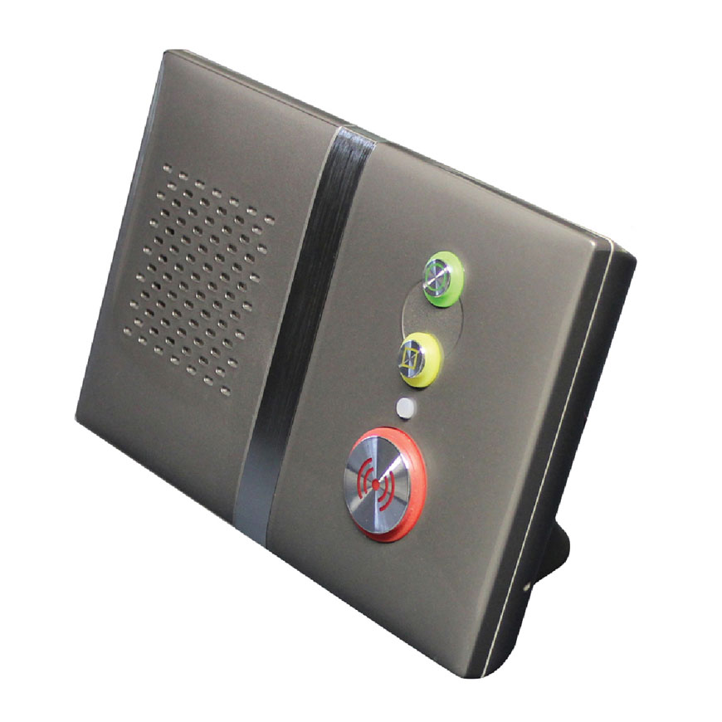
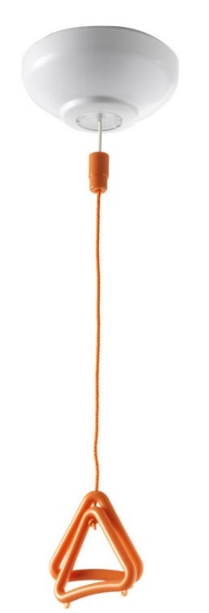
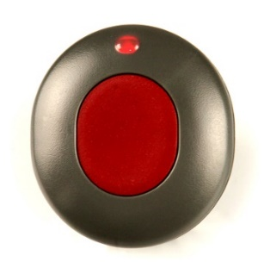

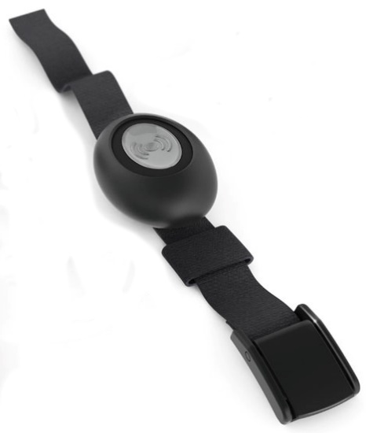

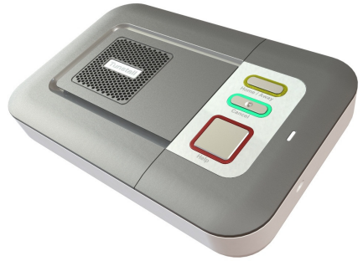
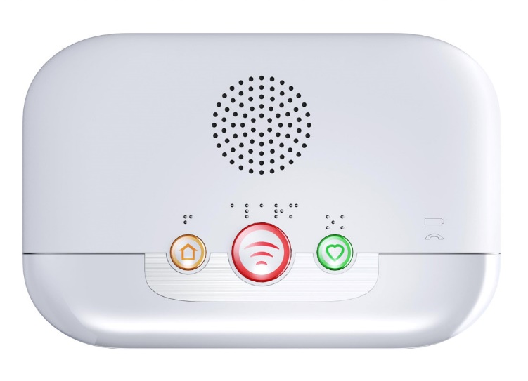
Social alarms (basic telecare)
Sometimes known as a ‘button and a box’ approach
Active devices - press or pull in emergency
Notes:
This slide is animated.
It introduces the community or social alarm as a simple method of raising an alarm.
It shows a pull cord, wrist worn pendant and wall-mounted ‘bogus-caller’ button as an example of ways of manually raising an alarm. It also shows three popular dispersed alarm units from Tunstall (Vi), Chubb (Care Unit) and Tynetec (Reach).
It also shows the limitations of this approach including pendants not being worn all the time, and the user being in denial regarding the extent of the problem and the hope that the problem will disappear on its own after a while.
N.B. ‘too timid’ refers to individuals who were scared of speaking with someone.

Slide 31

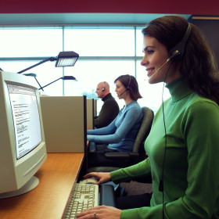


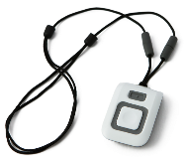
How alarm-based telecare works
Example: Fall detection
2. Alarm call raised
3. Call handler talks to service user to work out what help is needed
4. Call handler follows protocol and arranges appropriate response
1. Sensor automatically raises alarm to dispersed unit
Individual’shome
Telecare Monitoring
Centre (TMC)
Telecare hub / Dispersed Alarm Unit
Help!
Ouch!
service user id, alarm type
and location info
Response
Notes:
31
This slide is animated and demonstrates the components of an alarm telecare system and how it operates using the example of a worn fall detector – this example shows Tunstall equipment.
Eleanor Jones, the service user, comes running in to the house to answer the telephone but falls over (“ouch”) but does not panic because she is wearing a fall detector. This automatically detects the fall, and the fact that she can’t get up, and sends an automatic call through the dispersed alarm unit to the Telecare Monitoring Centre.
The call handler identifies that Eleanor has had a fall and is able to ask her if she is ok. She isn’t ok because she can’t get up and answers “help”. The call handler tells her not to worry and sends out the emergency response team. They help her up quickly, which means that she doesn’t have to go to hospital, and she retains her confidence and is able to continue to live independently in her own home.

Slide 32
Technology – Hands on session
Notes:
This is an opportunity to show some of the more popular telecare and related assistive technology devices to participants. The equipment should be passed around so that participants have a ‘hands-on’ experience.
Products to be shown might include:
Dispersed Alarm Unit
Alarm Trigger
Worn fall detectors
Bed occupancy sensors
Environmental sensors
Inactivity monitors
Medication support
Bogus caller alerts
Property exit monitor
If possible have some sensory/special switch equipment available:
Visual Beacons/Strobes
Pillow Shakers
Special Switches
It is worth commenting on features of some Dispersed Alarm Units that allow a person to signal a beep to the Monitoring Centre by pressing their pendant – this allows them to acknowledge the call handler if they have speech or communication issues.
There are also some products which support the Welsh Language e.g. Dispersed Alarm Units, the Forget-me-not electronic calendar and devices that allow you to upload images or record voice messages or use pre-recorded audio files to play messages/reminders.

Slide 33


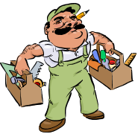





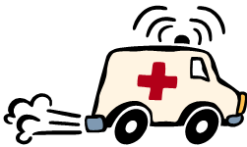


Emergency response team
Telecare
Monitoring
Centre
Other local
support services
Out of hours social care
?
Emergency
handyperson
Relatives,
friends,
and carers
24 hour home
care and
reablement
Individual protocols and escalation procedures for…
each individual,
for every time of day and
for every alarm type
Rapid
Response
Team
Emergency Services
Lifting
Service
Out-of-hours
GP
Notes:
This slide is animated.
It builds a ring of care to surround the individual with a safety-net of support in the event of an accident.
Central to this model is the need for individual protocols so that the service is tailored to them i.e. person-centred care. It emphasises the role of family carers and the emergency services, who in the future may be supported by other community teams with specialist equipment.
It is important to acknowledge that there are different services across Wales and the emergency response teams which provide the safety and support network will vary in different areas and local authorities. For example, not all areas will have a dedicated lifting service (for people who have fallen but who do not need an ambulance).

Slide 34
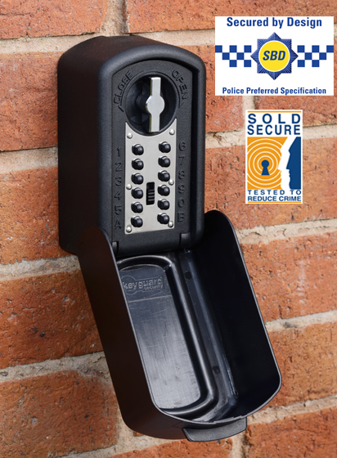
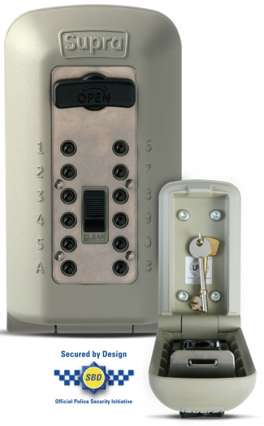
Property access in an emergency
Family members should have a key and be prepared to attend if they live locally
Neighbours or friends might also have a key – and their needs to be noted during assessment
Householders should be discouraged from bolting their doors and using door chains
Otherwise, the alternative to breaking down the door is the use of a secure box (usually called a key-safe) on the wall of the property
Access is possible only using a digital code which is known only to the monitoring centre
The most popular models are as secure as the door itself
Notes:
This slide is animated.
It asks the question, “how do the emergency services get into the property when the householder is injured or ill?”
It leads to the conclusion that a secure key-safe may be required which can be accessed using a digital code that is held by the monitoring centre. Best practice is to use only police-approved designs (also known as the ‘secured by design’ initiative).

Slide 35


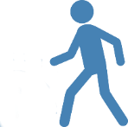

Models of technology enabled care
Person is housebound and lives alone; has no close family
Person lives with family carer who is with them at all times
Person lives with family carer who may be absent occasionally
Person is generally well. Does not want to involve external organisations.
Vulnerable person is not housebound but may be at risk
1
2
3
4
5
1 - 24/7 Call handling centre to notify family members if there is a problem
4 - Could use activity monitoring with alerts to carer’s phone in the event of a problem.
5 - Could use mobile care (mCare) with suitable apps; call handling centre optional
3 - Carer may be alerted through their mobile phone; call handling centre is optional backup
2 - Plesiocare – can use local alarm pager
Notes:
This slide is animated and shows five models of technology enabled care to show the different ways it can help…
Case 1 - Typically, the individual may be housebound and lives alone for all or most of the time. They may or may not have close family living locally who can attend in the event of a problem. They need a 24/7 monitoring service to alert remote family members or care/emergency services as required.
Case 2 – In this example, the individual either lives with a family carer or has personal assistants who are with them at all times. There is no need for a monitoring service, as there is always a responder present. This is called plesiocare.
Case 3 – This example shows someone who has close family support, perhaps they live with a family carer who may be away from home sometimes – perhaps at work. Any problems could be routed directly to the carer’s mobile phone in the first instance and only go to a monitoring service if the carer is unable to respond to the call.
Case 4 – This person is generally well, but would like a basic level of reassurance just in case; however, they are reluctant to involve external organisations. In this example, family members could use an activity monitoring service to monitor that everything is OK – and set up alerts that they would receive on their mobile phone or computer if there was a problem (e.g. if Mam hadn’t been to the kitchen to have a drink before 10am like she usually does).
Case 5 – This person is mobile and is able to go out alone for work, shopping or leisure. Perhaps it is a young adult with a learning disability who has recently got a new job. Ideally, they need an ‘always-available’ approach that supports them when they are at home and when out and about. Special apps for their smartphone could help them plan their day, find their way about and provide them with access to assistance if required.
Additional Background Information:
It is often apparent from the issues that individuals face that many of them relate directly to their risk of an accident or illness or are risks associated with lifestyle choices or their coping strategies. In each case, the risks needs to be managed either by reducing the likelihood of an adverse incident occurring or by reducing the impact of such an event. An effective means of supporting an improved outcome is through early detection and identification of an incident leading to an appropriate response.
This could mean a conventional telecare system based on fixed-line telephony linking a dispersed alarm unit in the home with a 24 hour monitoring centre. This corresponds to situation 1 and is ideally suited to someone who lives alone and rarely goes out unless accompanied. It is effectively the social alarm system which has provided support and reassurance for many mostly older people and their families for over 30 years.
Social alarm systems have evolved into telecare services by the addition of smart sensors and the adoption of personalised response protocols. They continue to provide important support to individuals and peace of mind to relatives. However, their essentially analogue nature means that they are not ideally suited to embracing advances in mobile and information technology. Furthermore, their requirement for a link to a 24-hour monitoring centre may be seen as an unnecessary intrusion by some. In particular, when a person lives with their family carer, who will inevitably respond to any emergencies detected by a sensor in the home, the role of a monitoring centre changes. This is the 2nd situation described and represents an application for “plesiocare” rather than telecare because the support is provided close by rather than at a distance. The sensors that may be relevant are similar to those used in situation 1, but need no longer connect to a dispersed alarm system but to a local alert notification system, such as a pager. This approach often results in a lower cost option, both in terms of the upfront cost of the equipment and on-going monitoring costs; however, their limitation is a lack of historical information on the nature and frequency of the alarms generated, which may offer an important insight in terms of preventing further problems.
In the same way, when the family carer goes out to work or to go shopping, leaving their older parent at home, to go to work or go shopping, they can be notified directly by programming the dispersed alarm unit to ring them or send them a message rather than using a monitoring centre. This is the 3rd situation shown and would generally use the same type of equipment in the home as in the 1st situation described above.
When the family lives some distance away from their loved one, they may choose to perform passive monitoring directly using internet-enabled services. These generally monitor movement and activity and employ exception rules that are set up specifically for that person. For example, a failure to enter the bathroom or kitchen during certain hours each day may indicate an alert, as might no use being made of the kettle, the microwave oven or the refrigerator. This type of need is described by the 4th situation and may be enhanced through the use of video interactions.
Finally, the vast majority of older people, whether they live alone or with friends or relatives, will spend time outside the home. It is recognised that the outdoors, exercise and opportunities for meeting with people will support well-being through relief of social isolation, as well as improvements in both physical and mental health. The concern that they may suffer an accident or illness may be managed by the use of a new range of mobile care devices that may be carried with them at all times, as well as linked sensors that may be worn and specialist apps that provide interaction and support. These mobile care (or mCare) applications can detect a range of problem situations including falls, periods of inactivity, convulsive seizures and becoming lost.
This 5th care situation shown is likely to become increasingly important as the population embrace the benefits of smartphones and mobile technology. This model of care could rapidly become dominant and provide attractive alternatives for all the scenarios in the slide, especially as access to the internet becomes ubiquitous and as telecare monitoring centres begin to support these services. In the meantime, it will be essential for assessors to consider which support scenario is most suitable for the potential service user.
It should be noted that all 5 scenarios relate to people living alone or with their carer. It may be apparent that many older people live as co-caring couples. Both may need monitoring so alarm systems may be relevant. However, current telecare systems don’t allow the activities of 2 or more people living together to be differentiated from each other, and this is a limitation. The exception is personal devices such as worn alarms. Indeed, one of the biggest advantages of wearable devices is that they provide information at an individual level. It must be assumed that future systems, and especially those that employ mCare, will allow for more person-centred approaches.

Slide 36
Time for a break …

Slide 37
Session 3: Example applications and case studies

Slide 38




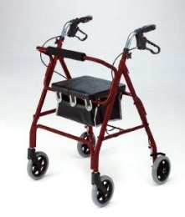

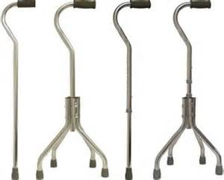
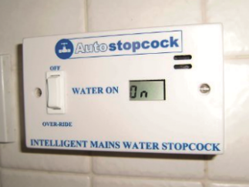









Mixed technologies approach
Local authority/Housing/
Care and Repair Wales
No-tech
Minor home adaptations
Low-tech
Community equipment store
or
Retail website
Aids to daily living
Smart assisted living systems
High-tech
Connected care and support
Integrated telecare service
Notes:
This slide is animated.
It introduces the idea of using a technology toolbox that includes lots of different types of technology, including the four groups described earlier in this course.
It also suggests that an effective approach might be to start with no technology (change the way that things are done) then low technology (simple equipment) and then high technology (more sophisticated devices).
Finally, it suggests that the whole approach can be supported by Care and Repair, the Joint Community Equipment Service and an Integrated Telecare Services working together.

Slide 39


Technologies to find people and things
Start with low-tech (and low price)
Notes:
39
Let’s look at an example of technologies to find people (and things).
It begins by showing a low cost system that allows a parent to keep track of a child or object such as a suitcase. The loc8tor uses radio-based ranging and can locate several tagged items using directional radio. It is ideally suited to finding house-keys, spectacles or a purse in the house, but can also be used to find someone if they are carrying a tag (in a supermarket for example).
The tag is shown – to scale – next to an image of a postage stamp, to illustrate its size.

Slide 40













GPS devices to find people
Then higher-tech (and higher price)
Latest GPS devices also provide:
Fall detection alerts
Geofence breach alerts
High speed travel alerts
Lack of movement alerts
They can be used by:
Children, lone workers, people at risk of getting lost and care staff
People who carry a phone
People who wear a watch
People who carry a key ring or bag (or in pocket)
Notes:
This slide is animated.
It shows three different types of GPS locator. The first group are based on mobile phone handsets, one of which uses satellites and is useful when there is no mobile phone coverage. The second group includes wearable devices that are worn on the wrist. The final group can be carried in a handbag or pocket or attached to a keyring.
Two examples of modern GPS multi-purpose devices are then shown – the Ownfone Footprint and the buddi. These are genuine mCare devices which can not only locate people but also detect immobility and falls.

Slide 41





GPS in practice
Track where people have been…
GPS tracker issues alert when outside geo-fence
Family or responders know where to look
Create safe and unsafe ‘zones’ known as ‘geofences’
Notes:
This slide is animated.
GPS monitoring allows the location of an individual wearing a special device to be obtained (and monitored) when required. For example, this image shows a map of someone travelling on the train from Bangor in North Wales to Cardiff (and back again).
GPS monitoring is useful for making sure that people who may become lost when out and about can be found if they need help. The call for assistance could be made by the individual themselves, e.g. by pressing a button to contact a monitoring centre or family member. This would then provide their co-ordinates so that assistance can be provided.
Alternatively, a family member or monitoring centre could request the current location of the individual if there was serious cause for concern (e.g. if they had not returned home by a certain expected time).
Another reason for raising an alarm may be if the person leaves an area that is considered to be safe (e.g. their local village) or, conversely, enters an area that is considered to be unsafe e.g. by a busy road or a deep lake. For these situations, it is useful to be able to define one or more ‘geofences’ to mark out these ‘safe’ and ‘unsafe’ zones.
In this example, the background shows a Google maps image [the example given is from Cardiff but could be replaced by a similar map from any town, city or area in Wales]. A star is introduced to indicate the individual’s home location, and this is surrounded by an area of safety, the circumferences of this can be defined as a geofence. If the individual moves outside this zone, then this can be detected through location tracking.

Slide 42
People who can be supported
Smart assistive technology can help anyone and everyone if chosen correctly by them and for them
People with physical disabilities
People with limited mobility
People with developmental/learning disability
People with epilepsy
People with limiting long term conditions
People with sensory needs
People with communication difficulties
People who have a mental health problems
People with a drug or alcohol dependency
People experiencing domestic violence
People who have had a stroke
People with short term memory issues
Carers
Notes:
This slide is animated.
It shows a long list of groups that could be supported by technology, but then dismisses them to conclude that anyone can be supported by the correct choice.

Slide 43

Application scenarios and services
Family homes
Enablement and rehab services
Hospital admission/readmission
Intermediate care services
Mental health and substance abuse
Sheltered and supported housing
Prisons and custody suites
Hotels and hostels
Domestic abuse and refuges
Residential care homes
End of life or palliative care services
Notes:
This slide is animated.
It provides a list of living environments and specialist services where technology can make a difference. This is to emphasise that there are many niches to consider. People shouldn’t make the mistake of thinking that technology support only works for older people and for those who have physical or sensory disabilities.

Slide 44

Issues of ethics and choice… discuss!
Notes:
After talking about GPS and location tracking and monitoring. Perhaps now is a good time to discuss issues related to ethics with participants. GPS tracking devices have been described as tags – the same technology is being deployed to monitor the movements of criminals released from jail under licence. How does that make people feel? Do the benefits out-weigh their concerns?
It is important that the abilities and benefits of technology are not over-sold to people. It is important that they are not over-confident and undertake risky behaviour because they have a new piece of equipment or service. The limitations of any technological solution should be clearly explained.
A range of ethical issues must be considered and explored as part of discussions and assessment including:
Providing good quality, clear information about all options including not introducing assistive technology or telecare
Consider benefits and any disadvantages or possible harm
Informed consent? Is the individual fully involved in the decision?
Concerns about monitoring – does this respect privacy and autonomy? Data security - where does it go? who has access?
Issues to do with intrusion and the use of prompts or notifications to try and ‘nudge’ user into better behaviour that will have a positive outcome on their wellbeing. Will users get fed up of constant ‘nagging’ by technology? Will they try and cheat the system into thinking that they are doing what they should be (e.g. paying the next door neighbour’s son to wear an activity monitoring device when they are taking the dog for a walk!)
Consider who benefits the most from the technology enabled care package? Is it the person or their carer? What are the issues to take into account here?
What about the design/look/feel of the products? Do they blend in or are they clearly a ‘badge of dependence’?

Slide 45
Some examples to consider
Doris who is lonely and doesn’t take her blood pressure medication properly
Mair, a housewife who suffers regular epileptic seizures in her home
Elizabeth, a frail lady of 93 who lives alone and who has returned home from hospital
Henry, a widower who lives alone and who is profoundly deaf
Joanna, a pregnant 24 year old with Type 1 diabetes who has an alcohol abuse problem
Notes:
Five different vignettes are available as case studies. All five may be useful in demonstrating the potential of technology in supporting specific individuals, but facilitators may wish to select a reduced number, perhaps three, if time is limited or there is unlikely to be local provision to support one or more of the vignette characters.

Slide 46
Improving the life of Doris
Doris is 82 years old and was married to Bill for 59 years
Bill died last year after a long illness
She now lives alone in a terraced house some 200 miles from her three children and six grandchildren
She only goes out to church on Sundays and to the local shops on a Tuesday (to collect her pension) and on a Friday
Her only visitors are the British Red Cross who deliver her frozen meals twice a week, and the milkman who collects her money once a week
She suffers from high blood pressure but it used to be under control. She hasn’t ordered a repeat prescription for two months.
Notes:
The facilitator may wish to read out the storyline or allow the participants to read it for themselves.

Slide 47
Social isolation and loneliness – Impact
Survey of older people. Due to feeling lonely …
Almost 1 in 5
Almost HALF
1 in 4
Almost 1 in 10
1 in 5
had lost touch with friends and relatives
don’t go out as much
gave up on their hobbies
don’t eat properly
don’t leave the house for days
Notes:
This slide is animated. Each point emphasises the impact that loneliness can have on people’s lives. It is estimated that loneliness has the same impact on health as smoking 15 cigarettes a day.
Due to feeling lonely …
17 per cent of older people said that they had lost touch with friends and relatives;
46 per cent said that they don’t go out as much;
26 per cent give up on their hobbies;
21 per cent don’t leave the house for days;
9 per cent said that they no longer eat properly;
13 per cent of older people said they worry about their mental health because they have no-one to talk to;
The physical health of most also suffers.

Slide 48

Technologies for communicating
Reaching vulnerable people can be difficult if they are not comfortable with modern technology
The television may be their only companion
Younger people are more comfortable with these technologies and modes of communication
Products such as Speakset or V-Connect Companion allow people to have video conversations using their own TV.
Notes:
This slide is animated.
Reaching vulnerable people is difficult if they are not comfortable with computers, mobile phones and social media.
It may be used to ask the audience of ideas on how to relieve loneliness. They are likely to suggest going out more, volunteering and owning a pet – all of which may be difficult if the person has no car and has a physical disability or limitation.
The use of the internet for engagement is not simple for many older people even if they desperately want to be able to contact and speak more with their relatives who could live on a different continent. Television may be the only technology that they are happy with, and it may already play a big role in keeping them company. It is therefore the ideal vehicle to give them a means of connecting with remote relative and friends. There are several set-top boxes that allow them to use their existing TV as their teleconference monitor. Tablet-based devices are also available.
These products can also provide additional services such as reminders to take medication, a means to view family photographs or simplified access to digital radio.

Slide 49
Managing the risks for David and Mair Jones
Mair has a diagnosis of tonic clonic epilepsy and has several seizures a week, some during the day, and some at night; she lives with her husband, David, who works long hours in a factory 10 miles away from their home in the Rhondda.
Mair is very independent and spends the days on her own at home often cooking and tending to their pets and garden. Rescue medication is not required when a seizure occurs but her epilepsy has previously resulted in admissions to hospital.
David is considering giving up work to ensure that his wife comes to no harm if she has a seizure.

Slide 50
Identified issues
Risks relating to daytime seizures
Mair has not been alerting anyone to her seizures and carries on with daily activities when she comes round from an episode. It is only when her husband returns from work that help is provided. There is a risk of personal harm when the seizures occur.
Risks following night-time seizure
David is sleeping poorly because he needs to wake up if his wife has a seizure. He is tired during the day and may have an accident at work. He will sleep well only if he’s confident that he’ll wake up when his wife is unwell.
Risk of fire
Mair enjoys cooking breakfast, dinner and supper. If a seizure occurs whilst carrying out these tasks then there is a risk of fire in the home.
Notes:
Ask the audience if they can think of any other issues.
Possible solutions - consider the following:
It’s not necessary to provide an m-Care solution (though these exist) because she doesn’t go out alone.
A telecare fall detector may be fine – a wrist-worn device may work well for her because it is less likely to get in the way when she’s cooking.
At night, a sensor that detects her convulsions in bed, and alerts her husband directly might be best.
Heat and smoke detectors linked to a call centre through a dispersed alarm may help manage the cooking risk.
If Mair wanted to go out alone and wanted her seizures to be monitored then she would have needed a device that linked into a mobile network to raise the alarm. Smart epilepsy watches can respond in this way and can also give the location. Their limitation is the battery life of both the sensor and the smartphone which couples with the sensor.
In this case, a telecare system with full coverage of the house and garden is ideal. The battery will last several months before it needs to be replaced.
There are several devices that detect convulsions during the night. Some use a thin polymer sensor sheet while others can be placed under the mattress of the pillow.

Slide 51
Protecting Elizabeth
Elizabeth is 93 years old. She is returning home to her terraced house in Bangor following a week in Ysbyty Gwynedd with a chest infection. She has declining eyesight and has become very frail putting her at risk of falls, and of taking the wrong medication for angina and type 2 diabetes.
The local enablement team will be providing her with day-time support, but there is a concern that she may have a fall during the night, and suffer a long lie which will put her independence at risk.
She has many friends in the local community and does not wish to consider residential care.
Notes:
The storyline for Elizabeth makes it clear that her frailty, poor eyesight and diabetes result in a number of risks and other issues that need to be addressed so that she can continue to live independently in the community.
The biggest risk is falling at night and being unable to get herself off the floor. The risk factor for falls include poor eyesight, poor lighting and poor medication adherence, all of which are in play for Elizabeth.

Slide 52





Managing Elizabeth’s risks
There’s a need to reduce the likelihood of a fall by offering her a range of standalone devices including movement activated lights, walking aids and medication reminders.
Her confidence can be boosted by ensuring that a fall is detected quickly enabling an emergency response to occur.
A linked bed occupancy monitor can generate an alarm if she leaves her bed at night but fails to return within an appropriate time.
Notes:
This slide is animated.
The first challenge is remove as many as the hazards as possible so that the risk of falling is reduced. These may include environmental factors such as clutter, trailing leads and too much furniture. It is also necessary to remind Elizabeth to change her habits regarding walking aids, and the importance of avoiding rushing to the door or to the phone. Cordless phones are ideal, and an intercom would enable her to confirm the need to answer the door.
Bed occupancy sensors are better than alarm pendants for raising an alarm at night but the type of sensor used needs to be sensitive to the type of bed and any fiddling or interfering that the individual might perform.

Slide 53
Keeping Henry safe
Henry is 88 years old and lost his wife of 60 years a few months ago. He now lives alone in Aberaeron.
He has two sons – one lives in Cardiff while the other lives abroad. One is concerned that his poor hearing is causing him to become socially isolated because he struggles to use the telephone and hear the TV.
The other worries that his security is at risk because he leaves the door open in case he doesn’t hear the door-bell, and that he will be slow to respond to environmental problems because he won’t hear the smoke alarm or the sounds of dripping water if he has left the taps on.

Slide 54





Some technologies for Henry
There are many telephones with features to help people experiencing hearing loss – these are versions for cordless/ mobile phones
Amplifiers for the TV mean that people experiencing hearing loss can keep in touch with news, weather, sport and other programmes
There are alarms and bells that work with pillow shakers and with flashing lights for alerting

Slide 55
Joanna and her diabetes
Joanna is 24 and has had Type 1 diabetes since she was a child. She needs to inject with insulin at least twice a day to keep her blood sugar levels at the right level, and to avoid dangerous hypo- or hyperglycaemic incidents.
She is fiercely independent, and something of a rebel. She chose to move out of her family home last year and now lives with a group of her former student friends in a flat in Swansea that has no telephone landline.
She has become pregnant and understands the risks to her unborn child if she doesn’t moderate her behaviour and take more control over her life-style. Like all her friends, she always keeps her smartphone with her at all times.

Slide 56




Helping Joanna to help herself
Joanna needs to regularly check her blood glucose levels as well as taking her medication on time, keeping her clinic appointments and controlling her calorie intake. She needs to be made aware of sudden drops in her levels so that she can respond rapidly.
There are wrist worn reminders or symptom alerts but Joanna could use her smartphone and an app to manage her condition more easily.
Notes:
The main issues for Joanna are controlling her blood sugar through insulin and diet, and detecting hypoglycaemic incidents before she loses consciousness.
The technologies to indicate low blood glucose levels detect a racing pulse and high levels of perspiration.
Although there are reminder watches for diabetics on the market, it may be possible to provide all the required functionality through a smartphone and apps.
The mySugr Diabetes logbook app (for iPhone and Android) can both provide reminders and a means of keeping track of calorie intake, and blood glucose levels. https://mysugr.com/logbook/

Slide 57
Services in your area
This slide should be replaced with details of telecare and community equipment services that are available at a local level.
This would include the referral routes, any limitations on service provision (e.g. whether out-of-hours installations are possible, and the availability of emergency response service).
Eligibility for free services should be noted (if appropriate) and the approximate weekly cost for those who are self-funding.
Notes:
If there are no details of local services to be presented, this slide can be omitted.

Slide 58
Session 4: Keeping up to date and future trends
Notes:
Before the final session begins, it may be worth reminding the audience that they have been shown a number of examples of how technology can support independence for different people facing a variety of issues. The solutions are not usually a single product but are a group of different products that may or may not interoperate. There is no single correct solution for any of these vignettes – but some solutions will be less expensive than others while others may be more suited to people who are happy to use mobile phones and more advanced technologies.

Slide 59
Technology support in Wales
Everyone is eligible for a local authority assessment of unmet needs and risks (but not all will be offered a service)
People, sometimes with help, will be able to identify and subscribe to services or buy items of technology either from local shops or online
They can also take advantage of free on-line resources that can help them find technology that is suitable for their needs
Some websites offer advice and a retail shop which stocks a limited range of products. Others are independent and help people find the most appropriate products and services and where they can be bought
Notes:
This slide is animated.
It refers to the situation in Wales following the implementation of the new Social Services and Well-being (Wales) Act 2014.
Everyone, including carers, is eligible for a local authority assessment of unmet needs and risks – but not all will be offered any type of social service
Many, with the help of their families and other advocates, will be able to identify and buy into local services or buy technology items either from shops such as pharmacies or from mail-order or online retail warehouses
They can also take advantage of free on-line resources that can help them find technology devices or systems that are suitable for their needs
Some offer both advice and a retail shop which stocks a limited range of products. Others are independent but can help people find the most appropriate products and where they can be bought.

Slide 60
Keeping informed and up to date
TelecareAware (www.telecareaware.com) – General news and information about the telecare, telehealth and related industry.
TSA (www.tsa-voice.org.uk) – the industry body for Technology Enabled Care.
Disabled Living Foundation (www.dlf.org.uk) – a national charity providing impartial advice and information.
Vivo (www.vivoguide.co.uk) – an independent and impartial source of information on technology enabled care and assisted living technologies, including detailed product guidance and reviews.
Notes:
Here are some example online resources for finding out more about assisted living technologies, telecare, and related technologies.
These details will be provided in the participant handouts.

Slide 61









A brief overview of Vivo
Wandering
Notes:
This slide is animated.
Here is an example resource. It shows the home page of the Vivo guide and its purpose.
Vivo helps people to find products by linking conditions to possible issues and then finding products that address these issues. It results in a wider range of product options that individuals can then apply different filters to (such as price, manufacturer, etc.)
Vivo is designed to be at the right level for members of the public to use with ease.
Vivo Pro will provide additional information that will be of relevance to health, social care and housing professionals and will help them to compare and recommend products.

Slide 62



Team exercise
Notes:
This is an exercise for the audience to perform in teams.
Specific instructions are provided in the Facilitator Guide along with details of how to prepare the cards needed to play the game. The exercise can be made to last anything from 10 minutes to 30 minutes.

Slide 63
The march of progress…
Person-based
(always available)
The
future
Smart clothing, implants, exoskeletons, robots, always available connected health …
Prevention
mCare, mHealth, wearables
Prediction
2016
Apps, IoT,
Big data
Management
2014
Telecare smart sensors
Monitoring
Community alarms
2006
2001
1980s
Detection
Home-based
(limited availability)
Telehealth, activity monitoring
Notes:
This slide is animated.
This diagram is intended to show the evolution of connected technologies for health and social care support.
It shows an origin in community alarm systems over 30 years ago, working through telecare alarms, telehealth and activity monitoring over the next 25 years, thanks to the rapid development in communication speeds, the Internet and mobile networks.
These enable applications to advance from detection to monitoring which then allows conditions to be managed, then predicted and, ultimately, prevented through appropriate interventions.
The other trend is a move from fixed (limited) availability linked to the home to always available connected healthcare based on wearables and always-on connectivity with the Internet and cloud-based services using technologies like the Internet of Things and improved mobile Internet connectivity and Wi-Fi.
It covers the period beyond the present and suggests the new and emerging technologies that are likely to be relevant in social care.

Slide 64

Smartphones – all will have one!
Features
Powerful processors
Large touch-screen colour display
Large memory and storage capacity
Telephone and text-messaging
Versatile apps
In-App notifications and messaging
Familiar interface options
Lightweight and always available
Battery life improving
Contactless and touch ID
Sensors, actuators and connectivity
Microphone
High quality audio
Accelerometers
GPS and GSM location
Magnetometer
Temperature
Camera(s)
Vibration unit
Bluetooth and Wi-Fi for connectivity
NFC and proximity sensor
Ideal platform for mCare and mHealth applications
Notes:
This slide is animated.
It allows the features of a smart phone to be described with some explanation.
It should be pointed out that the microphone and speaker is so good that it can be used hands-free for a group call. The camera supports video conferencing, the recording of film clips and an ability to recognise faces, read bar codes and identify food items.
The accelerometer can detect falls and seizures.
The Bluetooth radio allows the smartphone to be connected to a range of peripherals including those that measure vital signs that are relevant to chronic disease management. An app on the phone can be used to interact with these devices and the data that they generate.

Slide 65













Health and well-being apps
Notes:
This slide is animated.
It shows examples of apps – diabetes tracking, anxiety measurement, mood, smoking cessation, hearing aid/test and a community-powered assistance app for people who are blind/have a visual impairment.
Find out more at the following websites:
http://www.diabetespa.com/
http://sam-app.org.uk/
http://www.nhs.uk/Tools/Pages/iphonesmoking.aspx
http://petralex.pro/
http://www.bemyeyes.org/

Slide 66






Why is chronic disease increasing?
< 2.5 million years >
< 100,000 years >
< 50 years >
Notes:
This slide is animated.
It describes how man has evolved over time from an ape that walked on all fours to a creature that can run and then to make tools for hunting and for making tasks easier.
All this has been spoilt in the last half century by changes in lifestyle including TV and super-sized snacks and meals.

Slide 67






Current telehealth equipment
Notes:
People can take more control of their conditions by monitoring their health by measuring their vital signs and answering subjective questions about how they feel.
A number of different systems have been introduced over the past decade, and which allow these measurements to be recorded and either viewed remotely by physicians and nurses or to automatically detect when readings indicate a potential issue allowing call handlers to discuss practical issues with them.
However, these systems are relatively expensive and are used typically only once or twice a day.

Slide 68








Future collection of health data
Notes:
This slide is animated.
In the future, the technology will be far easier to use and, thanks to mobile phone and internet technology, will be able to take measurements at any time, whether the individual is at home or out and about.
The slide shows eight different ways that this is already possible:
Apple watch
Fitbit Surge
This is a sheet from South Korea that records vital signs while the person is in bed
A smart vest with built in sensors and electrodes
An electronic sticking plaster
A sensor chip built into medication.
A “magic mirror” that uses camera technology to look at how the flow of blood through the body changes its colour, enabling the pulse rate to be calculated.
Finally, there is the Scanadu Scout, a device which can be pressed against the forehead at any time to measure a range of vital signs.
Wearable devices are becoming important for overcoming the problem of placing sensors close to the part of the body most relevant to measuring a physiological parameter.

Slide 69


Virtual reality immersion
Virtual reality headsets will offer people an entertainment or reminiscence experience that can overcome the limitations of their mobility and finance.
Notes:
High quality virtual reality headsets with significant processing power will become available in 2016. They present two images that give a 3D effect and, through sensors, can allow panoramic views to be generated. Initial applications will be in games but this will quickly give way to therapies and for the training of staff in performing complex tasks.

Slide 70











Smart and connected items in the home
Notes:
This slide includes many connected electrical appliances and monitoring systems which can share data with other devices inside and outside the home.
Top Row
1 – Sleep number smart bed
2 – Keyton sensor chair
3 – MIT smart mirror
4 – Smart bathtub
Middle Row
1 – Dacor Discovery iQ smart cooker
2 – Samsung smart microwave oven
3 – Sage ‘smart’ kettle
4 – Electrolux cyber fridge
Bottom Row
1 – Philips smart TV
2 – SWD intelligence auto-wash toilet
3 – iHouse smart faucet/tap

Slide 71





The ‘Internet of Things’
Everyone and Everything
Retail
The Internet of Things (IoT) is the network of physical objects – devices, vehicles, buildings and other items embedded with electronics, software, sensors, and network connectivity – that enables these objects to collect and exchange data.
Health
Government
Transport
Community
There are about 5 billion connected devices at the moment. This number is predicted to exceed 50 billion devices by 2020.
Entertainment
Industrial
Notes:
This slide is animated.
The Internet of Things (IoT) is the network of physical objects — devices, vehicles, buildings and other items embedded with electronics, software, sensors, and network connectivity — that enables these objects to collect and exchange data.
It fills a home with connected devices including washing machines that measure performance data that can be shared with other machines and computers anywhere in the world. If a device is likely to break down next week, it will result in a warning message being generated so that maintenance can be applied before the fault appears.
It also allows (or will allow) always-on connectivity throughout neighbourhoods – thus extending the scope of telecare applications to be always available when out and about – thus supporting and encouraging people to get out and about more.
It will also offer a low-cost and common platform for multiple applications including mHealth and mCare and will threaten the dominance of existing closed proprietary protocols for telecare platforms in the home (i.e. the way in which devices from a particular manufacturer ‘talk’ and ‘understand’ each other – IoT will hopefully force them to use open protocols so products from different manufacturers can work together). This will eventually lead to true plug and play capabilities between peripherals from multiple manufacturers and different telecare home hubs/dispersed alarm units – allowing a true mix and match approach where the best possible equipment can be selected irrespective of the manufacturer of the home hub used.

Slide 72











Exoskeletons… to robots!
Vs
Low-tech, fixed with limited availability
Hi-tech, mobile and always available
Notes:
This slide is animated.
Exoskeletons allow people to walk freely wherever they are. They can also increase the strength of the individual so that they can carry items or perform tasks such as gardening that they may not be able to accomplish without help.
The eventual shift from stair-lifts to exoskeletons is an excellent metaphor for the direction of travel for health and care technology. i.e. from a low-tech, fixed, limited availability approach to high-tech, mobile and always available.
The future will undoubtedly involve robots to provide a wide range of assistance including physical, personal and, ultimately, emotional support.
How does this make people feel?

Slide 73
Learning review and evaluation
Any questions?
Notes:
This is an opportunity to remind audience that technologies have come a long way in supporting people to perform tasks that they had previously struggled with. They are not difficult to understand.
Remind the audience to complete and hand in their evaluation forms.

